Slide 1
James - Which James?
Reading: James 1:1-11

Slide 2
Which James?
James, the son of Zebedee, brother of John, one of the 12 (Matthew 4:21)
James the less, the son of Alphaeus, one of the 12 (Mark 15:40)
James, the Lord’s half brother (Matthew 13:55)

Slide 3
Acts 15 - James
15:23 ... greeting unto the brethren which are of the Gentiles...
15:13 ...brethren, hearken unto me...
James listens to others and then is last to speak
1:1 ... to the twelve tribes which are scattered abroad, greeting My brethren...
2:5 ... hearken my beloved brethren...
1:19 ... let every man be swift to hear, slow to speak...
“he [Jesus] was seen of James; then of all the apostles.” 1 Corinthians 15:7

Slide 4
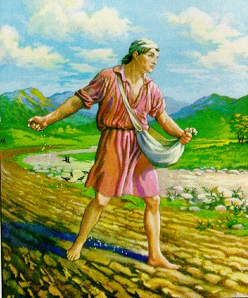
Links to Jesus’ teaching The Parable of The Sower
Scattered 1:1 Sown 3:18
Sun 1:11 Reaped 5:4
Firstfruits 1:18 Fields 5:4
Implanted 1:21 Husbandman 5:7
Good Fruit 3:17 Fruit 3:18, 5:7, 5:18

Slide 5
The Sower
James was there listening!
Matthew 12:46-13:1-9
Seed is the word James 1:21
Birds are the devil James 4:7
Stony is the trial by sun James 1:11
Thorns are the riches James 5:1-
Good – brings forth fruit James 3:17-18

Slide 7
The Fruit of the Spirit in James’ letter
Fruit 3:17
Love 2:8
Joy 1:2
Peace 3:18
Longsuffering sw. 5:10
Gentleness 3:17
Goodness 3:17
Faith 2:20
Meekness 1:21
Temperance 5:7
The ‘Fruit of the Spirit’ is from Galatians 5:22-23

Slide 8
James and Galatians balance
James corrects:
Galatians corrects:
Hearers only
Doers only
Christ did it all. I don’t need to do anything or change
Judaisers – I must work to earn my salvation

Slide 9
Jesus upheld God’s righteousness
He lived a life manifesting the character of God – full of grace and truth
He cut off the flesh! He never sinned! He always put God’s will over his own
He gave his life on the cross – showed anything associated with sin needs to die

Slide 10
Paul/James
Galatians | James
5:1, “Stand fast therefore in the liberty wherewith Christ hath made us free” | 2:12 “So speak ye, and so do, as they that shall be judged by the law of liberty.”
5:3 “I testify again to every man that is circumcised, that he is a debtor to do the whole law.” | 2:10 “whosoever shall keep the whole law, and yet offend in one point, he is guilty of all.”
5:14, “For all the law is fulfilled in one word, even in this; Thou shalt love thy neighbour as thyself.” | 2:8 “If ye fulfil the royal law according to the scripture, thou shalt love thy neighbour as thyself”

Slide 11
“For whosoever shall do the will of my Father which is in heaven, the same is my brother, and sister, and mother.” Matthew 12:50

Slide 12
James, a servant of God and of the Lord Jesus Christ, to the twelve tribes which are scattered abroad, greeting. My brethren, count it all joy when ye fall into divers temptations; Knowing this, that the trying of your faith worketh patience. But let patience have her perfect work, that ye may be perfect and entire, wanting nothing. If any of you lack wisdom, let him ask of God, that giveth to all men liberally, and upbraideth not; and it shall be given him. But let him ask in faith, nothing wavering. For he that wavereth is like a wave of the sea driven with the wind and tossed.

Slide 13
Rejoicing in trials
“... when they had called the apostles, and beaten them, they commanded that they should not speak in the name of Jesus, and let them go. And they departed from the presence of the council, rejoicing [stem of James 1:2] that they were counted worthy to suffer shame for his name. And daily in the temple, and in every house, they ceased not to teach and preach Jesus Christ.”
Acts 5:40-42

Slide 14
Rejoicing in trials
Paul wrote regarding the Macedonian ecclesias:
“in a great trial of affliction the abundance of their joy and their deep poverty abounded unto the riches of their liberality.”
2 Corinthians 8:2

Slide 15
Trials can do us good!
“Now no chastening for the present seemeth to be joyous, but grievous:
nevertheless afterward it yieldeth the peaceable fruit of righteousness unto them which are exercised thereby.”
Hebrews 12:11
“My brethren, count it all joy when ye fall into divers temptations”
James 1:2
“the fruit of righteousness is sown in peace of them that make peace”
James 3:18

Slide 16
Source of wisdom
“The wise men are ashamed, they are dismayed and taken: lo, they have rejected the word of the LORD; and what wisdom is in them?” Jeremiah 8:9

Slide 17
Lessons for our lives
Embed in our lives the fruit of the spirit
Stay on the good ground
The good ground is where the seed/word can have a chance
God can bring us through the trials of life
We are responsible for our sins
Help is on offer for us – in the word
The Word is able to save our souls (SOS)

Slide 18
James “The Implanted Word”
Reading: James 1

Slide 19
Developing Patience
Jesus said…“that on the good ground are they, which in an honest and good heart, having heard the word, keep it, and bring forth fruit with patience” Luke 8:15
James’ letter exhorts us…
The trying of our faith develops our patience

Slide 20
“For the Lord giveth wisdom:
out of his mouth cometh knowledge and understanding.
He layeth up sound wisdom for the righteous:
he is a buckler to them that walk uprightly.”
Proverbs 2:6-7
Uprightly = with integrity

Slide 21
“the wicked are like the troubled sea, when it cannot rest, whose waters cast up mire and dirt.” Isaiah 57:20
“I will cause many nations to come up against thee, as the sea causeth his waves to come up” Ezekiel 26:3

Slide 22
“Every valley shall be exalted, and every mountain and hill shall be made low: and the crooked shall be made straight, and the rough places plain…The grass withereth, the flower fadeth: but the word of our God shall stand for ever.” (Isaiah 40:4,8)
“Let the brother of low degree rejoice in that he is exalted: But the rich, in that he is made low: because as the flower of the grass he shall pass away. For the sun is no sooner risen with a burning heat, but it withereth the grass, and the flower thereof falleth” (James 1:9-11)

Slide 23
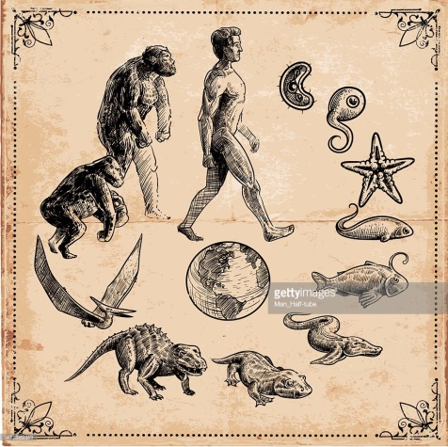
big bang – chemical changes – biological changes
No explanation for a beginning – no purpose – no hope!

Slide 24
“But understand this, that in the last days there will come times of difficulty. For people will be lovers of self, lovers of money, proud, arrogant, abusive, disobedient to their parents, ungrateful, unholy, heartless, unappeasable, slanderous, without self-control, brutal, not loving good, treacherous, reckless, swollen with conceit, lovers of pleasure rather than lovers of God” (2 Timothy 3:1-4)

Slide 25
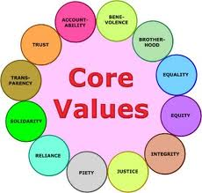
Education
No authority
“Post-truth society” (Professor Donaldson)
There is no truth – you choose
“there was no king in Israel, but every man did that which was right in his own eyes.” (Judges 17:6)

Slide 26
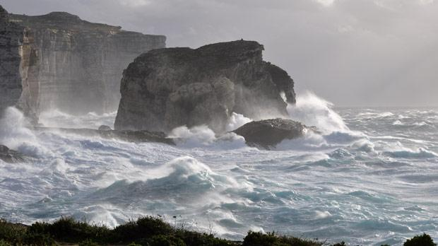

Slide 27
“Do not err”
“Be not deceived; God is not mocked: for whatsoever a man soweth, that shall he also reap.” (Galatians 6:7)

Slide 28
Being tried by God
“Let no man say when he is tempted I am tempted of God” (James 1:13)
“By faith, Abraham when he was tried offered up Isaac” (Hebrews 11:17)
cf. “God did tempt Abraham” (Genesis 22:1)
“By myself have I sworn, saith the LORD, for because thou hast done this thing, and hast not withheld thy son, thine only son: That in blessing I will bless thee…” (Genesis 22:16-17)

Slide 29
Contrast God and Man
Man’s sin...
...bringeth forth...
(G616 - apokueō)
...death!
God’s will...
...begat us...
(G616 - apokueō)
...through his word...
...to be alive!

Slide 30
“we should be a kind of firstfruits” James 1:18
“ourselves also, which have the firstfruits of the Spirit” Romans 8:23
the spirit = the mind of God/Christ, shown to us in “the word of truth”

Slide 31
Implanted word
Engrafted/Implanted - G1721 - emphytos
From G1722 – en and a derivative of G5453 - phyō
“some fell upon a rock; and as soon as it was sprung up, it withered away” Luke 8:6
“other fell on good ground, and sprang up, and bare fruit an hundredfold. And when he had said these things, he cried, He that hath ears to hear, let him hear.” Luke 8:8

Slide 32
Chapter 1: | Theme | Other refs in James
2 | Joy | 4:9
2 | Temptation | 1:12-, 4:7
3 | Patience/endurance | 5:7-11
4 | Work
5 | Wisdom
6 | Faith
5-6 | Ask
6 | Wavering
7 | Receive
8 | Double minded
9 | Brother/brethren
9 | Low degree
9 | Rejoice
9 | Exalted
10-11 | Rich
17 | God doesn’t change
18 | Truth
18 | Fruit
19 | Hear
19 | Speak
20 | Wrath of man
20 | Righteousness
21 | Meekness
21 | Able to save
21 | Save souls
22 | Doer
23 | Mirror
25 | Law
26 | Tongue
26 | Bridle
27 | Fatherless, widow
27 | World | 4:4

Slide 33
two looks in the mirror
1st man looks intently (katanoeo)
Sees his face: the whole person/personality
Squirms, sees the problem
Gets some ‘pleasure’ from seeing the problem: believes God is right to condemn sin
Does nothing, forgets until next week!

Slide 34
two looks in the mirror
2nd man bends down to look (parakupto)
Wants to look deeply – Luke 24:12, John 20:5, 11, 1 Peter 1:12 – searching for answers
“continues therein”: he remains beside the word
Sees the liberating work of the Lord Jesus Christ, is humble enough to be moved so that he doesn’t forget…
Wants to be associated with the Lord, do becomes a doer of the word – and is happy in his doing!

Slide 35
Tools for examination
THE WORD: “For the word of God is quick, and powerful, and sharper than any two edged sword, piercing even to the dividing asunder of soul and spirit, and of the joints and marrow, and is a discerner of the thoughts and intents of the heart.” Hebrews 4:12
TRIALS: “Blessed is the man that endureth temptation: for when he is tried, he shall receive the crown of life” James 1:12

Slide 36
Hear and do
“Therefore whosoever heareth these sayings of mine, and doeth them, I will liken him unto a wise man, which built his house upon a rock” (Matthew 7:24)

Slide 37
The law of liberty
Echoes of Deuteronomy 15:7-11 – the year of release. (Slaves set free/at liberty)
“For the law of the Spirit of life in Christ Jesus hath made me free [liberated] from the law of sin and death.” (Romans 8:2)

Slide 38
Lessons for our lives
God’s wisdom is the only unchanging rock we can build our lives on
Recognise we are responsible for our sins
It’s the implanted word which is able to save our souls
The Lord Jesus Christ has set us free – what a reason to show our thanks!

Slide 40
James “Faith without works is dead”
Reading: James 2

Slide 41
The laver
“And he made the laver of brass, and the foot of it of brass, of the looking glasses of the women assembling, which assembled at the door of the tabernacle of the congregation”. (Exodus 38:8)
“Thou shalt also make a laver of brass, and his foot also of brass, to wash withal: and thou shalt put it between the tabernacle of the congregation and the altar, and thou shalt put water therein. For Aaron and his sons shall wash their hands and their feet thereat”. (Exodus 30:18-20)

Slide 42
“But we all, with open face beholding as in a glass the glory of the Lord, are changed into the same image from glory to glory, even as by the Spirit of the Lord”. (2 Corinthians 2:18)
“A father of the fatherless and a judge of the widows, is God in his holy habitation” (Psalm 68:5)

Slide 43
10
9
8
7
6
5
4
3
2
1
0
Faith & Works
“Faith comes by hearing, and hearing by the word of God” (Romans 10:17)
Time in God’s word

Slide 44
Structure of James
Swift to listen... Chapter 1, be a hearer
Slow to speak... Chapter 3, the tongue
Slow to anger... Chapter 4-5, stop fighting

Slide 45
Structure of James
Swift to listen... Chapter 1, be a hearer
chapter 2, FAITH, “faith comes by hearing...”
Slow to speak... Chapter 3, the tongue
Slow to anger... Chapter 4-5, stop fighting

Slide 46
Example of David (‘beloved’)
“Hearken my ‘beloved’ brethren” James 2:5
“For he that said, Do not commit adultery, said also, Do not kill.” James 2:11
2 Samuel 11, 12
David committed murder and adultery
Nathan told David a parable about a rich and a poor man

Slide 47
The mercy of God
So speak ye, and so do, as they that shall be judged by the law of liberty. For he shall have judgment without mercy, that hath shewed no mercy; and mercy rejoiceth against judgment.” James 2:12-13
“forgive us our debts, as we forgive our debtors... For if ye forgive men their trespasses, your heavenly Father will also forgive you: But if ye forgive not men their trespasses, neither will your Father forgive your trespasses.”
Matthew 6:12,14-15

Slide 48
Liberty, Gk: eleutheria
Romans 8:21
1 Corinthians 10:29
2 Corinthians 3:17
Galatians 2:4, 5:1, 5:13, 5:13
James 1:25, 2:12
1 Peter 2:16
2 Peter 2:19

Slide 49
John Baptist’s teaching
“And the people asked him, saying, What shall we do then? He answereth and saith unto them, He that hath two coats, let him impart to him that hath none; and he that hath meat, let him do likewise.” (Luke 3:10-11)

Slide 50
10
9
8
7
6
5
4
3
2
1
0
Faith & Works
“Faith comes by hearing, and hearing by the word of God” (Romans 10:17)
Time in God’s word

Slide 51
Contrast Man and God
Men (us)
1:6-8 – doubleminded
2:1-4 – show partiality
3:9-11 – bless and curse
4:4 – commit adultery with the world
4:8 – doubleminded
God
1:5 – gives to all[no partiality] liberally [singleness of heart]
1:17 – with him is no variation
3:17 – the wisdom from above is first pure

Slide 52
“You believe that God is one”
“The first of all the commandments is, Hear, O Israel; The Lord our God is one Lord:
And thou shalt love the Lord thy God with all thy heart, and with all thy soul, and with all thy mind, and with all thy strength: this is the first commandment.” (Mark 12:29-30)

Slide 53
Legion – a double minded man
James | Gospel account of Legion
A double minded man is unstable in all his ways (1:8) | My name is Legion, because we are many (Mark 5:9)
The devils [mentally ill] believe (James 2:19) | Many devils were entered into him (Luke 8:30)
Believe God is one (2:19) | Jesus thou Son of God most high (Luke 8:28)

Slide 54
Legion – a double minded man
James | Gospel account of Legion
A double minded man is unstable in all his ways (1:8) | My name is Legion, because we are many (Mark 5:9)
The devils [mentally ill] believe (James 2:19) | Many devils were entered into him (Luke 8:30)
Believe God is one (2:19) | Jesus thou Son of God most high (Luke 8:28)
If a brother or sister be naked (2:15)... [clothe them] | Legion was ... sitting at the feet of Jesus, clothed, and in his right mind (Luke 8:35)

Slide 55
A¹⁷ Even so faith, if it hath not works, is dead, being alone.
B ¹⁸ Yea, a man may say, Thou hast faith, and I have works: shew me thy faith without thy works, and I will shew thee my faith by my works.
C¹⁹ Thou believest that there is one God; thou doest well: the devils also believe, and tremble.
D²⁰ But wilt thou know, O vain man, that faith without works is dead?
E²¹ Was not Abraham our father justified by works, when he had offered Isaac his son upon the altar?
D’²² Seest thou how faith wrought with his works, and by works was faith made perfect?
C’23 And the scripture was fulfilled which saith, Abraham believed God, and it was imputed unto him for righteousness: and he was called the Friend of God.
B’²⁴ Ye see then how that by works a man is justified, and not by faith only.
E2 ²⁵ Likewise also was not Rahab the harlot justified by works, when she had received the messengers, and had sent them out another way?
A’ ²⁶ For as the body without the spirit is dead, so faith without works is dead also.

Slide 56
Rahab a...
“I know that Yahweh that given you the land...for we have heard”
“she took the two men and hid them”
“she sent them away and they departed”
Joshua 2
...pattern of Faith
“Faith comes by hearing and hearing by the word of God” (Rom 10:17)
“she received the spies with peace” (Heb 11:31)
“justified by works when she received the messengers and had sent them out another way” (Jam 2:25)

Slide 57
Lessons for our lives
“be swift to hear” – the basis of our faith
Be consistent with how we treat our brothers and sisters
Live our faith/belief in “one God”
Serve with all our heart; show kindness to those in need
Rely on faith – otherwise we’re dead!
like David, like Rahab, like Abraham!
Be single-minded, not double-minded!
Give God our all

Slide 59
James “The tongue can no man tame”
Reading: James 3

Slide 60
Hearing/faith & doing/works
“whoso looketh into the perfect law of liberty, and continueth therein, he being not a forgetful hearer, but a doer of the work, this man shall be blessed in his deed.” James 1:25
“faith, if it hath not works, is dead”
James 2:17, 20, 26

Slide 61
“the whole body”
The ecclesia:
1 Corinthians 12:17
Ephesians 4:15-16
“the head, even Christ: from whom the whole body fitly joined together”

Slide 62
Serpent
Gk: ophis ‘serpent’
Matt 7:10, 10:16, 23:33
Mark 16:18
Luke 11:11
John 3:14
1 Corinthians 10:9
2 Corinthians 11:3
Revelation 9:19, 12:9, 14, 15, 20:2
Gk: herpeton
Acts 10:12
“creeping things”
Acts 11:6
“creeping things”
Romans 1:23
“creeping things”
James 3:7

Slide 63
Man taming/having dominion
‘tamed’ – Gk. damazō (akin to Latin, dominus)
“God said, Let us make man in our image, after our likeness: and let them have dominion over the fish of the sea, and over the fowl of the air, and over the cattle, and over all the earth, and over every creeping thing that creepeth upon the earth.” Genesis 1:26

Slide 64
Poison
“with their tongues they have used deceit; the poison of asps is under their lips” Romans 3:13
An asp is a small and venemous serpent, it’s bite is deadly! (Thought to be an Egyptian cobra – Egypt is always deadly!!)

Slide 65
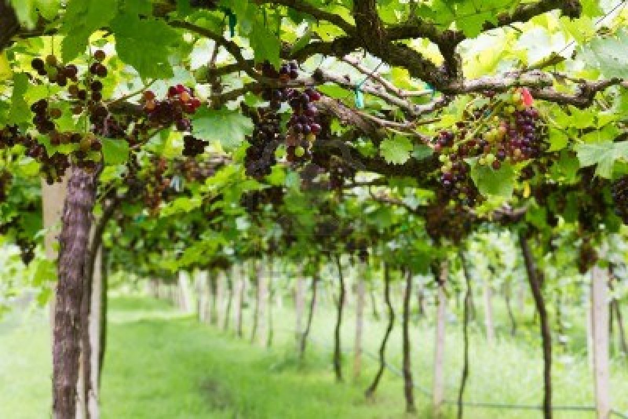
Fig tree
Fountain
Vine

Slide 66
“God blessed them, and God said unto them, Be fruitful, and multiply, and replenish the earth, and subdue it: and have dominion over the fish of the sea, and over the fowl of the air, and over every living thing that moveth upon the earth.” Genesis 1:28

Slide 67
Two wisdoms
Earthly wisdom
Sensual – natural
Devilish – demoniacal
Bitter envying
Strife/Faction – splits!
Confusion
Every evil work
Heavenly wisdom
Pure
Peaceable
Gentle
Easy to be intreated
Full of mercy and good fruits
Without partiality
Without hypocrisy

Slide 68
The wisdom from above
“If ye then be risen with Christ, seek those things which are above, where Christ sitteth on the right hand of God. Set your affection on things above, not on things on the earth.” Colossians 3:1-2

Slide 69
God’s wisdom
A gift from God above
James 1:17, James 3:15-17
Comes down from above, like manna
cp. James 1:17, John 6:31-58

Slide 70
Reference trail!
Deuteronomy 8:3
Matthew 4:4
James 4:7
The LORD thy God “humbled thee, and suffered thee to hunger, and fed thee with manna, which thou knewest not, neither did thy fathers know; that he might make thee know that man doth not live by bread only, but by every word that proceedeth out of the mouth of the LORD doth man live.” Deuteronomy 8:3
Jesus “answered and said, It is written, Man shall not live by bread alone, but by every word that proceedeth out of the mouth of God.” Matthew 4:4
“Submit yourselves therefore to God. Resist the devil, and he will flee from you..” James 4:7

Slide 71
God’s wisdom
A gift from God above (James 1:17, James 3:15-17)
Comes down from above, like manna (cp. James 1:17, John 6:31-58)
Manna was there to teach Israel to rely on the word of God
Jesus showed us the need to listen/open our ear to the word morning by morning
An open ear can prepare the tongue and body

Slide 72
James | Proverbs
1:5, “if any of you lack wisdom, let him ask of God, who giveth liberally” | 2:6–7, “the LORD giveth wisdom”
1:10, “the rich, in that he is made low…he shall pass away” | 11:28, “he that trusteth in his riches shall fall”
1:19, “let every man be…slow to wrath” | 14:29, “he that is slow to wrath is of great understanding”
2:1, “have not the faith of our Lord Jesus Christ…with respect of persons” | 18:5, “it is not good to accept the person of the wicked”
2:2-6, “ye have respect to him that weareth the fine clothing…and say to the poor stand thou here, or sit under my footstall” | 14:20–21, “the poor is hated even of his own neighbour: but the rich hath many friends”

Slide 73
James | Proverbs
3:2 “if any man offend not in word, the same is a perfect man” | 10:19, “he that refraineth his lips is wise”
3:6, “the tongue is a fire” | 16:27, “in his lips is a burning fire”
4:6, “God resisteth the proud, but giveth grace unto the lowly” | 3:34, “Surely he [God] scorneth the scorners: but he giveth grace unto the lowly.”
4:13–14, “go to now, ye that say, Today or tomorrow we will…ye know not what shall be on the morrow” | 27:1, “Boast not thyself of tomorrow; for thou knowest not what a day may bring forth”
5:20, “he which converteth the sinner…shall cover a multitude of sins” | 10:12, “love covereth all sins”
“The LORD possessed me in the beginning of his way, before his works of old. I was set up from everlasting, from the beginning, or ever the earth was.” (Proverbs 8:22-23)

Slide 74
Jesus can tame!
“had been often bound with fetters and chains, and the chains had been plucked asunder by him, and the fetters broken in pieces: neither could any man tame him.” (Mark 5:4)
Jesus tamed his human nature – early wisdom;
He tamed the serpent's deadly poison – sin!
One ‘member’ done it for the ‘whole body’!

Slide 75
Lessons for our lives
Keep listening to/hearing the word
“Faith comes by hearing”
We must hear and do!
“Faith without works is dead”
Control our tongue
It can set on fire the whole body!
Ask God for wisdom – the wisdom from above!
Assimilate God’s wisdom into our lives

Slide 77
One member tamed sin for the whole body!
“the tongue is a little member, and boasteth great things. Behold, how great a matter a little fire kindleth! And the tongue is a fire, a world of iniquity: so is the tongue among our members, that it defileth the whole body” (James 3:5-6)
“For the body is not one member, but many…If the whole body were an eye, where were the hearing?” (1 Corinthians 12:14,17)

Slide 78
James “Draw nigh to God”
Reading: James 4

Slide 79
“let every man be swift to hear, slow to speak, slow to wrath [G3709]” (James 1:19)
“ye kill” (James 4:2)
“Ye have heard that it was said by them of old time, Thou shalt not kill; and whosoever shall kill shall be in danger of the judgment: But I say unto you, That whosoever is angry [G3710 from G3709] with his brother without a cause shall be in danger of the judgment” (Matthew 5:21-22)

Slide 80
“Know ye not that friendship of the word is enmity with God” (James 3:4)
“I will put enmity between thee and the woman, and between thy seed and her seed” (Genesis 3:15)
Seed of the Serpent
- Those who adhere to natural wisdom (the thinking of the flesh)
Seed of the Woman
- Those who adhere to God’s wisdom (His word)

Slide 81
NOT asking amiss
Ask, and it shall be given you, seek and ye shall find...
...Seek ye first the kingdom of God and all these things will be added to you...
...O my Father, if it be possible, let this cup pass from me: nevertheless not as I will, but as thou wilt...
...humble yourselves in the sight of the Lord and he shall lift you up.

Slide 82
“all these things”
“The devil taketh him up into an exceeding high mountain, and sheweth him all the kingdoms of the world, and the glory of them; And saith unto him, All these things will I give thee, if thou wilt fall down and worship me. Then saith Jesus unto him, Get thee hence, Satan: for it is written, Thou shalt worship the Lord thy God, and him only shalt thou serve. Then the devil leaveth him, and, behold, angels came and ministered unto him.” (Matthew 4:8-11)
“seek ye first the kingdom of God, and his righteousness; and all these things shall be added unto you.” (Matthew 6:33)

Slide 83
“draw nigh to God…”
“The devil taketh him up into an exceeding high mountain, and sheweth him all the kingdoms of the world, and the glory of them; And saith unto him, All these things will I give thee, if thou wilt fall down and worship me. Then saith Jesus unto him, Get thee hence, Satan: for it is written, Thou shalt worship the Lord thy God, and him only shalt thou serve. Then the devil leaveth him, and, behold, angels came and ministered unto him.” (Matthew 4:8-11)
“Submit yourselves therefore to God. Resist the devil, and he will flee from you. Draw nigh to God, and he will draw nigh to you” (James 4:7-8)

Slide 84
He shall lift you up
“being found in fashion as a man, he humbled himself, and became obedient unto death, even the death of the cross. Wherefore God also hath highly exalted him, and given him a name which is above every name” (Philippians 2:8-9)
“Humble yourselves in the sight of the Lord, and he shall lift you up.” (James 4:10)

Slide 85
James | Matthew | Link word
1v2 | 5v12 | Joy
1v4 | 5v48 | Perfect
1v4 | 7v11 | Wanting nothing
1v5 | 7v7-11 | Ask of God
1v5 | 7v7 | It shall be given him
1v10 | 6v30 | Pass away
1v11 | 6v30 | Grass
1v14 | 5v28 | Lust
1v17 | 7v11 | Good gifts
1v20 | 6v23 | Righteousness (of God)
1v21 | 5v5 | Meek(ness)
1v22 | 7v21 | Doers of the word
1v22 | 7v24-27 | Hearing & doing
2v3 | 7v1-2 | Judging wrongly

Slide 86
James | Matthew | Link word
2v5 | 5v3 | Kingdom
2v8 | 5v43 | The Royal Law
2v10 | 5v19 | One
2v10 | 5v3 | Guilty (of all)
2v11 | 5v21 | Kill
2v11 | 5v27-28 | Adultery
2v13 | 7v2 | Judgment (without mercy)
2v13 | 6v15 | Mercy
2v16 | 7v26 | What doth it profit
2v18 | 7v16-17 | Fruits
2v26 | 5v16 | Works
3v6 | 5v22 | Hell fire
3v9 | 5v44 | Bless them that curse you
2v18 | 7v21 | Faith & works

Slide 87
James | Matthew | Link word
3v12 | 7v16 | Fruits
3v18 | 5v9 | Peacemakers
4v2 | 7v7 | Asking
4v4 | 6v24 | Service
4v9 | 5v4 | Mourning
4v9 | 5v48 | Mourn
4v11 | 7v1-2 | Judgement
4v14 | 6v34 | The morrow
5v2 | 6v20 | Moth & rust
5v3 | 6v20 | Lay up treasure
5v6 | 5v39 | Resist
5v9 | 7v1 | Be not judged
5v10 | 5v12 | Prophets
5v11 | 5v10 | Enduring
5v12 | 5v34-37 | Swearing

Slide 88
“Blessed are the poor in spirit: for theirs is the kingdom of heaven.” (Matthew 5:3)
“to this man will I look, even to him that is poor and of a contrite spirit, and trembleth at my word.” (Isaiah 66:2)

Slide 89
The Sermon on the Mount
The Beatitudes
Poor - 2:5 “Hath not God chosen the poor of this word, rich in faith and heirs of the kingdom”
Mourn - 4:9 “be afflicted, mourn and weep”
Meek - 3:13 “let him show out of a good conversation his works with meekness”

Slide 90
The Sermon on the Mount
The Beatitudes
Righteousness - 5:16 “the effectual fervent prayer of a righteous man availeth much”
Merciful - 2:13 “mercy rejoiceth against judgement”
Pure in heart - 1:26-27 “If any man among you…deceiveth his own heart his religion is vain. Pure religion and undefiled before God is…”

Slide 91
The Sermon on the Mount
The Beatitudes
Peace - 3:18 “the fruit of righteousness is sown in peace of them that make peace”
Persecuted - 2:6 “Do not rich men oppress you”, Job suffered affliction.
Rejoice - 1:1 “to the twelve tribes which are scattered abroad greeting”[sw joy!]

Slide 92
James – drawing nigh
Question:
Why does James keep referring to the teaching of the Lord Jesus Christ?
Answer:
Jesus can help us draw nigh to God.
“Neither is there salvation in any other: for there is none other name under heaven given among men, whereby we must be saved.” (Acts 4:12)

Slide 93
James – drawing nigh
The Sermon on the Mount
Love your enemies!
Walk two miles not one!
Turn the other cheek!

Slide 94
Luke 15
“when he had spent all”
“he would fain” (v16)
Joined himself to a citizen of that country (v15)
He arose and came to his father...his father saw him...and ran (v20)
“I have sinned...I am no more worth to be called thy son” (v22)
“bring forth the best robe, and put it on him; and put a ring on his hand and shoes on his feet (v22)
His brother judged him!
James 4
“consume it upon your lusts” (v3)
“Ye lust” (v2)
Adulterers...friendship of the world (v4)
“draw nigh to God and he will draw nigh to you” (v8)
“humble yourselves in the sight of the Lord (v10)
“he shall lift you up” [exalt you] (v10)
“He that speaketh evil...and judgeth his brother” (v11)

Slide 95
“But if ye forgive not men their trespasses, neither will your Father forgive your trespasses”
Matthew 6:15

Slide 96
James 4:13
“Take therefore no thought for the morrow: for the morrow shall take thought for the things of itself. Sufficient unto the day is the evil thereof.”
Matthew 6:34

Slide 97
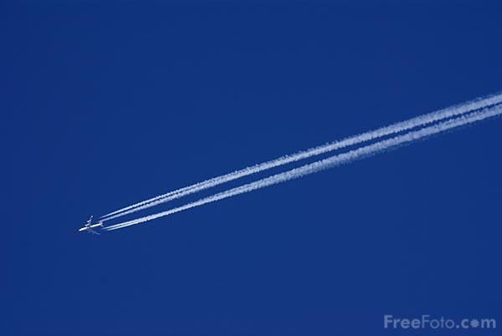
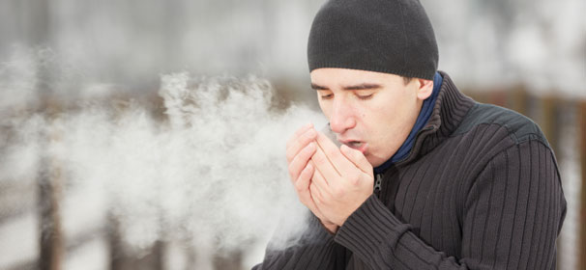
Life is a vapour
Your life “is even a vapour that appeareth for a little time and then vanisheth away” (James 4:14)
Abel = breath/vapour

Slide 98
Lessons for our lives
Friendship of the world is enmity with God
Work and home (be consistent)
Keep the Lord Jesus in the forefront of our minds, he said “learn of me”!
“If the Lord will, we shall live, and do this or that”
what we do should be in accordance with God will/our faith!
Use our time – “today – hear his voice”

Slide 100
Inspiration of scripture
God’s in control
2 Samuel 23:1-2
Mark 12:36
John 14:26
2 Timothy 3:16
1 Peter 1:10
2 Peter 1:21
Problems that arise
‘Paul’s chauvinistic opinion…’
‘Their simple understanding…’
‘the inspired apostle writes…’
‘under inspiration…’
‘the spirit has drawn James’ mind to...’
The tongue “defileth the whole body”
Defile – cf. Ephesians 5:25-27 ‘spot’

Slide 101
The Lord’s Prayer
“forgive us our debts, as we forgive our debtors...For if ye forgive men their trespasses, your heavenly Father will also forgive you: But if ye forgive not men their trespasses, neither will your Father forgive your trespasses.” (Matthew 6:12-15)

Slide 102
James “Be patient therefore, Brethren”
Reading: James 5

Slide 103
James 1 | Theme | Reference in James
2 | Joy | 4:9
2 | Temptation | 1:12-, 4:7
3 | Patience/endurance | 5:7-11
4 | Work | 1:19-, 2:14-26, 3:13
5 | Wisdom | 3:13-17
6 | Faith | 2:1, 2:5, 2:14-26, 5:15
5-6 | Asking | 4:1-3
6 | Wavering | 2:4 “are ye” and “partial”
7 | Receive | 1:12, 4:3
8 | Double minded | 3:11-12, 4:8
9 | Brother/brethren | 17 times throughout – key
9 | Low degree | 4:9 sw “humble”
9 | Rejoice | 4:16
9 | Exalted | 4:10
10-11 | Rich | 2:1-, 5:1-6

Slide 104
James 1 | Theme | Ref. in James
2 | Joy | 4:9
2 | Temptation | 1:12-, 4:7
3 | Patience/endurance | 5:7-11
4 | Work | 1:19-, 2:14-26, 3:13
5 | Wisdom | 3:13-17
6 | Faith | 2:1, 2:5, 2:14-26, 5:15
5-6 | Asking | 4:1-3
6 | Wavering | 2:4 “are ye” and “partial”
7 | Receive | 1:12, 4:3
8 | Double minded | 3:11-12, 4:8
9 | Brother/brethren | 17 times throughout – key
9 | Low degree | 4:9 sw “humble”
9 | Rejoice | 4:16
9 | Exalted | 4:10
10-11 | Rich | 2:1-, 5:1-6

Slide 105
James 1 | Theme | Ref. in James
2 | Joy | 4:9
2 | Temptation | 1:12-, 4:7
3 | Patience/endurance | 5:7-11
4 | Work | 1:19-, 2:14-26, 3:13
5 | Wisdom | 3:13-17
6 | Faith | 2:1, 2:5, 2:14-26, 5:15
5-6 | Asking | 4:1-3
6 | Wavering | 2:4 “are ye” and “partial”
7 | Receive | 1:12, 4:3
8 | Double minded | 3:11-12, 4:8
9 | Brother/brethren | 17 times throughout – key
9 | Low degree | 4:9 sw “humble”
9 | Rejoice | 4:16
9 | Exalted | 4:10
10-11 | Rich | 2:1-, 5:1-6

Slide 106
James 1 | Theme | Ref. in James
2 | Joy | 4:9
2 | Temptation | 1:12-, 4:7
3 | Patience/endurance | 5:7-11
4 | Work | 1:19-, 2:14-26, 3:13
5 | Wisdom | 3:13-17
6 | Faith | 2:1, 2:5, 2:14-26, 5:15
5-6 | Asking | 4:1-3
6 | Wavering | 2:4 “are ye” and “partial”
7 | Receive | 1:12, 4:3
8 | Double minded | 3:11-12, 4:8
9 | Brother/brethren | 17 times throughout – key
9 | Low degree | 4:9 sw “humble”
9 | Rejoice | 4:16
9 | Exalted | 4:10
10-11 | Rich | 2:1-, 5:1-6

Slide 107
James 1 | Theme | Ref. in James
2 | Joy | 4:9
2 | Temptation | 1:12-, 4:7
3 | Patience/endurance | 5:7-11
4 | Work | 1:19-, 2:14-26, 3:13
5 | Wisdom | 3:13-17
6 | Faith | 2:1, 2:5, 2:14-26, 5:15
5-6 | Asking | 4:1-3
6 | Wavering | 2:4 “are ye” and “partial”
7 | Receive | 1:12, 4:3
8 | Double minded | 3:11-12, 4:8
9 | Brother/brethren | 17 times throughout – key
9 | Low degree | 4:9 sw “humble”
9 | Rejoice | 4:16
9 | Exalted | 4:10
10-11 | Rich | 2:1-, 5:1-6

Slide 108
James 1 | Theme | Ref. in James
2 | Joy | 4:9
2 | Temptation | 1:12-, 4:7
3 | Patience/endurance | 5:7-11
4 | Work | 1:19-, 2:14-26, 3:13
5 | Wisdom | 3:13-17
6 | Faith | 2:1, 2:5, 2:14-26, 5:15
5-6 | Asking | 4:1-3
6 | Wavering | 2:4 “are ye” and “partial”
7 | Receive | 1:12, 4:3
8 | Double minded | 3:11-12, 4:8
9 | Brother/brethren | 17 times throughout – key
9 | Low degree | 4:9 sw “humble”
9 | Rejoice | 4:16
9 | Exalted | 4:10
10-11 | Rich | 2:1-, 5:1-6

Slide 109
17 | God doesn’t change | 2 – don’t show partiality
18 | Truth | 3:14, 5:19
18 | Fruit | 3:17-18, 5:7, 5;18
19 | Hear | 2:5
19 | Speak | 2:12
20 | Wrath of man | 4:1-
20 | Righteousness | 2:23, 3:18
21 | Meekness | 3:13
21 | Able to save | 4:12
21 | Save souls | 5:20
22 | Doer | 2:14, 4:11
25 | Law | 2:8-12, 4:11
26 | Tongue | 3:1-12
26 | Bridle | 3:2
27 | Fatherless, widow | 5:17 ?
27 | World | 4:4

Slide 110
17 | God doesn’t change | 2 – don’t show partiality
18 | Truth | 3:14, 5:19
18 | Fruit | 3:17-18, 5:7, 5;18
19 | Hear | 2:5
19 | Speak | 2:12
20 | Wrath of man | 4:1-
20 | Righteousness | 2:23, 3:18
21 | Meekness | 3:13
21 | Able to save | 4:12
21 | Save souls | 5:20
22 | Doer | 2:14, 4:11
25 | Law | 2:8-12, 4:11
26 | Tongue | 3:1-12
26 | Bridle | 3:2
27 | Fatherless, widow | 5:17 ?
27 | World | 4:4

Slide 111
17 | God doesn’t change | 2 – don’t show partiality
18 | Truth | 3:14, 5:19
18 | Fruit | 3:17-18, 5:7, 5;18
19 | Hear | 2:5
19 | Speak | 2:12
20 | Wrath of man | 4:1-
20 | Righteousness | 2:23, 3:18
21 | Meekness | 3:13
21 | Able to save | 4:12
21 | Save souls | 5:20
22 | Doer | 2:14, 4:11
25 | Law | 2:8-12, 4:11
26 | Tongue | 3:1-12
26 | Bridle | 3:2
27 | Fatherless, widow | 5:17 ?
27 | World | 4:4

Slide 112
James 1 | Theme | Ref. in James
2 | Joy | 4:9
2 | Temptation | 1:12-, 4:7
3,12 | Patience/endurance | 5:7-11
4 | Work | 1:19-, 2:14-26, 3:13
5 | Wisdom | 3:13-17
6 | Faith | 2:1, 2:5, 2:14-26, 5:15
5-6 | Asking | 4:1-3
6 | Wavering | 2:4 “are ye” and “partial”
7 | Receive | 1:12, 4:3
8 | Double minded | 3:11-12, 4:8
9 | Brother/brethren | 17 times throughout – key
9 | Low degree | 4:9 sw “humble”
9 | Rejoice | 4:16
9 | Exalted | 4:10
10-11 | Rich | 2:1-, 5:1-6

Slide 113
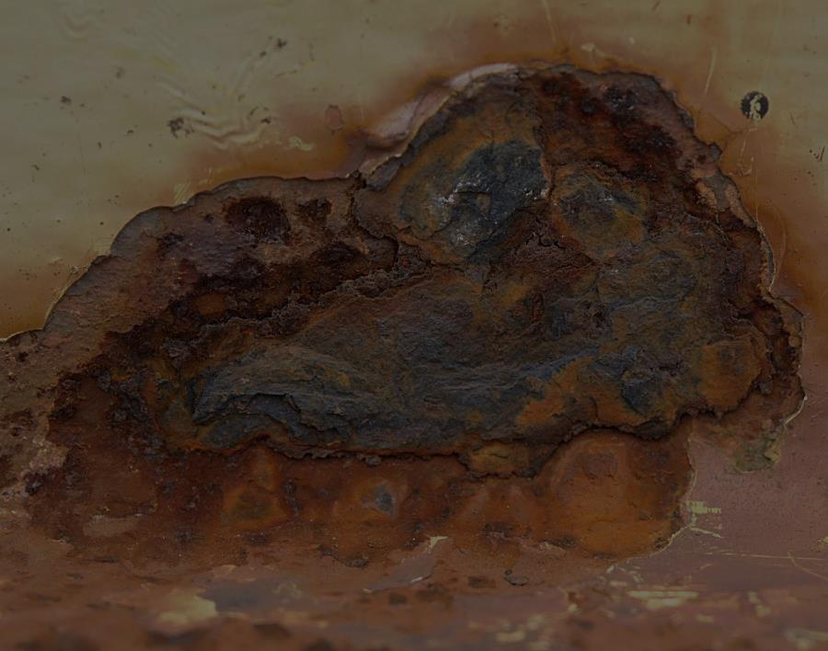
“lay up for yourselves treasures in heaven, where neither moth nor rust doth corrupt, and where thieves do not break through nor steal: For where your treasure is, there will your heart be also.” Matthew 6:20-21
“Your gold and silver is cankered; and the rust of them shall be a witness against you, and shall eat your flesh as it were fire. Ye have heaped treasure together for the last days…ye have nourished your hearts”. James 5:3,5

Slide 114
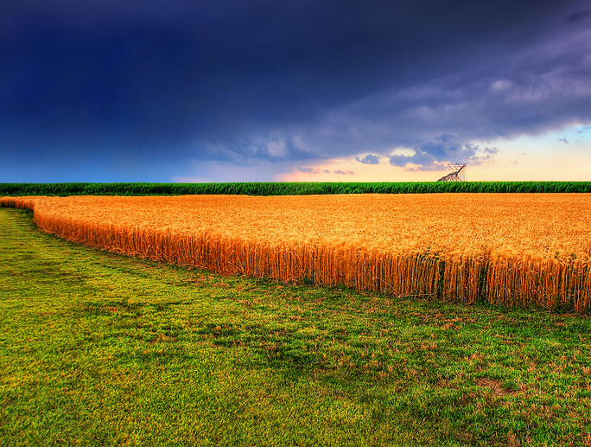
“the husbandman waiteth, and hath long patience over it” James 5:7
“The Lord is not slack concerning his promise, as some men count slackness; but is longsuffering to us-ward, not willing that any should perish, but that all should come to repentance” 2 Peter 3:9

Slide 115
Job – Eliphaz speaking | James
22:6-7 “stripped the naked of their clothing…withholden bread from the hungry” | 2:15 “If a brother or sister be naked, and destitute of daily food”
22:9 “thou hast sent widows away empty and the arms of the fatherless have been broken” | 1:27 “Pure religion…to visit the fatherless and widows in their affliction”
“Behold thou hast instructed man, and thou hast strengthened the weak hands. Thy words have upholden him that was falling, and thou hast strengthened the feeble knees” Job 4:3

Slide 116
Job – Eliphaz speaking | James
22:6-7 “stripped the naked of their clothing…withholden bread from the hungry” | 2:15 “If a brother or sister be naked, and destitute of daily food”
22:9 “thou hast sent widows away empty and the arms of the fatherless have been broken” | 1:27 “Pure religion…to visit the fatherless and widows in their affliction”
22:20 “the fire consumeth” | 5:3 “shall eat your flesh as it were fire”
22:23 “if thou return to the Almighty, thou shalt be built up” | 4:10 “Humble yourselves in the sight of the Lord, and he shall lift you up.”
22:24 “lay up gold [RV treasure]” | 5:3 “ye have heaped up treasure”
22:27, 29 “thou shalt make thy prayer unto him…he shall save the humble person” | 5:15 “the prayer of faith shall save the sick”
22:30 “the cleanness of thy hands” | 4:8 “cleanse your hands”

Slide 117
Job’s oppression and endurance
“Do not rich men oppress you” James 2:6
The brothers and sisters were being mistreated
“Wilt thou break [‘oppress’ Ps 10:18] a leaf driven to and fro?” Job 13:25
Job was being mistreated/oppressed

Slide 118
Job – Job speaking | James
23:7, “so should I be delivered for ever from my judge.” | 5:9 “Grudge not one against another, brethren, lest ye be condemned: behold, the judge standeth before the door”

Slide 119
Job – Job speaking | James
23:7, “so should I be delivered for ever from my judge.” | 5:9 “Grudge not one against another, brethren, lest ye be condemned: behold, the judge standeth before the door”
24:3 “the fatherless...the widow” | 1:27 “the fatherless...the widow”
24:6, 10 “they reap everyone his corn in the field…they take away the sheaf from the hungry” | 5:4 “Behold the hire of the labourers who have reaped down your fields”
24:7 “They cause the naked to lodge without clothing, that they have no covering in the cold” | 2:15-16 “If a brother or sister be naked…and one of you say unto them, Depart in peace, be ye warmed…notwithstanding ye give them not those things which are needful to the body; what doth it profit?”

Slide 120
Job – Job speaking | James
24:12 “the soul of the wounded crieth out” | 5:4 “the cries of them which have reaped are entered into the ears of the Lord of sabaoth.”
24:14 “the murderer rising with the light killeth the poor” | 4:2 “Ye lust, and have not: ye kill, and desire to have, and cannot obtain: ye fight and war”
24:15 “the eye also of the adulterer waiteth for the twilight” | 4:4 “Ye adulterers and adulteresses, know ye not that the friendship of the world is enmity with God?”
24:24, “they are exalted for a little while…and brought low” | 4:10 OPPOSITE! “Humble yourselves in the sight of the Lord, and he shall exalt you.” [RV]

Slide 121
“Blessed are ye, when men shall revile you, and persecute you, and shall say all manner of evil against you falsely, for my sake. Rejoice, and be exceeding glad: for great is your reward in heaven: for so persecuted they the prophets which were before you.” Matthew 5:11-12
“So the LORD blessed the latter end of Job more than his beginning” Job 42:12

Slide 122
Job = ‘hated’
“And ye shall be hated of all men for my name’s sake: but he that endureth <5278> to the end <5056> shall be saved” Matthew 10:22
“Behold, we count them happy which endure <5278>. Ye have heard of the patience <5281> of Job, and have seen the end <5056> of the Lord; that the Lord is very pitiful, and of tender mercy” James 5:11

Slide 123
“I say unto you, Swear not at all; neither by heaven; for it is God's throne: Nor by the earth; for it is his footstool: neither by Jerusalem; for it is the city of the great King. Neither shalt thou swear by thy head, because thou canst not make one hair white or black. But let your communication be, Yea, yea; Nay, nay: for whatsoever is more than these cometh of evil.” Matthew 5:34-37

Slide 124
Oil – James 5:14
Luke 10 has the story of the Good Samaritan who helped the wounded man using oil.
The disciples “went out, and preached that men should repent. And they cast out many devils, and anointed with oil many that were sick, and healed them.” Mark 6:12-13

Slide 125
The widow at Zarephath
“draw nigh to God and he will draw nigh to you”
James 4:8
What could save the woman’s spiritual life?
The oil? NO “the cruise of oil will not fail until the LORD sendeth rain”
The word? YES “the word of Yahweh in thy mouth is truth”

Slide 126
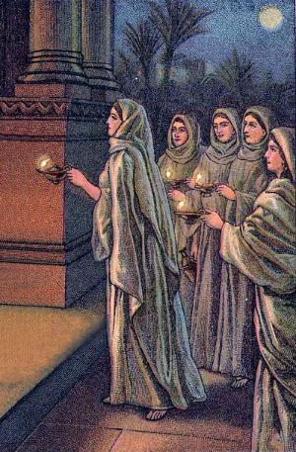
5 wise virgins
“the bridegroom came, and they that were ready went in with him to the marriage.” Matthew 25:10
We need to have oil (the word) to be ready!

Slide 127
Being Sick
Spiritually – we need the word
Naturally – we need medicine

Slide 128
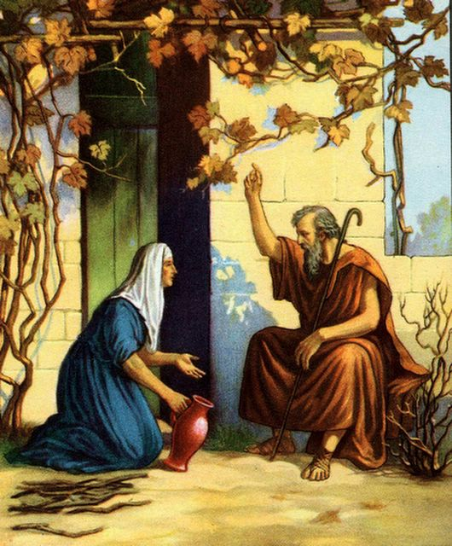
Elijah a man of prayer and action
“pure religion and undefiled before God and the Father is this: to visit the fatherless and the widow in their affliction.”
James 1:27
In 1 Kings 17 James visited the widow and her son (the fatherless)

Slide 129
The widow and fatherless
Spiritually
Fatherless without God “our Father which art in heaven”
Matthew 6:9
Widow without Christ “I have espoused you to one husband...Christ”
2 Corinthians 11:2

Slide 130
sinners are sick people
“They that be whole need not a physician, but they that are sick... I am not come to call the righteous, but sinners to repentance”
Matthew 9:12-13
The Lord Jesus Christ’s work was about giving everlasting life – the forgiveness of sins!

Slide 131
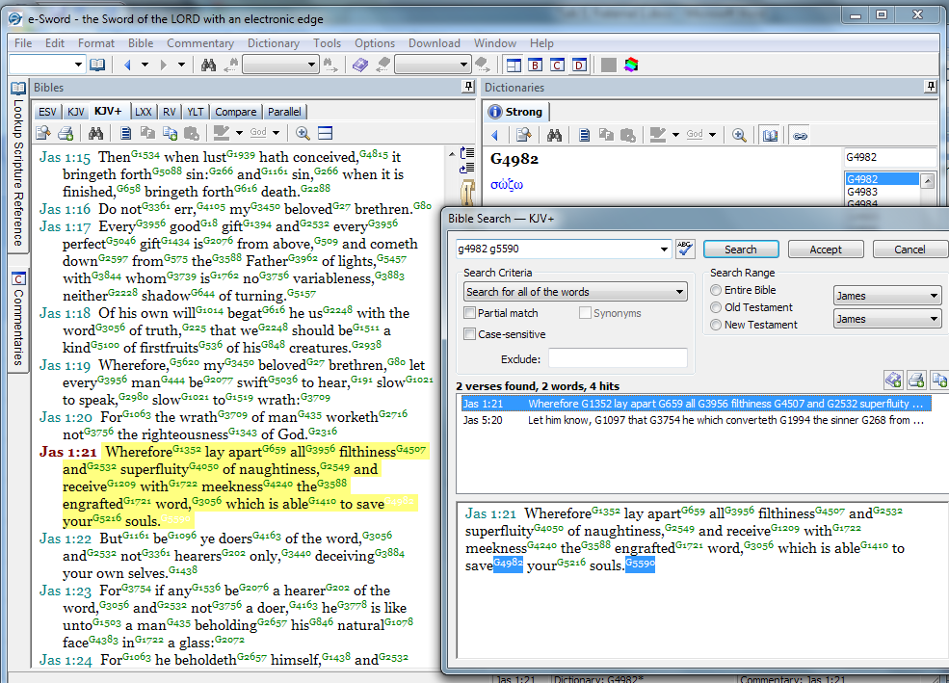

Slide 132
“Remember ye the law of Moses my servant, which I commanded unto him in Horeb for all Israel, with the statutes and judgments. Behold, I will send you Elijah the prophet before the coming of the great and dreadful day of the LORD: And he shall turn the heart of the fathers to the children, and the heart of the children to their fathers, lest I come and smite the earth with a curse.” Malachi 4:4-6
“he shall go before him in the spirit and power of Elias, to turn the hearts of the fathers to the children, and the disobedient to the wisdom of the just; to make ready a people prepared for the Lord.” Luke 1:17

Slide 133
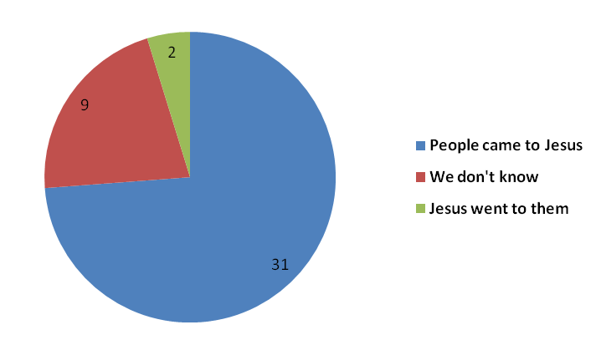
Jesus’ focus was on preaching the word
In Jesus ministry many came to him, and he never ignored them. But his focus give people the gospel message [the word] which can save people forever! He did not try to solve the social issues in the world.

Slide 134
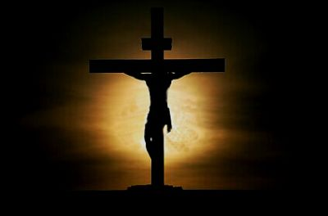
Jesus – the “righteous man”
“Father, forgive them; for they know not what they do”
“Verily I say unto thee today, shalt thou be with me in paradise”
“Father, into thy hands I commend my spirit”
“when the centurion saw what was done, he glorified God, saying, Certainly this was a righteous man” (Luke 23:47)

Slide 135
James 5:16
“the effectual fervent prayer of a righteous man availeth much”
“Neither pray I for these alone, but for them also which shall believe on me through their word” (John 17:20)
Jesus ‘the righteous man’ prayed for us!

Slide 136
Lessons for our lives
To live one day at a time – seek first the kingdom
To endure trials, let them humble us
To be consistent in life – single minded!
Help people in need
Practically, get them medicine
Spiritually, show them the word of God
The word is able to SOS

Slide 137
Recap of James
Ch 1 – Endure trials, take responsibility for sin, hear and do the word
Ch 2 – Live your faith, don’t respect persons (Abraham and Rahab)
Ch 3 – Be consistent, like the Lord Jesus – the perfect man – use the wisdom from above
Ch 4 – Keep looking to Jesus, he helps us to draw nigh to God, use our time now!
Ch 5 – Be patient – practically help people – remember WORD alone saves eternally

Slide 139
Our Faith Progresses
God’s word comes true
God’s love for us
God works in our lives
God is in control
Perspective
Purpose
Able to deal with problems

