Slide 1
The Kingmaker Make us a King!

Slide 2
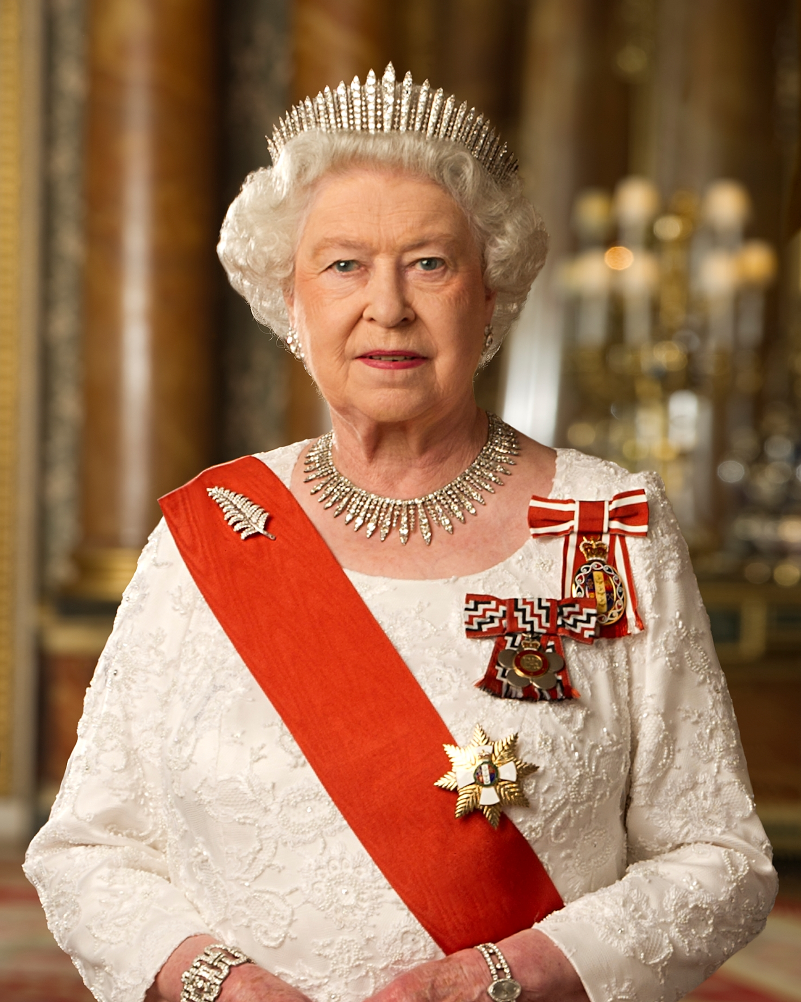

Slide 3
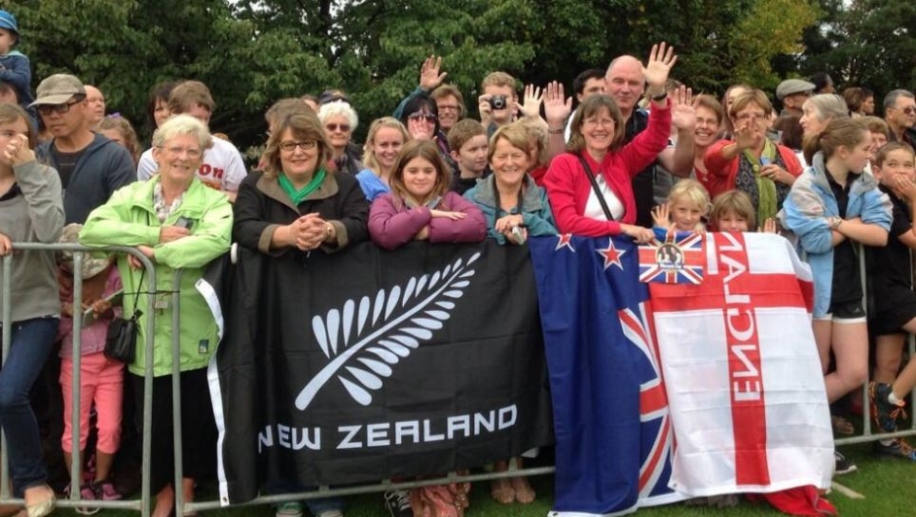

Slide 4
John 19

Slide 5
rejection

Slide 6
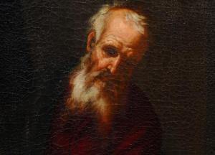

Slide 7
Root “shaphat”:
‘to determine’
‘to decide’
‘to umpire’

Slide 8
Root “shaphat”:
‘to determine’
‘to decide’
‘to umpire’
‘to save’
‘to rescue’

Slide 9
1 Samuel 8

Slide 10
Genesis 17:6, 16
“I will make you exceedingly fruitful; and I will make nations of you, and kings shall come from you”
Genesis 35:11
“God said to him: “I am God Almighty. Be fruitful and multiply; a nation and a company of nations shall proceed from you, and kings shall come from your body.”
Numbers 20:17
“Please let us pass through your country…. we will go along the King’s Highway; we will not turn aside to the right hand or to the left until we have passed through your territory.’”
Deuteronomy 17:15-20
“...you shall surely set a king over you whom the Lord your God chooses; one from among your brethren you shall set as king over you”

Slide 11
Commitment

Slide 12
goyim
from Hebrew gôy
Yiddish - someone ignorant of Jewish religion
1 Samuel 8:5
“Now make us a king to judge us - like all the nations”
1 Samuel 8:20
“that we also may be like all the nations - and that our king may judge us and go out before us and fight our battles”

Slide 13
goyim
from Hebrew gôy
Yiddish - someone ignorant of Jewish religion
1 Samuel 8:5
“Now make us a king to judge us - like all the nations”
1 Samuel 8:20
“that we also may be like all the nations - and that our king may judge us and go out before us and fight our battles”

Slide 14
goyim
from Hebrew gôy
Yiddish - someone ignorant of Jewish religion
1 Samuel 8:5
“Now make us a king to judge us - like all the nations”
1 Samuel 8:20
“that we also may be like all the nations - and that our king may judge us and go out before us and fight our battles”
“may we also be”

Slide 15
loyalty
Latin root “ligo”:
‘to bind’
“LEGAL”
“OBLIGATION”

Slide 16
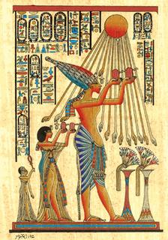
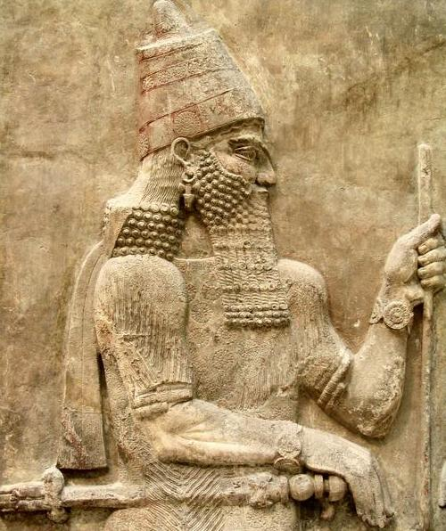
the god-king

Slide 17
Jeremiah 17:5
“Thus says the Lord:
“ Cursed is the man who trusts in man and makes flesh his strength, whose heart departs from the Lord.”

Slide 18
Jeremiah 17:5
“Thus says the Lord:
“ Cursed is the man who trusts in man and makes flesh his strength, whose heart departs from the Lord.”
“REBELS”
“REVOLTS”

Slide 19
Numbers 14

Slide 20
REJECTION

Slide 21
REJECTION
REBELLION

Slide 22
REJECTION
REBELLION
FEAR

Slide 23
REJECTION
REBELLION
FEAR
LACK OF BELIEF

Slide 24
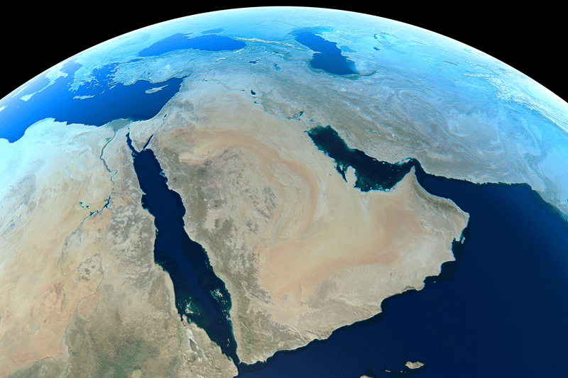
Assyria
Egypt

Slide 25
Assyria
Egypt

Slide 26
Job 28:9-11
“He puts his hand on the flint; He overturns the mountains at the roots.
He cuts out channels in the rocks, And his eye sees every precious thing.
He dams up the streams from trickling; What is hidden he brings forth to light.”

Slide 27
Assyria
Egypt

Slide 29
REJECTION
REBELLION
FEAR
LACK OF BELIEF

Slide 30
REJECTED
Mark 7:9
“All too well you reject the commandment of God, that you may keep your tradition.”
‘rejection’ - Greek ‘atheteo’
“to act as if something has been ANNULLED”
“to make VOID”

Slide 31
REJECTED
Mark 7:9
“All too well you reject the commandment of God, that you may keep your tradition.”
‘rejection’ - Greek ‘atheteo’
“to act as if something has been ANNULLED”
“to make VOID”

Slide 32
REJECTED
1 Peter 2:4
“Coming to Him as to a living stone, rejected indeed by men, but chosen by God and precious…”
Luke 10:16
“…he that despiseth you despiseth me; and he that despiseth me despiseth him that sent me.”

Slide 33
REJECTED
1 Peter 2:4
“Coming to Him as to a living stone, rejected indeed by men, but chosen by God and precious…”
Luke 10:16
“…he that despiseth you despiseth me; and he that despiseth me despiseth him that sent me.”

Slide 34
Psalm 69

Slide 35
REJECTED
Matthew 21:42
“Jesus said to them, “Have you never read in the Scriptures: ‘ The stone which the builders rejected has become the chief cornerstone. This was the LORD’s doing, And it is marvelous in our eyes’?”
‘rejected’ - Greek root - ‘dokimazo’
‘to scrutinize’
‘to inspect whether something is genuine or not’

Slide 36
REJECTED
Matthew 21:42
“Jesus said to them, “Have you never read in the Scriptures: ‘ The stone which the builders rejected has become the chief cornerstone. This was the LORD’s doing, And it is marvelous in our eyes’?”
‘rejected’ - Greek root - ‘dokimazo’
‘to scrutinize’
‘to inspect whether something is genuine or not’

Slide 37
Psalm 22

Slide 38
Job 30

Slide 39
rejection

