Slide 1
The Kingmaker
Making God in mans’ image

Slide 2
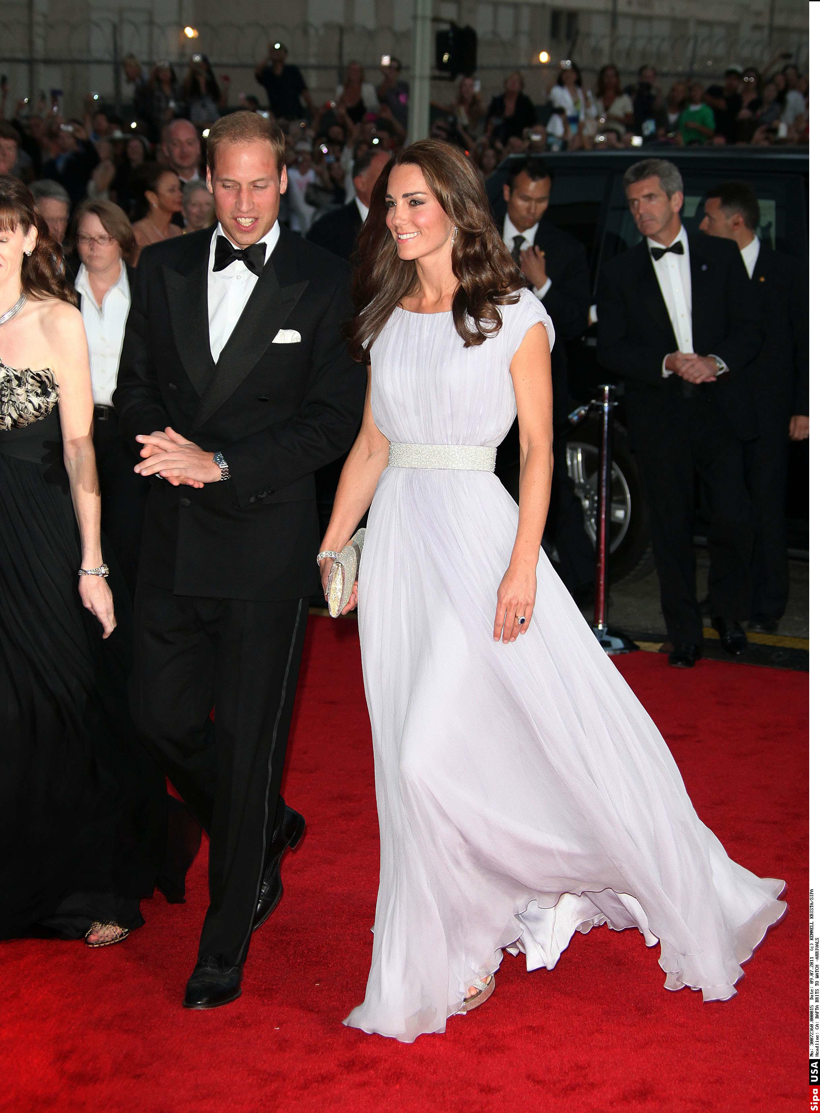

Slide 4
TIME PERIOD / REGION | KINGS AND QUEENS
Ancient Near East | 570
Hellenistic | 174
Roman and Byzantine | 289
Barbarian | 213
European | 2,139
Islamic | 596
Indian | 97
Far East | 499
African | 77
New World | 45
TOTAL | 4,699

Slide 5
France
Kingdom of Burgundy c990AD – Rudolf III The Sluggard
Dutchy of Brittany c990AD – Conan the Crooked
Holland
County of Flanders c880AD – Baldwin the Bald
County of Flanders c1070AD – Arnulf the Unfortunate
Germany
House of Habsburg c1500AD – Philip the Handsome
House of Habsburg c1505AD – Joan the Crazy

Slide 7
1 in 23,500,000

Slide 9
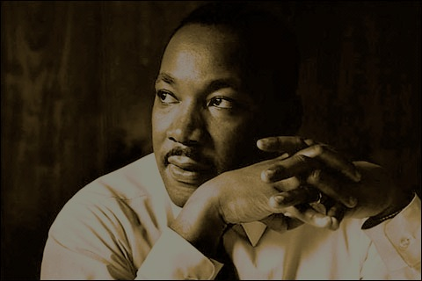
Martin Luther King Jr. “Measure of a Man”
“Although there is a widespread agreement in asking the question, there is a fantastic disagreement in answering it. There are those that believe man is little more than an animal and those who would lift man almost to the position of a god”

Slide 11
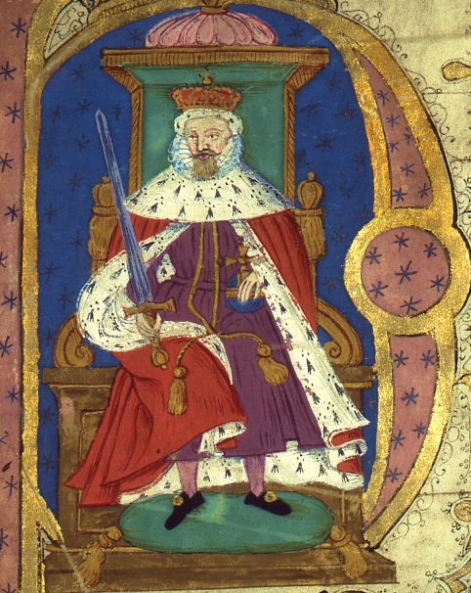
‘Highness’
One who is elevated on high
‘Majesty’
lit. “greatness, glory"
French "grandeur, nobility”
‘King’
lit. “leader of the people”

Slide 12
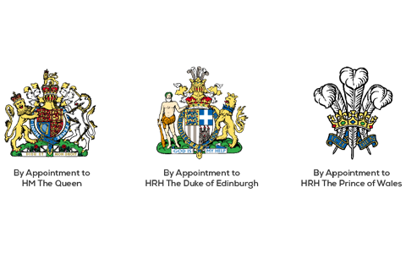

Slide 13
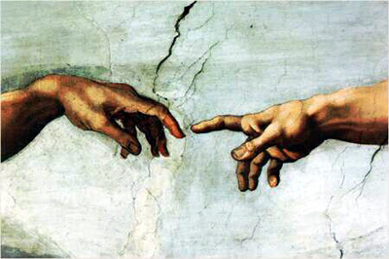
Historical Origins
MAGICAL
One possessed with a higher degree of power
DIVINE
One filled with a divine spirit

Slide 14
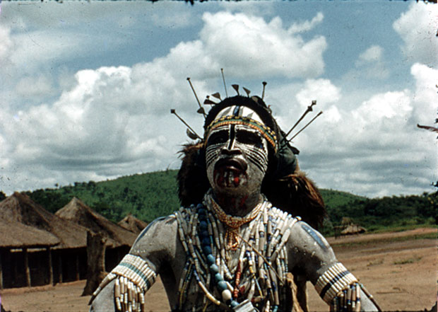
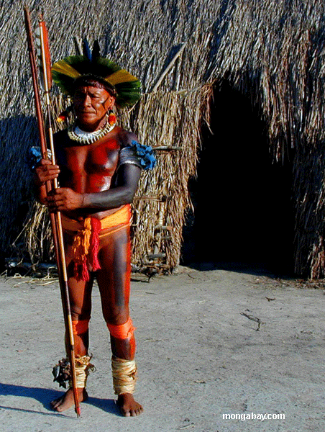
The Magician King

Slide 15
The Magician King
West Africa - the rain-man
East Africa - the medicine man
Papua New Guinea - the shaman
South America– the magician or medicine man
✔ Be the wise man and philosopher
✔ Regulate nature for the good of the community
✔ Study the secret ways of nature.

Slide 16
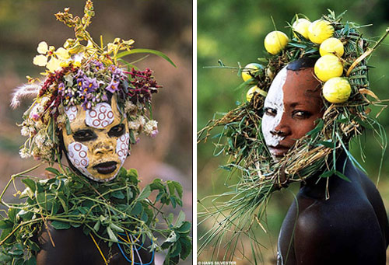
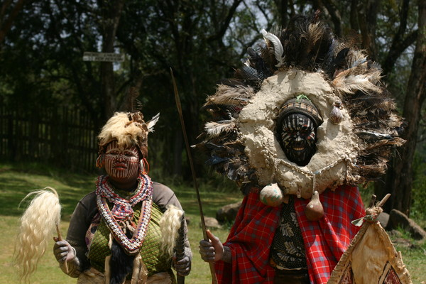
The Magician King

Slide 17
The Magician
chartom (Aramaic) – ‘magician’
ashshaph – ‘astrologer, conjurer, enchanter’
parat – ‘to chant’. Lit. ‘to scatter words’

Slide 18
The Magician
chartom (Aramaic) – ‘magician’
ashshaph – ‘astrologer, conjurer, enchanter’
parat – ‘to chant’. Lit. ‘to scatter words’
kashaph - ‘to use enchantment, magical songs,
‘to mutter incantations’:
Exodus 7:11 – Pharoah’s sorcerers
Exodus 22:18, Deuteronomy 18:10 - witch
Jeremiah 27:9, Daniel 2:2, Malachi 3:5 – gentile sorcerers

Slide 19
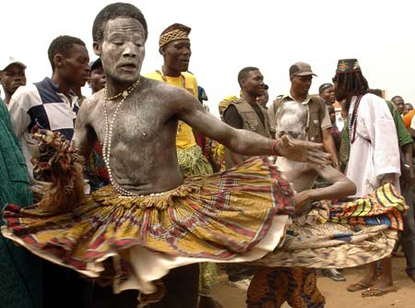
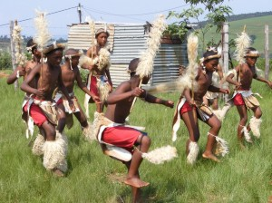
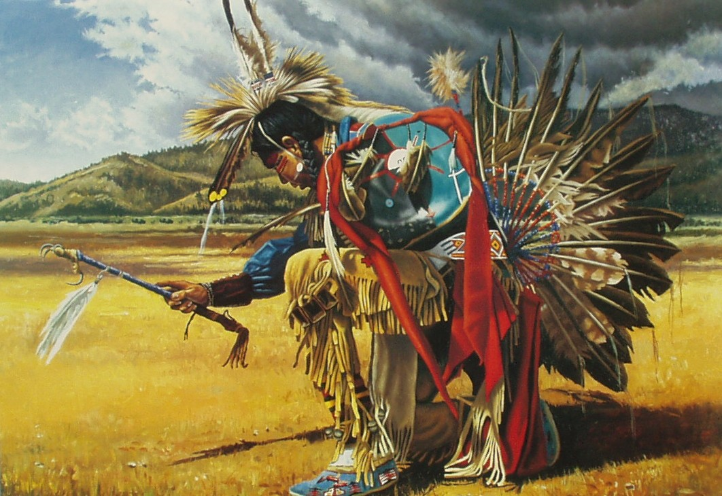
The Magician

Slide 20
The Magician
chartom (Aramaic) – ‘magician’
ashshaph – ‘astrologer, conjurer, enchanter’
parat – ‘to chant’. Lit. ‘to scatter words’
kashaph - ‘to use enchantment, magical songs,
‘to mutter incantations’:
Exodus 7:11 – Pharoah’s sorcerers
Exodus 22:18, Deuteronomy 18:10 - witch
Jeremiah 27:9, Daniel 2:2, Malachi 3:5 – gentile sorcerers
gezar – ‘soothsayer’
Lexicon - ‘cut’, ‘determine’
ie – ‘the determiner’ or ‘the decider’

Slide 21
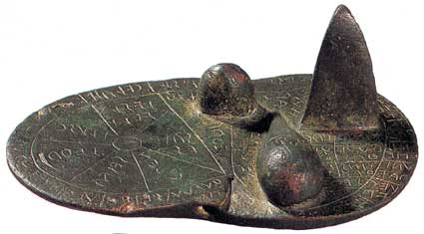
Etruscan Haruspex – c700BC

Slide 22
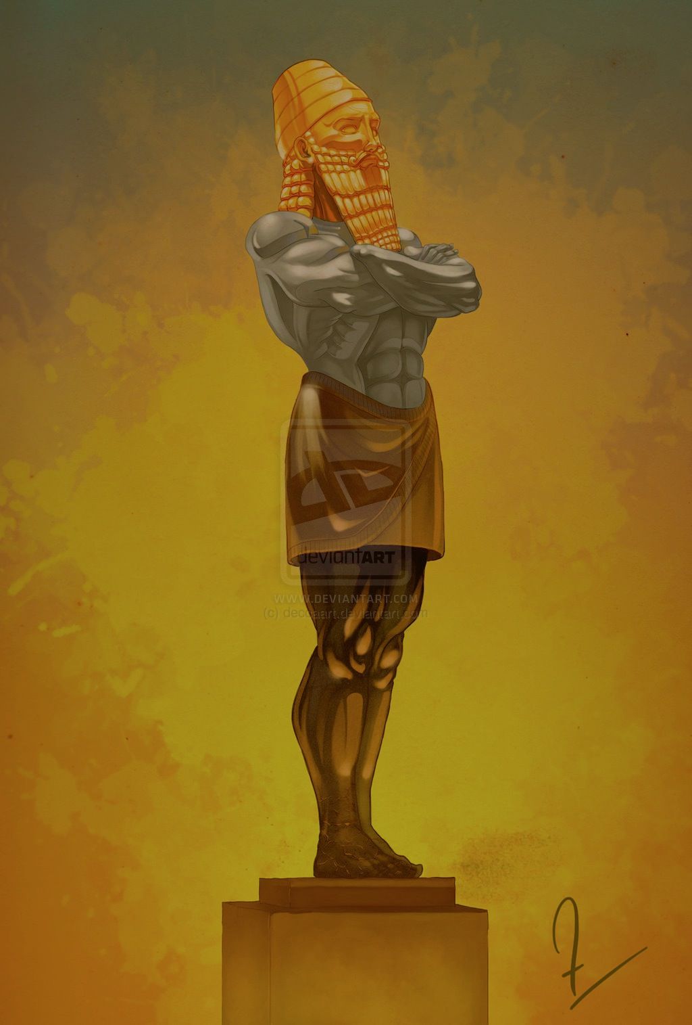
Daniel 2:31-34,45
31 “You, O king, were watching; and behold, a great image! This great image, whose splendor was excellent, stood before you; and its form was awesome.
32 This image’s head was of fine gold, its chest and arms of silver, its belly and thighs of bronze, 33 its legs of iron, its feet partly of iron and partly of clay.
34 You watched while a stone was cut out without hands, which struck the image on its feet of iron and clay, and broke them in pieces.

Slide 23
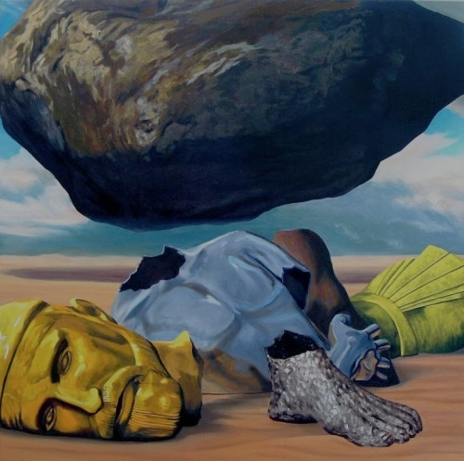
45 Inasmuch as you saw that the stone was cut out of the mountain without hands, and that it broke in pieces the iron, the bronze, the clay, the silver, and the gold—the great God has made known to the king what will come to pass after this. The dream is certain, and its interpretation is sure.”

Slide 24
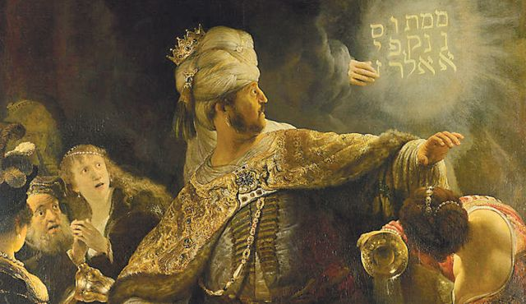
26 …God has numbered your kingdom, and finished it;
27…You have been weighed in the balances, and found wanting; 28 …Your kingdom has been divided, and given to the Medes and Persians

Slide 25
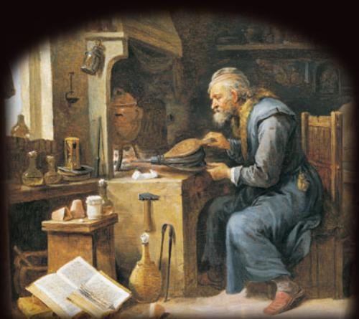
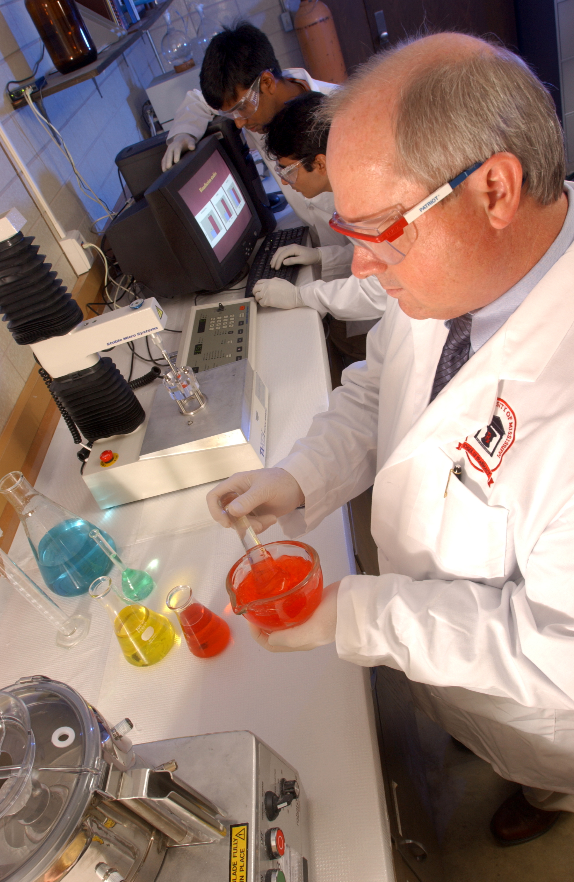
The Magician
pharmakeus – ‘Sorcerer’
Lexicon – ‘one who prepares magical remedies’

Slide 26
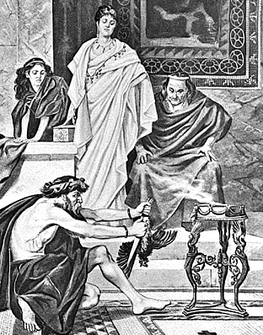
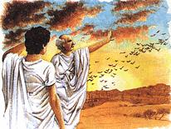
The Auspex

Slide 27
Superstitions
731 - Holy water can heal.
1000 - the wine protects you from the devil
1050 - the sign of the cross protects you
1600 - the Bible protects women and children
1700 – the wine heals whooping cough.
1800 – butter from cows that feed in the church-yard is clean of witchcraft
…. if you got sick at church
…. if a clock struck during a hymn
…. if a clock struck during a wedding

Slide 28
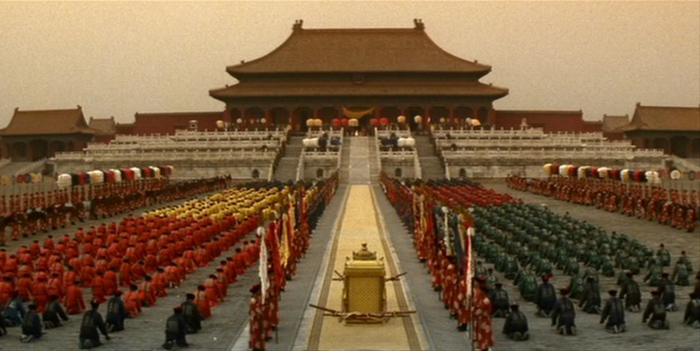
The god-king
The incarnation, or manifestation of a god
Divine powers
over the RAIN
to HEAL
over FERTILITY
The AGENT OF god
Sacred
Infallible
Worshipped as a god

Slide 29
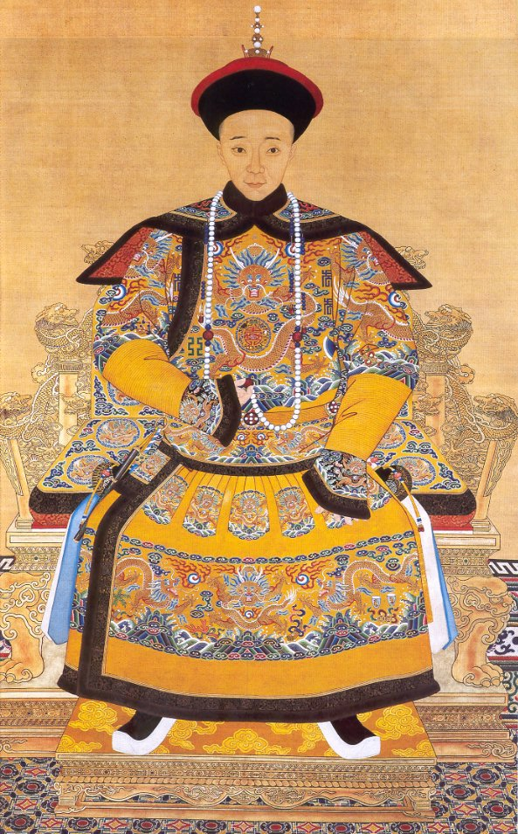
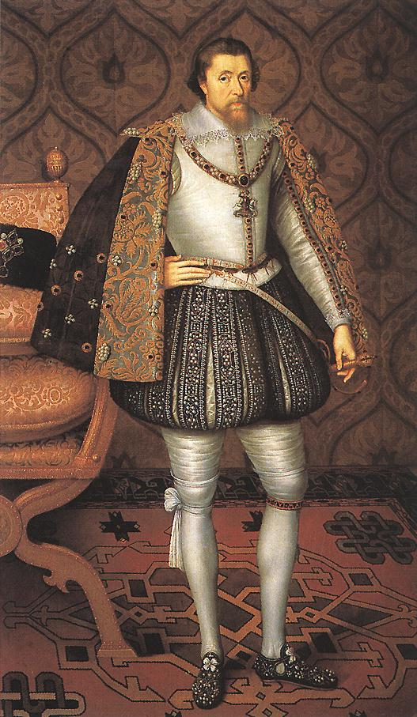
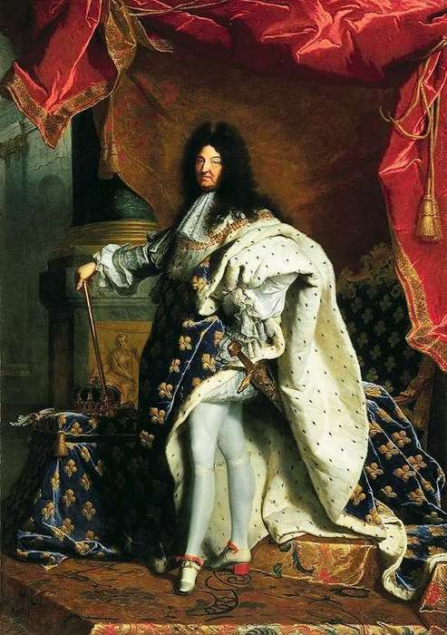
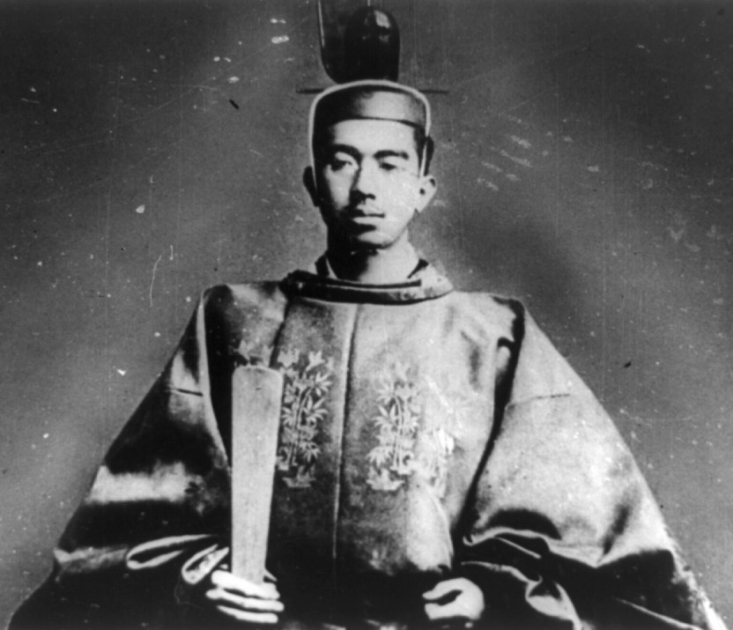
The god-king

Slide 30
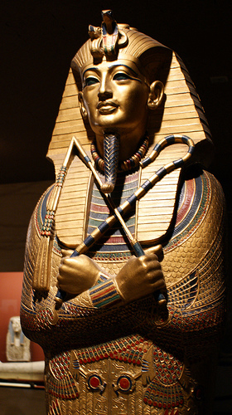
The god-king
EGYPTIAN god-king
Son of Re
God’s “living image on earth”
Carried the ankh “sign of life”
‘at one' with their human bodies
but not immortal

Slide 31
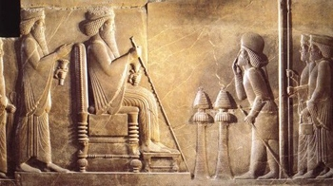
The god-king
MESOPOTAMIAN god-king
The king possessed divine powers but remained subservient to the god
A mediator position between the gods and men

Slide 32
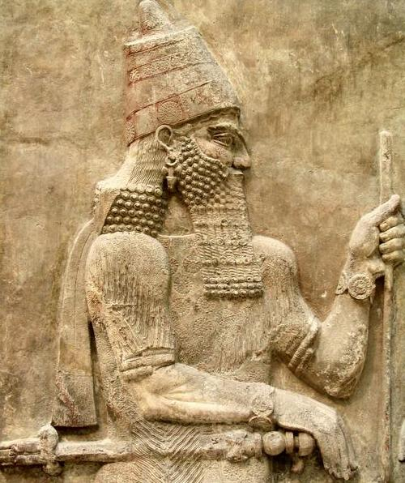
King Sargon of Akkad: 2335BC
“King of the four corners of the world”

Slide 33
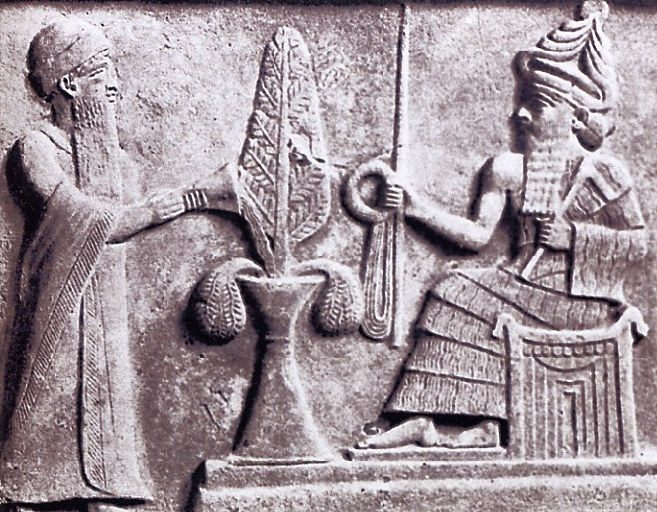
King Shulgi: 2094BC
“I the king, from the time I was in the maternal womb I was hero… I am the king of the four regions, I am a shepherd”

Slide 34
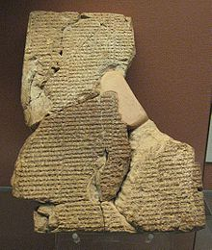
Babylon - ‘Atramchasis myth’
‘inuma ilua wilu’
“When the gods were human”

Slide 35
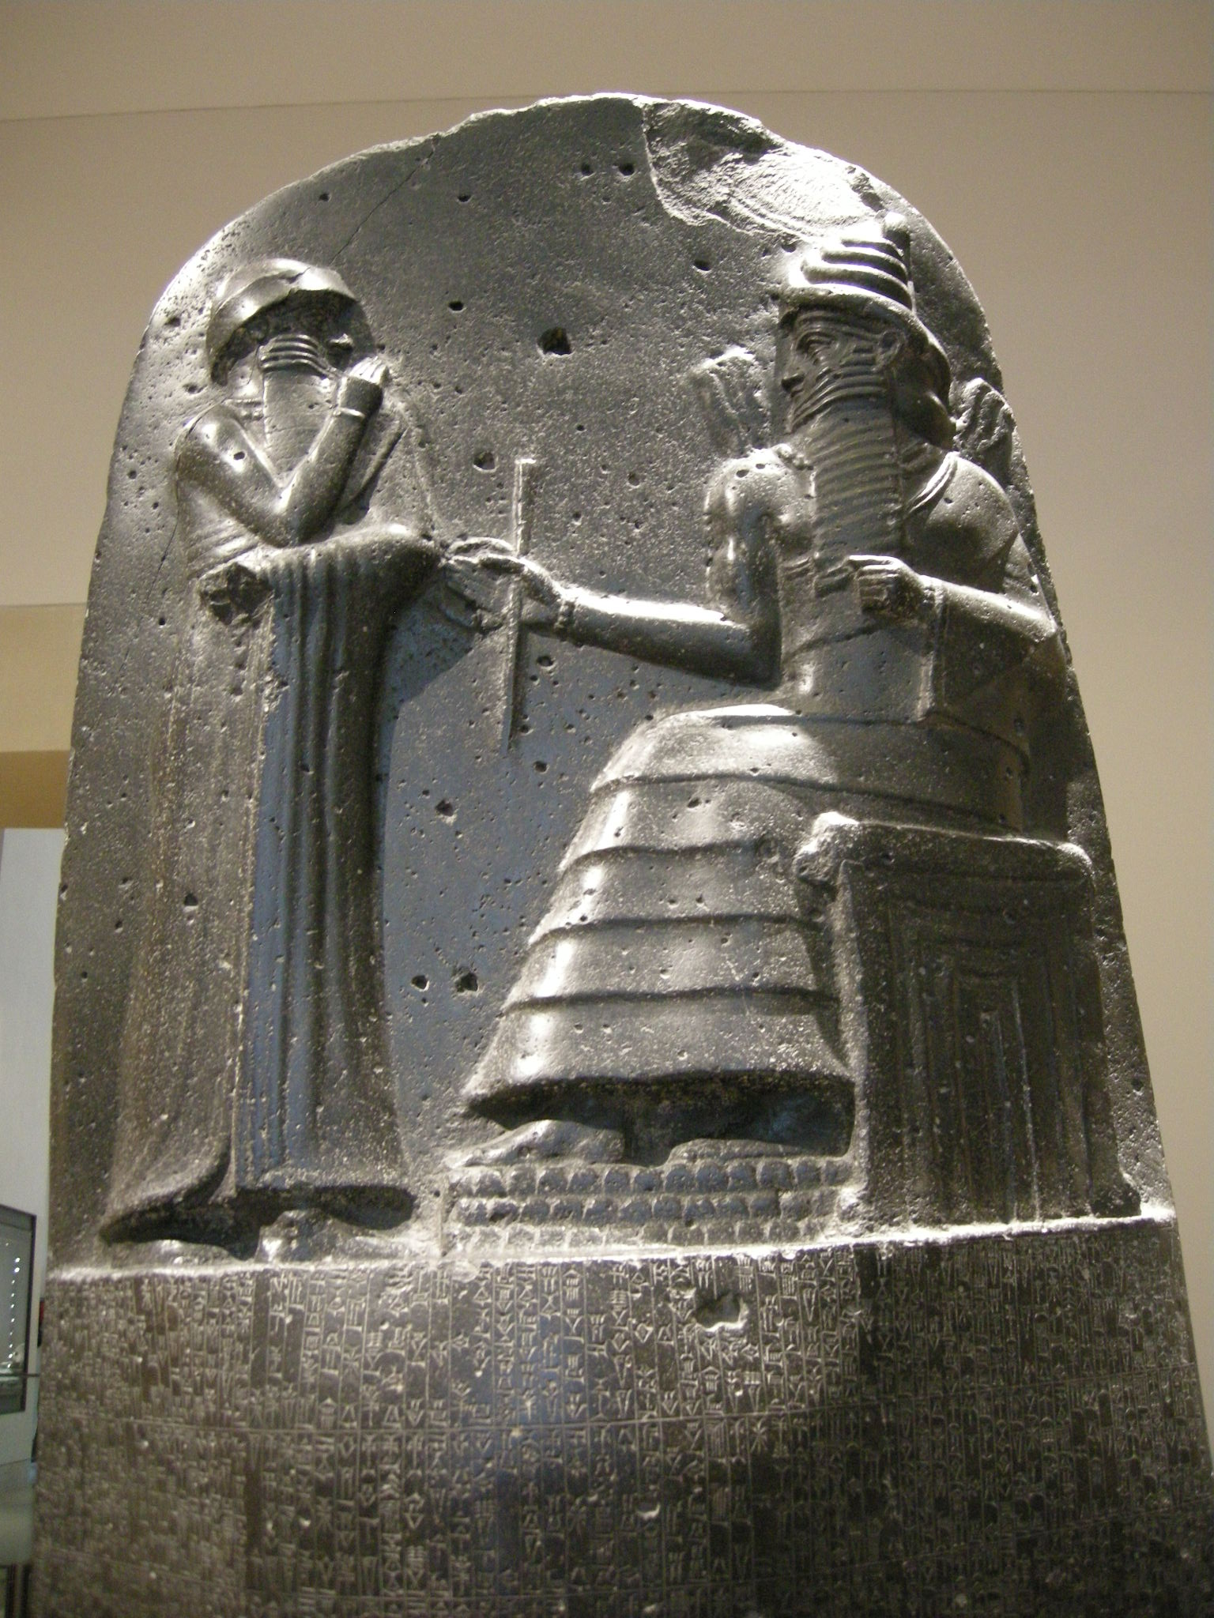
Hammurabi: 1792BC
“I am Hammurabi, the perfect king...”
“SHAMASH, the great judge of heaven and earth, from whom the king is bestowed with the right and given the task to protect and serve the weak…”

Slide 36
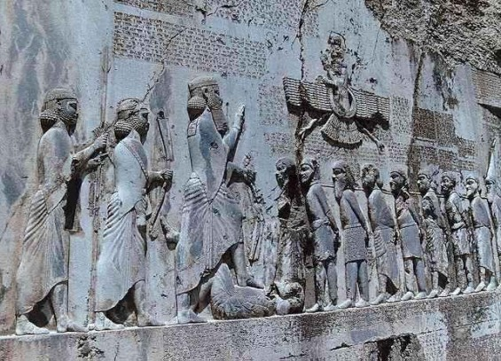
Darius: 520BC
“By the favour of Ahuramazda… I dealt with the countries which fought against each other, where people were killing each other, so that their people do not kill each other any more and I returned everyone to his place… By the favour of Ahuramazda I completed many building projects which had previously been abandoned…”

Slide 37
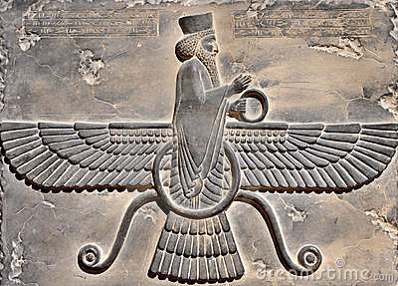
Xerxes: 480BC
“Thus was the desire of Ahuramazda that Darius, my father, was made king over this earth… And by the favour of Ahuramazda, became I king in my father’s place.”
“Me, may Ahuramazda protect, together with the gods, and my kingdom…”

Slide 39
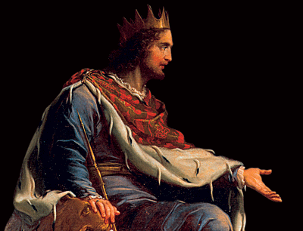
The god-king
Judge
Lawgiver
Warlord
Shepherd
Priest
Saviour over cosmic ‘chaos’

Slide 40
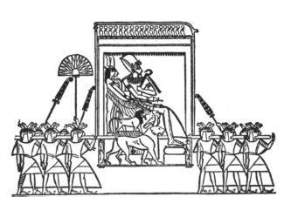
The God-King
Strict regulations to preserve purity and power
Separated from the people
Not allowed to eat or drink certain things
Could not be touched
Carried

Slide 41
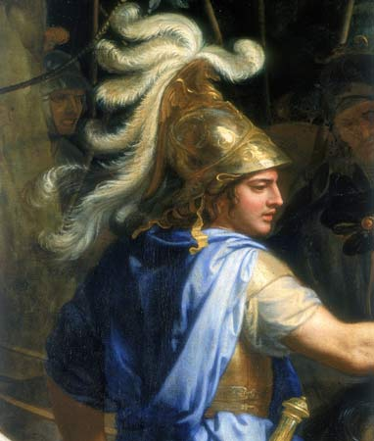
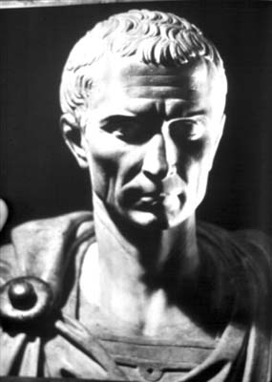
The Emperor Cult
FUSED together religious and non-religious practices within the empire
Focused all authority on the RULER
A ruler who would be:
CROWNED
WORSHIPPED as ‘divine’
‘God’s representative on earth’ - “Holy Father”

Slide 42
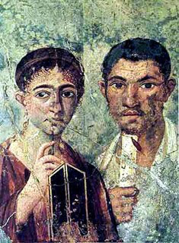
Acts 18
1 After these things Paul departed from Athens and went to Corinth. 2 And he found a certain Jew named Aquila, born in Pontus, who had recently come from Italy with his wife Priscilla (because Claudius had commanded all the Jews to depart from Rome); and he came to them…

Slide 43
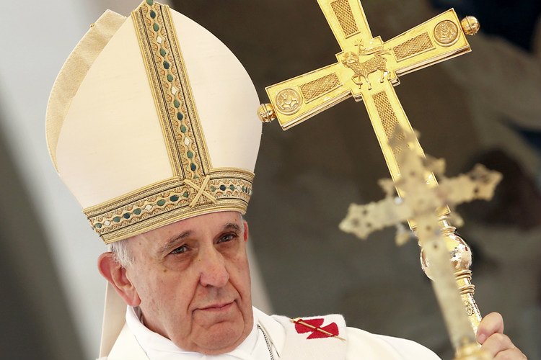
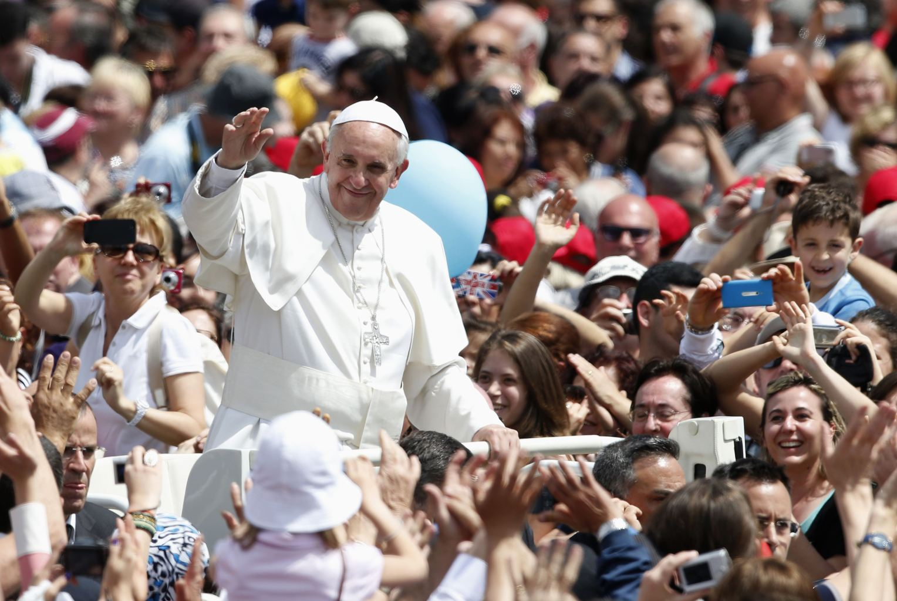
A legacy of the Emperor Cult
CROWNED
WORSHIPPED as ‘divine’
‘God’s representative on earth’ - “Holy Father”

Slide 44
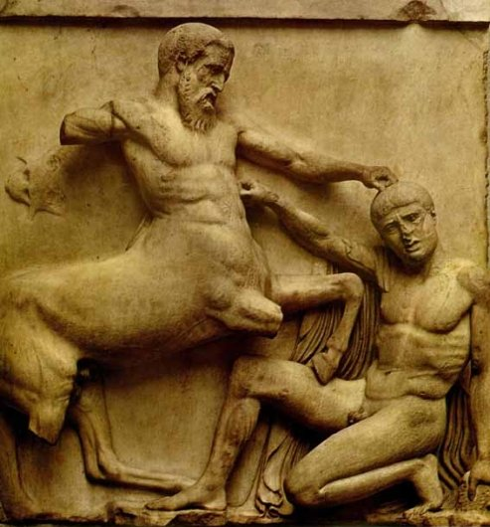
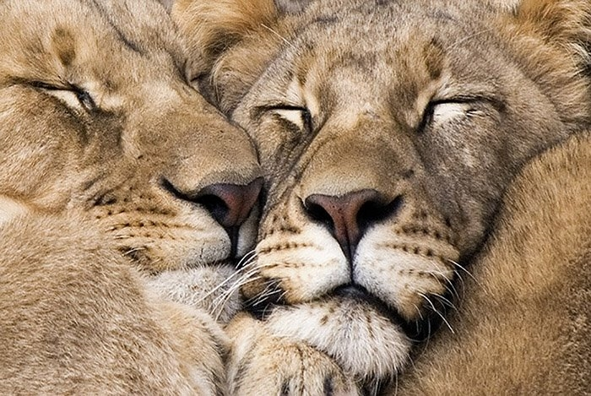
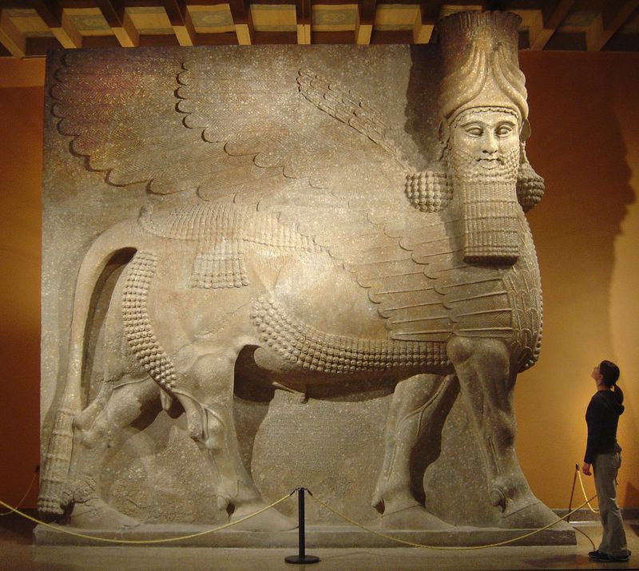
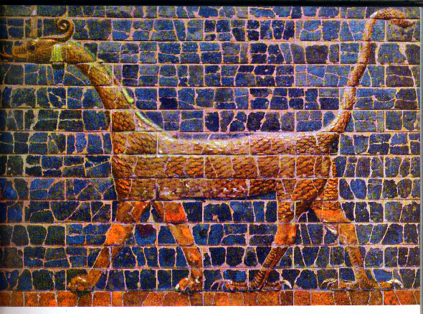

Slide 45
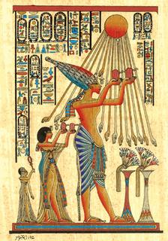
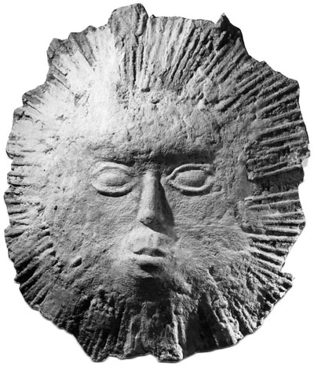
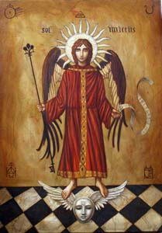
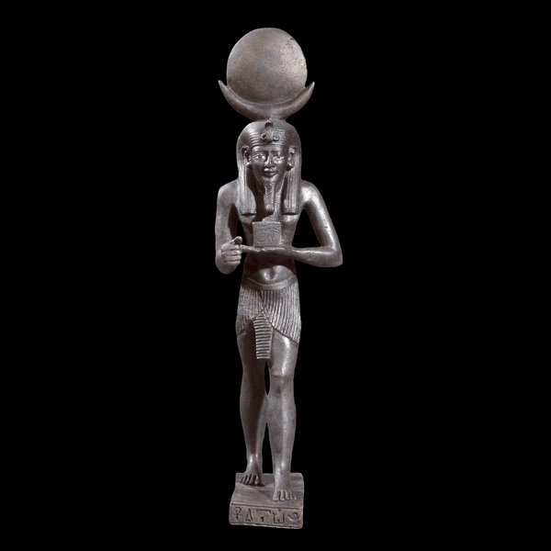
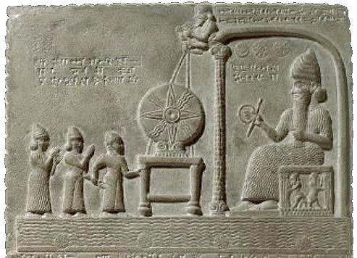
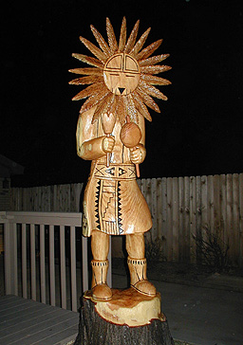

Slide 47
Acts 12:21-24
21 So on a set day Herod, arrayed in royal apparel, sat on his throne and gave an oration to them.
22 And the people kept shouting, “The voice of a god and not of a man!”
23 And immediately an angel of the Lord struck him, because he did not give glory to God. And he was eaten by worms and died.
24 But the word of God grew and multiplied.

Slide 48
Acts 12:21-24
21 So on a set day Herod, arrayed in royal apparel, sat on his throne and gave an oration to them.
22 And the people kept shouting, “The voice of a god and not of a man!”
23 And immediately an angel of the Lord struck him, because he did not give glory to God. And he was eaten by worms and died.
24 But the word of God grew and multiplied.

Slide 49
Acts 12:21-24
21 So on a set day Herod, arrayed in royal apparel, sat on his throne and gave an oration to them.
22 And the people kept shouting, “The voice of a god and not of a man!”
23 And immediately an angel of the Lord struck him, because he did not give glory to God. And he was eaten by worms and died.
24 But the word of God grew and multiplied !

