Slide 1
The Kingmaker The journey of a priest

Slide 2
rejection

Slide 3
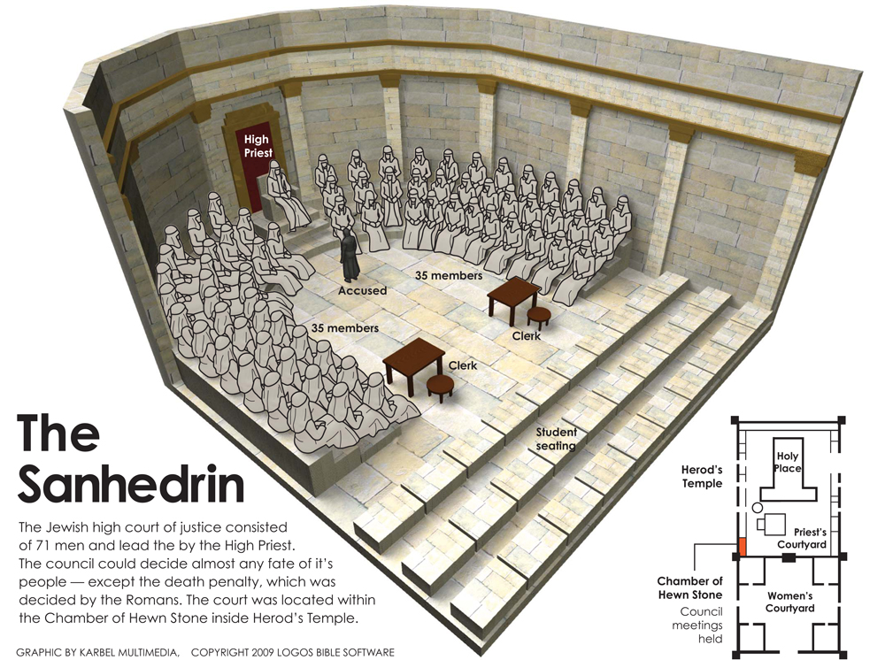

Slide 4
Numbers 11

Slide 5
Luke 12:48
“…For everyone to whom much is given, from him much will be required; and to whom much has been committed, of him they will ask the more.”

Slide 6
Luke 12:48
“committed”
“…For everyone to whom much is given, from him much will be required; and to whom much has been committed, of him they will ask the more.”
“deposited” / “entrusted”
“superabundant” / “super-added”

Slide 7
Numbers 11

Slide 8
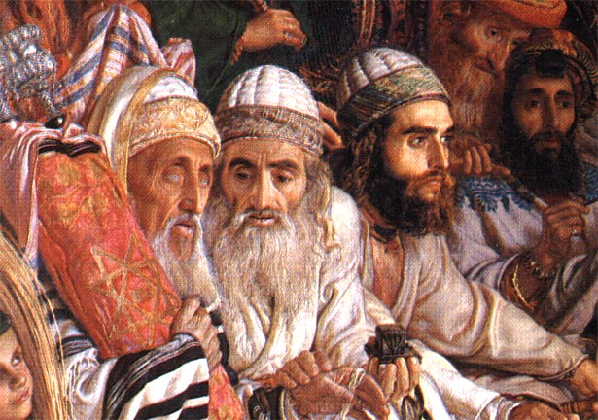
70 elders

Slide 9
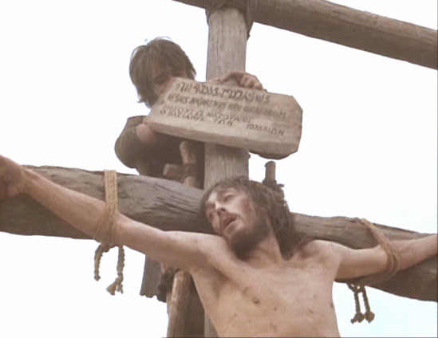
“This is the King of the Jews”

Slide 10
rejection

Slide 11
acceptance

Slide 12
1 Samuel 7:15-17
15 And Samuel judged Israel all the days of his life.
16 He went from year to year on a circuit to Bethel, Gilgal, and Mizpah, and judged Israel in all those places.
17 But he always returned to Ramah, for his home was there. There he judged Israel, and there he built an altar to the LORD.

Slide 13
Bethel
Mizpeh
Gilgal
Ramah
Notes:
Samuel

Slide 14
1 Samuel 12:1-3
1 Now Samuel said to all Israel: “Indeed I have heeded your voice in all that you said to me, and have made a king over you. 2 And now here is the king, walking before you; and I am old and grayheaded, and look, my sons are with you. I have walked before you from my childhood to this day. 3 Here I am….

Slide 15
Bethel
Ramah
Gilgal
Jericho
Mizpeh
Jerusalem

Slide 16
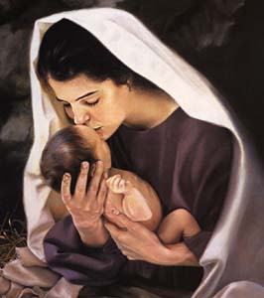

Slide 17
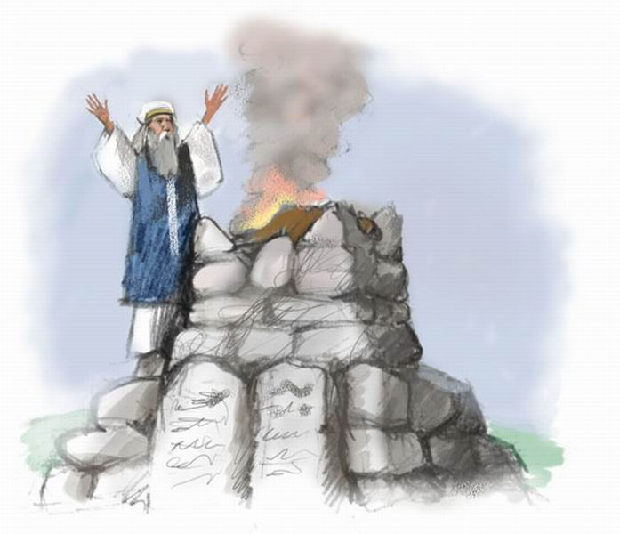

Slide 18
Bethel
Ramah
Gilgal
Jericho
Mizpeh
Jerusalem

Slide 19
Bethel
Ramah
Gilgal
Jericho
Mizpeh
Jerusalem

Slide 20
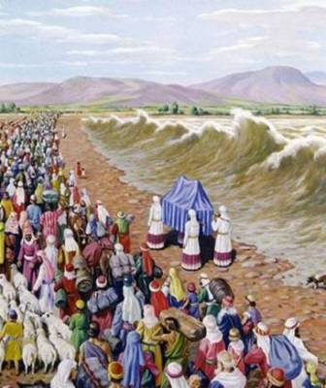

Slide 21
Bethel
Ramah
Gilgal
Jericho
Mizpeh
Jerusalem

Slide 22
Mizpeh
1 Samuel 7:5-6
5 And Samuel said, “Gather all Israel to Mizpah, and I will pray to the LORD for you.” 6 So they gathered together at Mizpah, drew water, and poured it out before the LORD. And they fasted that day, and said there, “We have sinned against the LORD.” And Samuel judged the children of Israel at Mizpah.

Slide 23
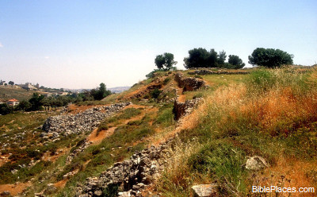

Slide 24
Bethel
Ramah
Gilgal
Jericho
Mizpeh
Jerusalem

Slide 25
ALTITUDE
Elevation
Sea level

Slide 26
GOD
Spiritual
Elevation
MAN
Sea level

Slide 27
Bethel
Gilgal
Mizpeh
Ramah
ACCEPT !

Slide 28
1 Samuel 10

Slide 29
Anointed by Samuel
2 messengers with good news

Slide 30
Anointed by Samuel
2 messengers with good news
3 men bearing gifts and offerings

Slide 31
Anointed by Samuel
2 messengers with good news
3 men bearing gifts and offerings
Sons of the prophets

Slide 32
Anointed by Samuel
2 messengers with good news
3 men bearing gifts and offerings
Sons of the prophets
Wait 7 days

Slide 33
Anointed by Samuel
2 messengers with good news
3 men bearing gifts and offerings
Sons of the prophets
Wait 7 days
Proclaimed King

Slide 34
Progression
Samuel
Two men
Three men
Sons of the Prophets
ISRAEL

Slide 35
Progression
Anointed

Slide 36
Progression
Glad Tidings

Slide 37
Progression
Gifts and Offerings

Slide 38
Progression
Fellowship Instruction Spirit Gifts

Slide 39
Progression
Anointed
Glad Tidings
Gifts and Offerings
Fellowship Instruction Spirit Gifts
KINGSHIP

Slide 40
Progression
Turn your life over to God

Slide 41
Progression
Have faith.
Put your trust in God

Slide 42
Progression
Your life as a personal offering to Lord

Slide 43
Progression
Praise Fellowship Instruction

Slide 44
Progression
Turn your life over to God
Have faith. Put your trust in God
Your life as a personal offering to Lord
Praise Fellowship Instruction
LEADERSHIP

Slide 45
Saul’s journey
KING
Turn your life over to God
Have Faith.
Trust the Lord
Personal Sacrifice and Offering
Praise, Fellowship, Instruction

Slide 46
Ramah
Saul’s journey

Slide 47
Ramah
Zelzah
Saul’s journey

Slide 48
Bethel
Ramah
Zelzah
Saul’s journey

Slide 49
Bethel
Ramah
Zelzah
Gibeah
Saul’s journey

Slide 50
Bethel
Gilgal
Ramah
Zelzah
Gibeah
Saul’s journey

Slide 51
Bethel
Gilgal
Mizpeh
Ramah
Zelzah
Gibeah
Saul’s journey

Slide 52
Bethel
Gilgal
Mizpeh
Ramah
Zelzah
Gibeah
Saul’s journey

Slide 53
Bethel
Gilgal
Mizpeh
Ramah
Samuel’s journey

Slide 54
Bethel
Gilgal
Mizpeh
Ramah
Zelzah
Gibeah
Saul’s journey

Slide 55
Bethel
Gilgal
Mizpeh
Ramah
Zelzah
Gibeah
Saul’s journey

Slide 56
Judges 19

Slide 57
Saul’s journey
PRIEST
Turn your life over to God
Have Faith.
Trust the Lord
Personal Sacrifice and Offering
Praise, Fellowship, Instruction

Slide 58
The king who couldn’t see God
1 Samuel 17:11
11 When Saul and all Israel heard these words of the Philistine, they were dismayed and greatly afraid.
1 Samuel 18:12, 29
12 Saul was afraid of David, because the LORD was with him, but had departed from Saul.
29 and Saul was still more afraid of David. So Saul became David’s enemy continually.
1 Samuel 28:5
5 When Saul saw the army of the Philistines, he was afraid, and his heart trembled greatly.
1 Samuel 28:20 Immediately Saul fell full length on the ground, and was dreadfully afraid because of the words of Samuel. And there was no strength in him…

Slide 59
The king who could
Acts 2:25 -26
25 For David says concerning Him:
‘I foresaw the LORD always before my face, For He is at my right hand, that I may not be shaken.
26 Therefore my heart rejoiced, and my tongue was glad; Moreover my flesh also will rest in hope.

