Slide 1
The Kingmaker Ruling in the fear of God

Slide 3
The average American’s statistical likelihood that you will become…
A BILLIONARE ?
A Governor ?
A Senator ?
President ?

Slide 4
The average American’s statistical likelihood that you will become…
A BILLIONARE ?
A Governor ?
A Senator ?
President ?
1 in 260,000
1 in 300,000
1 in 400,000
1 in 18,700,000

Slide 5
The statistical likelihood if your FATHER was …
A BILLIONARE ?
A Governor ?
A Senator ?
President ?
1 in 260,000
1 in 300,000
1 in 400,000
1 in 18,700,000
1 in 9
1 in 51
1 in 47
1 in 13

Slide 6
John Dalberg-Acton
POWER CORRUPTS.
ABSOLUTE POWER CORRUPTS ABSOLUTELY.

Slide 7
The king’s dilemma
Without power a King is IMPOTENT
With all the power a King becomes a TYRANT

Slide 8
The Authorized Version c1600
To the most high and mighty prince, James, by the Grace of God, King of Great Britain…
Great and manifold were the blessings, most dread Sovereign, which Almighty God, the Father of all mercies, bestowed upon us the people of England, when first he sent Your Majesty's Royal Person to rule and reign over us. … the appearance of Your Majesty, as of the Sun in his strength… gave unto all that were well affected exceeding cause of comfort; especially when we beheld the Government established in Your Highness and Your hopeful Seed.… Your very name is precious among (the people): their eye doth behold You with comfort, and they bless You in their hearts, as that sanctified Person, who, under God, is the immediate author of their true happiness…

Slide 9
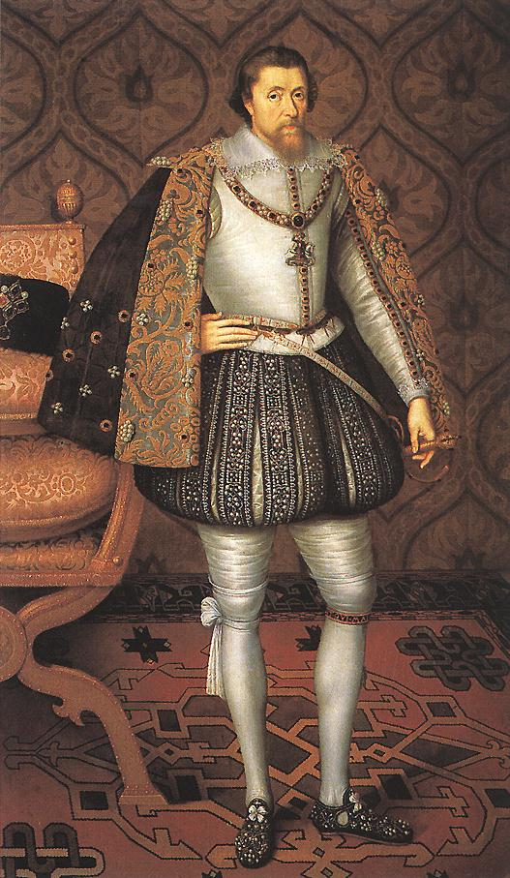
1614 to 1621
Allowed no Parliamentary Session
Ignored Bills
Tore up Bills

Slide 10
“James I was cunning, covetous, wasteful, idle, drunken, greedy, dirty, cowardly, a great swearer, and the most conceited man on earth”
Charles Dickens

Slide 11
‘to govern’
‘Reign’ from Latin ‘regere’ = “to GOVERN”
‘Govern’ - from French ‘gouverner’
- from Latin ‘gubernare’
- from Greek ‘kubernan’
- “TO STEER” (influence)
The King STEERS the nation.

Slide 12
Judges 5

Slide 13
Judges 5
V2 …when the people willingly offered themselves.
NIV - “When the princes in Israel take the lead”
NKJV - “When leaders lead in Israel”
NKJV margin - “when locks are loosed”
IE - “When leaders lead in Israel, locks are loosed, and the people willingly offer themselves”

Slide 14
Judges 5
V2 …when the people willingly offered themselves.
NIV - “When the princes in Israel take the lead”
NKJV - “When leaders lead in Israel”
NKJV margin - “when locks are loosed”
IE - “When leaders lead in Israel, locks are loosed, and the people willingly offer themselves”

Slide 15
Nehemiah 7:1-2
1 Then it was, when the wall was built and I had hung the doors, when the gatekeepers, the singers, and the Levites had been appointed, 2 that I gave the charge of Jerusalem to my brother Hanani, and Hananiah the leader of the citadel, for he was a faithful man and feared God more than many.

Slide 16
Nehemiah 7:1-2
1 Then it was, when the wall was built and I had hung the doors, when the gatekeepers, the singers, and the Levites had been appointed, 2 that I gave the charge of Jerusalem to my brother Hanani, and Hananiah the leader of the citadel, for he was a faithful man and feared God more than many.
FAITH
FEAR OF GOD

Slide 17
to judge
Hebrew - ‘Mashal’
‘to rule’, ‘to judge’
‘TO ASSIMILATE’ - “to MAKE LIKE”
Genesis 45:7-8
7 And God sent me before you to preserve a posterity for you in the earth, and to save your lives by a great deliverance.
8 So now it was not you who sent me here, but God; and He has made me a father to Pharaoh, and lord of all his house, and a ruler throughout all the land of Egypt.

Slide 18
“The process of INFLUENCE in which one person can enlist the aid and support of others in the accomplishment of a common task”

Slide 19
“Creating a way for people to contribute to making something extraordinary happen”

Slide 20
“Encouraging dialogue, establishing processes and articulating values and visions clearly. Setting agendas, identifying problems, and initiating change”

Slide 21
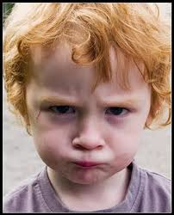
“I hate him - because he never prophesies anything good about me”

Slide 22
Deuteronomy 17

Slide 23
Proverbs for Kings
Proverbs 25 - How to handle ISSUES
Proverbs 26 - How to discern CHARACTER
Proverbs 27 - How to handle RELATIONSHIPS
Proverbs 28 - How to show INTEGRITY
Proverbs 29 - How to govern with WISDOM

Slide 24
Proverbs for Kings
Lead based on scriptural principles and truths.
Resolve issues and problems with wisdom, understanding, and kindness.
Be able to identify different people and personalities - and learn to work with them.

Slide 25
Proverbs for Kings
Lead based on scriptural principles and truths.
Resolve issues and problems with wisdom, understanding, and kindness.
Be able to identify different people and personalities - and learn to work with them.

Slide 26
Proverbs for Kings
Lead based on scriptural principles and truths.
Resolve issues and problems with wisdom, understanding, and kindness.
Be able to identify different people and personalities - and learn to work with them.

Slide 27
Proverbs for Kings
Lead based on scriptural principles and truths.
Resolve issues and problems with wisdom, understanding, and kindness.
Be able to identify different people and personalities - and learn to work with them.
TRUTH
MERCY

Slide 28
Proverbs for Kings
Lead based on scriptural principles and truths.
Resolve issues and problems with wisdom, understanding, and kindness.
Be able to identify different people and personalities - and learn to work with them.
ASSIMILATE

Slide 29
1 Samuel 22

Slide 30
500BC – Confucius
Leadership is a matter of FIVE principles:
1) intelligence
2) trustworthiness
3) humaneness
4) courage
5) discipline

Slide 31
BALANCE
intelligence alone - results in rebelliousness.
humaneness alone - results in weakness
trust alone - results in folly.
courage alone - results in violence.
discipline alone - results in cruelty.

Slide 32
BALANCE
“When one has all five virtues together, each appropriate to its function, then one can be a leader.” Confucius

Slide 33
Intelligence
Courage
Humaneness
Trustworthiness
Discipline

Slide 34
to rule
New Testament
‘Arkho’ – to rule, to be chief, to be first
‘Brabeuo’ – to rule, UMPIRE, decide, to determine
‘Hegeomai’ – to rule, be a leader, have authority
‘Proistemi’ – to set over, preside over, superintend.

Slide 35
John 21:15-17
15 Jesus said to Simon Peter, “Simon, son of Jonah, do you love Me more than these?” He said to Him, “Yes, Lord; You know that I love You.” He said to him, “Feed My lambs.”
bosco = FEED
16 He said to him again a second time, “Simon, son of Jonah, do you love Me?” He said to Him, “Yes, Lord; You know that I love You.” He said to him, “Tend (AV - Feed) my sheep.”
poimaino = RULE / NOURISH
17 He said to him the third time, “Simon, son of Jonah, do you love Me?” Peter was grieved because He said to him the third time, “Do you love Me?” And he said to Him, “Lord, You know all things; You know that I love You.”
Jesus said to him, “Feed My sheep.
bosco = FEED

Slide 36
John 21:15-17
15 Jesus said to Simon Peter, “Simon, son of Jonah, do you love Me more than these?” He said to Him, “Yes, Lord; You know that I love You.” He said to him, “Feed My lambs.”
bosco = FEED
16 He said to him again a second time, “Simon, son of Jonah, do you love Me?” He said to Him, “Yes, Lord; You know that I love You.” He said to him, “Tend (AV - Feed) my sheep.”
poimaino = RULE / NOURISH
17 He said to him the third time, “Simon, son of Jonah, do you love Me?” Peter was grieved because He said to him the third time, “Do you love Me?” And he said to Him, “Lord, You know all things; You know that I love You.”
Jesus said to him, “Feed My sheep.
bosco = FEED

Slide 37
to rule
‘Poimaino’
‘to rule’, ‘to govern’
‘to tend’, ‘to keep’, ‘to NOURISH’
1 Peter 5:2
2 Feed the flock of God, taking the oversight not by constraint but willingly, not for filthy lucre, but of a ready mind
Acts 20:28
28 Therefore take heed to yourselves and to all the flock, among which the Holy Spirit has made you overseers, to shepherd the church of God which He purchased with His own blood.

Slide 38
to nourish
Latin ‘nutrir’
‘to feed and cherish’
Revelation 7:15-17
15 Therefore they are before the throne of God, and serve Him day and night in His temple. And He who sits on the throne will dwell among them.
16 They shall neither hunger anymore nor thirst anymore; the sun shall not strike them, nor any heat;
17 for the Lamb who is in the midst of the throne will shepherd them and lead them to living fountains of waters. And God will wipe away every tear from their eyes.”

Slide 39
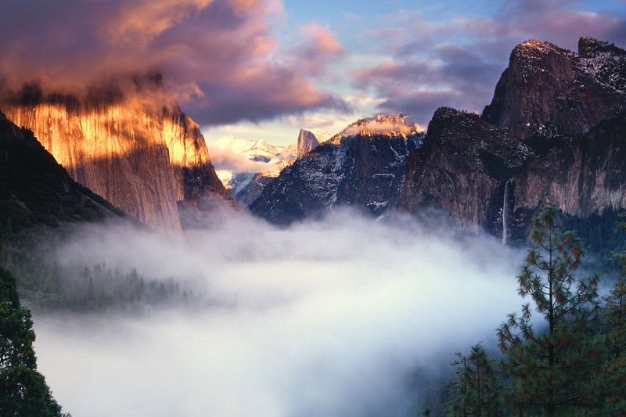
leaders, rulers, chiefs
Hebrew ‘nasi’
- ‘leader’, ‘ruler’, ‘chief’
- ‘one who is lifted up’
- Lexicon – ‘a rising mist’, ‘a rising vapour’

Slide 40
Scriptural guidance for leadership
Assimilate to the people
Steer and influence them towards God
Be a source of nourishment
Practice righteousness
Be a servant

Slide 41
Our journey
PRIEST
Turn your life over to God
Have Faith.
Trust the Lord
Personal Sacrifice and Offering
Praise, Fellowship, Instruction

Slide 42
2 Samuel 23:1-4
1 Now these are the last words of David…
3 The God of Israel said, The Rock of Israel spoke to me: ‘He who rules over men must be just, ruling in the fear of God.
4 And he shall be like the light of the morning when the sun rises, a morning without clouds, Like the tender grass springing out of the earth, a clear shining after rain.’

