Slide 1
The Kingmaker “A scepter shall rise out of Israel”

Slide 2
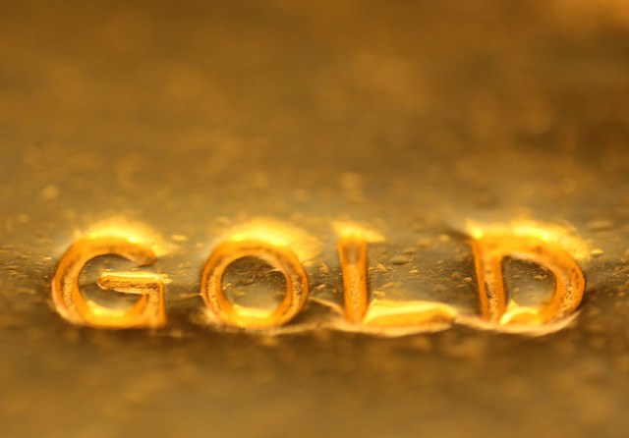

Slide 4
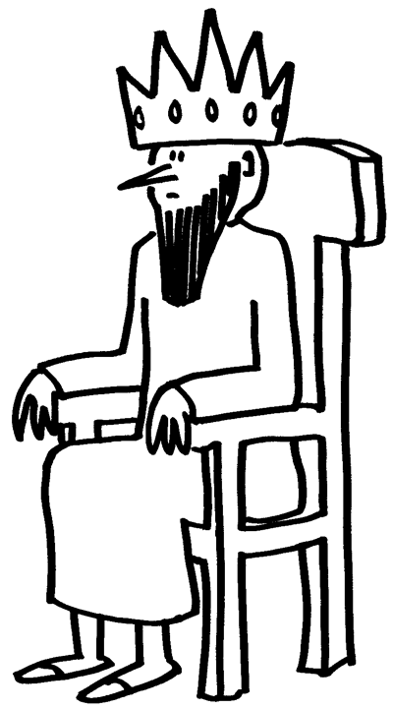

Slide 5
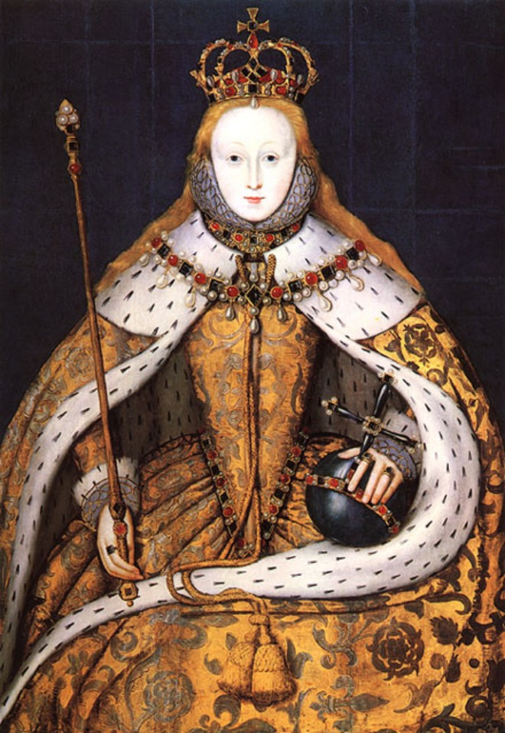
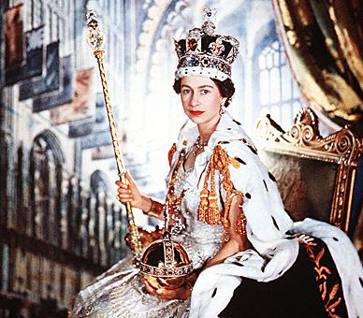

Slide 6
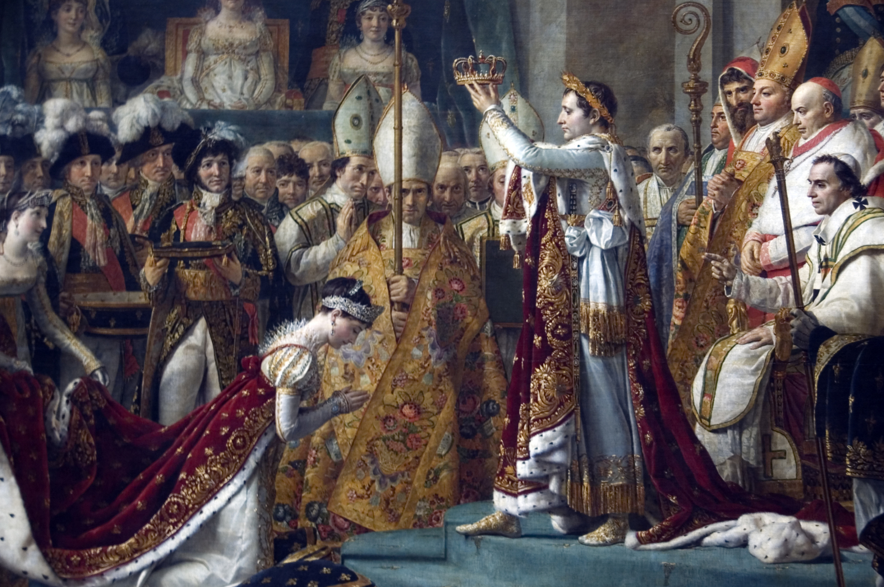

Slide 7
Symbols of Kingship
SCEPTER
History
Scripture
Our King
CROWN
History
Scripture
Our King
THRONE
History
Scripture
Our King

Slide 8
Symbols of Kingship
SCEPTER
History
Scripture
Our King
CROWN
History
Scripture
Our King
THRONE
History
Scripture
Our King

Slide 9
Symbols of Kingship
SCEPTER
History
Scripture
Our King
CROWN
History
Scripture
Our King
THRONE
History
Scripture
Our King

Slide 10
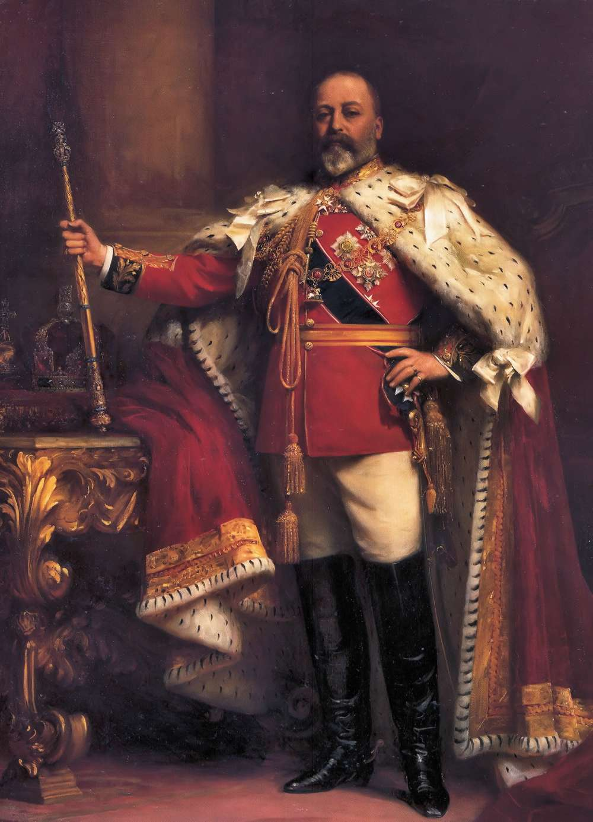

Slide 11
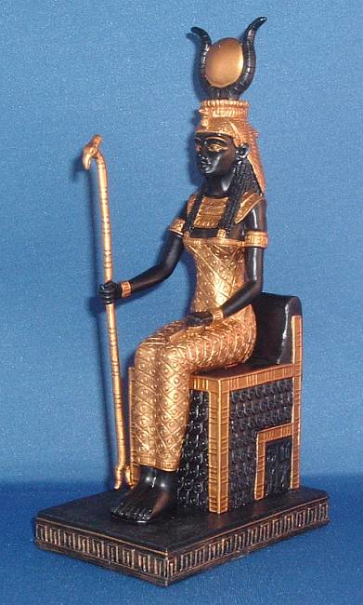
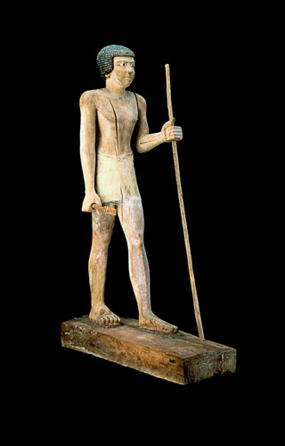
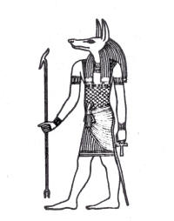
Scepter
Egypt
Symbolized the divine power, authority and control of the King.

Slide 12
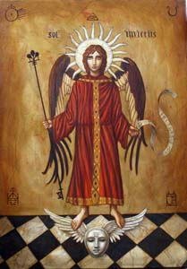
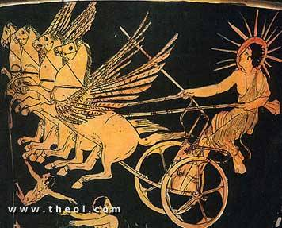
Scepter
Greece
‘skeptron’ – a staff (lit.) ‘to lean upon’
Rome
‘sceptrum’. Symbolized the emperor’s power bestowed by the gods.

Slide 13
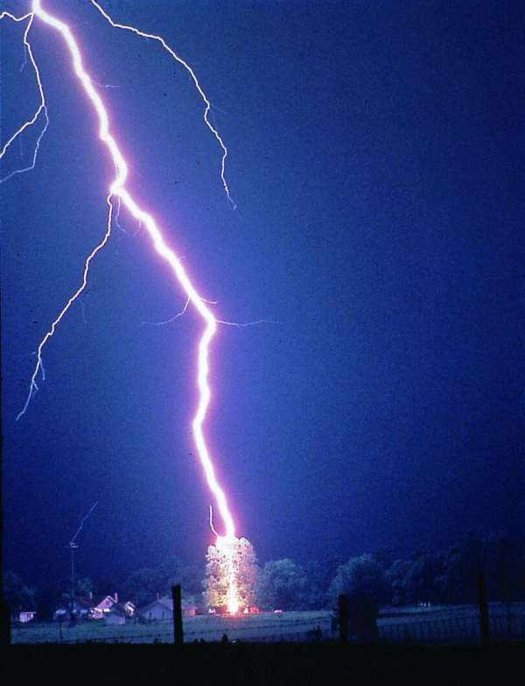
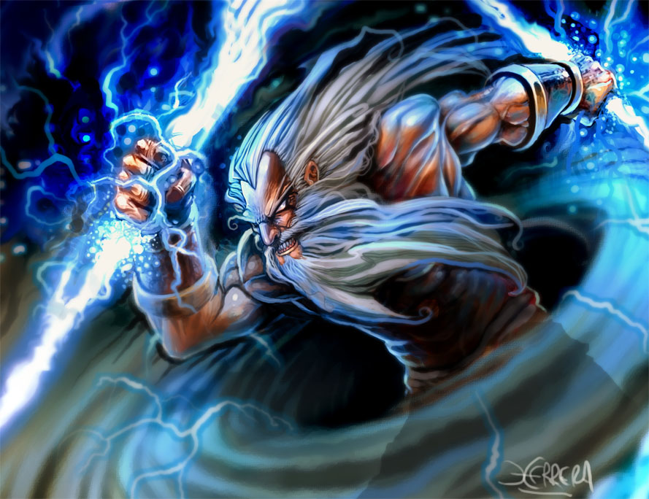
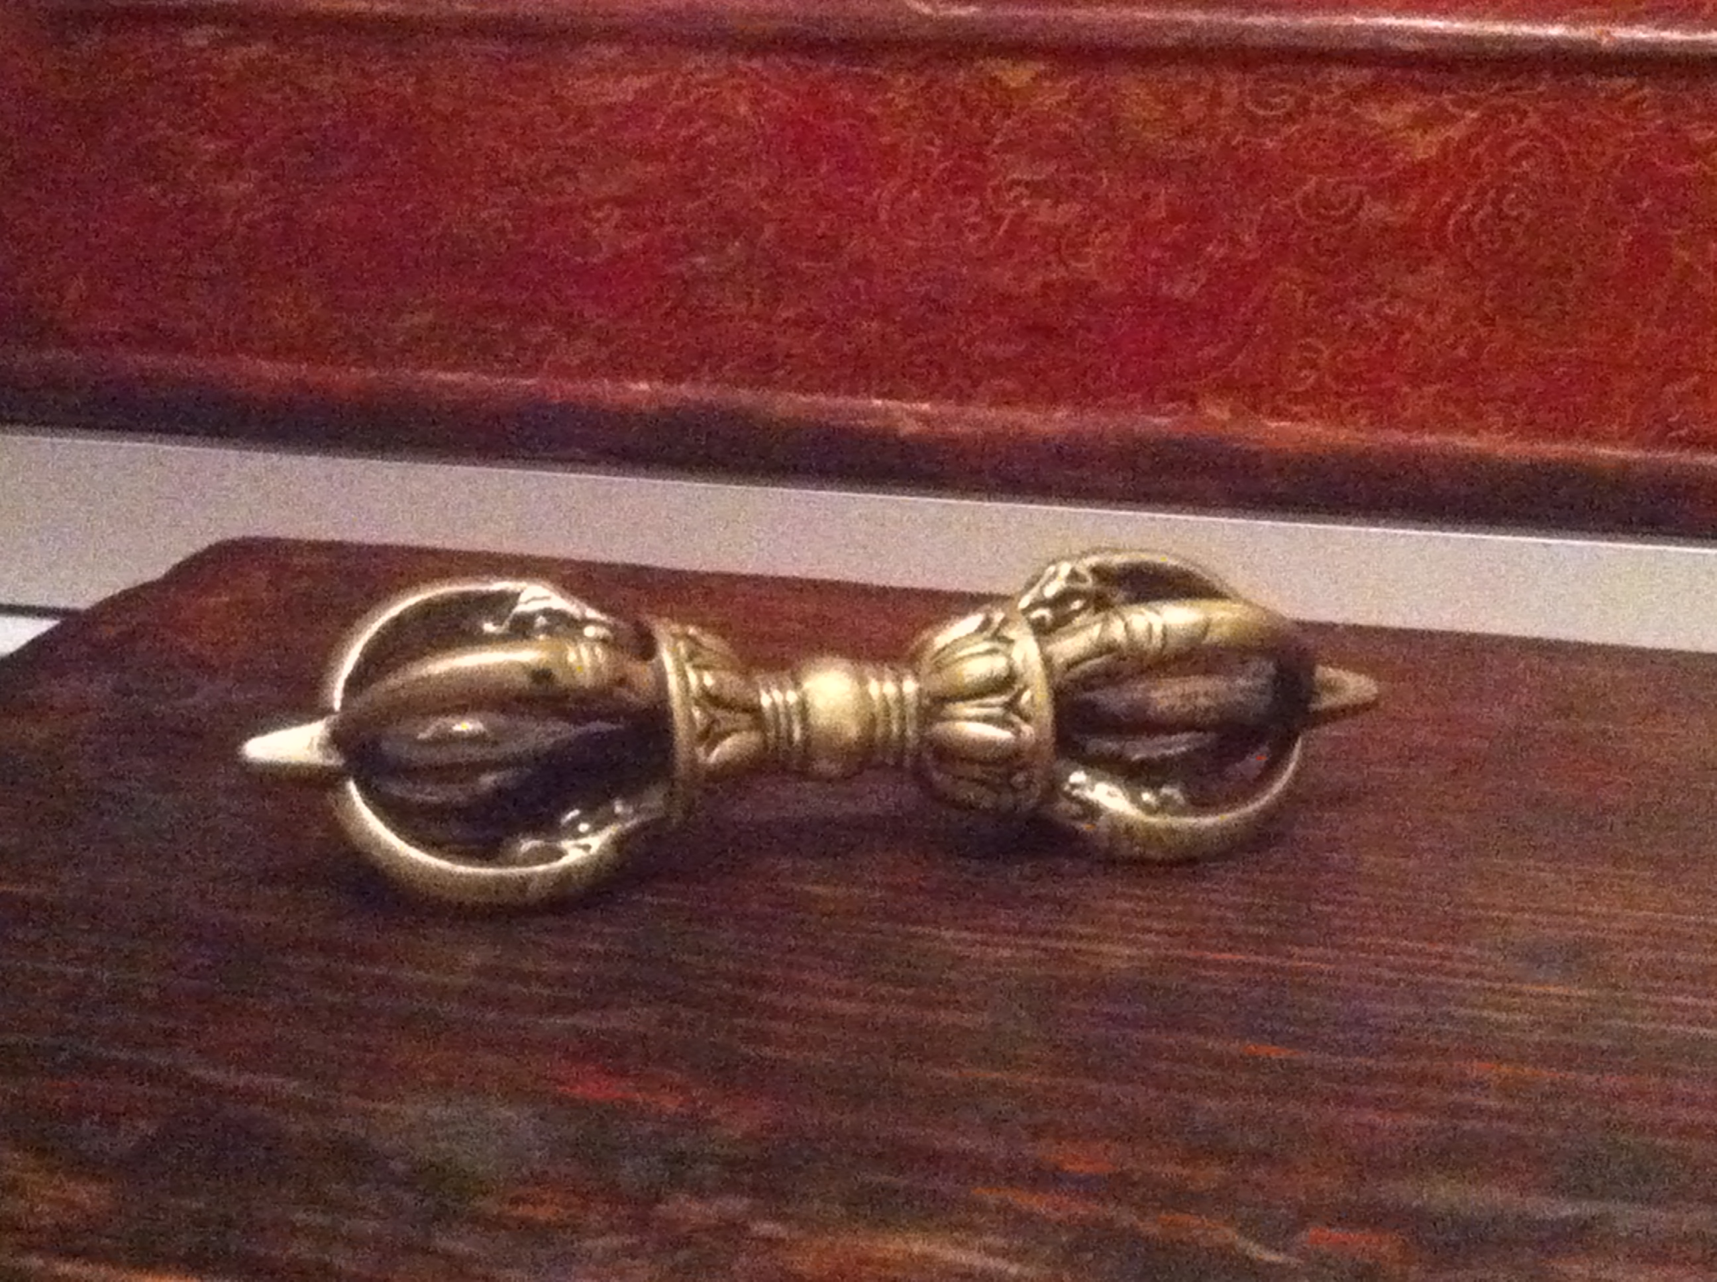

Slide 14
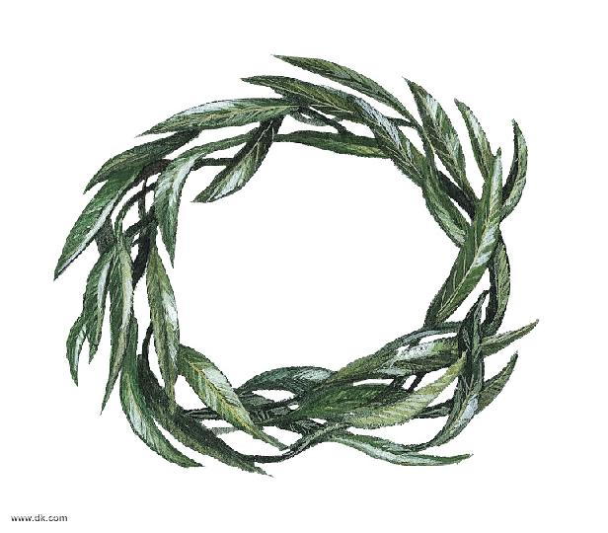
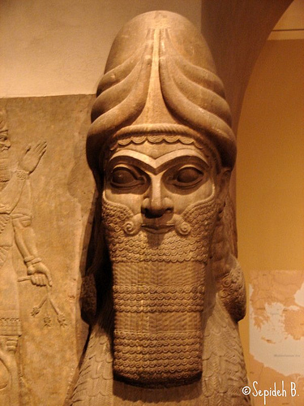
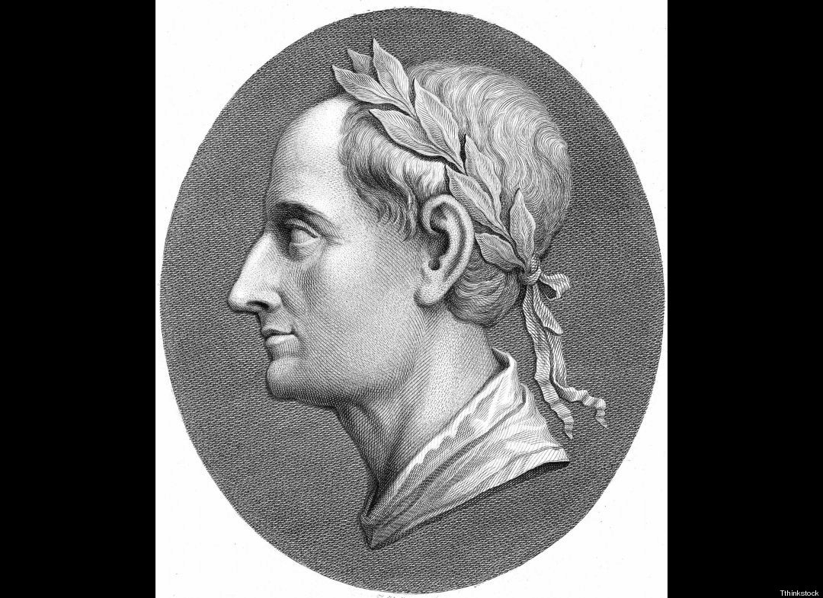

Slide 15
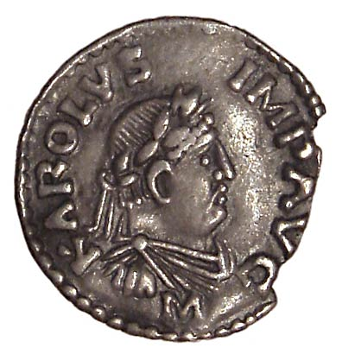

Slide 16
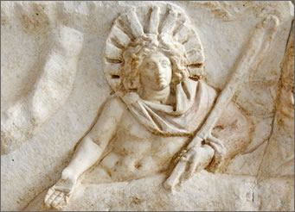

Slide 17
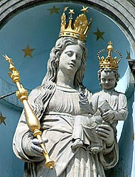
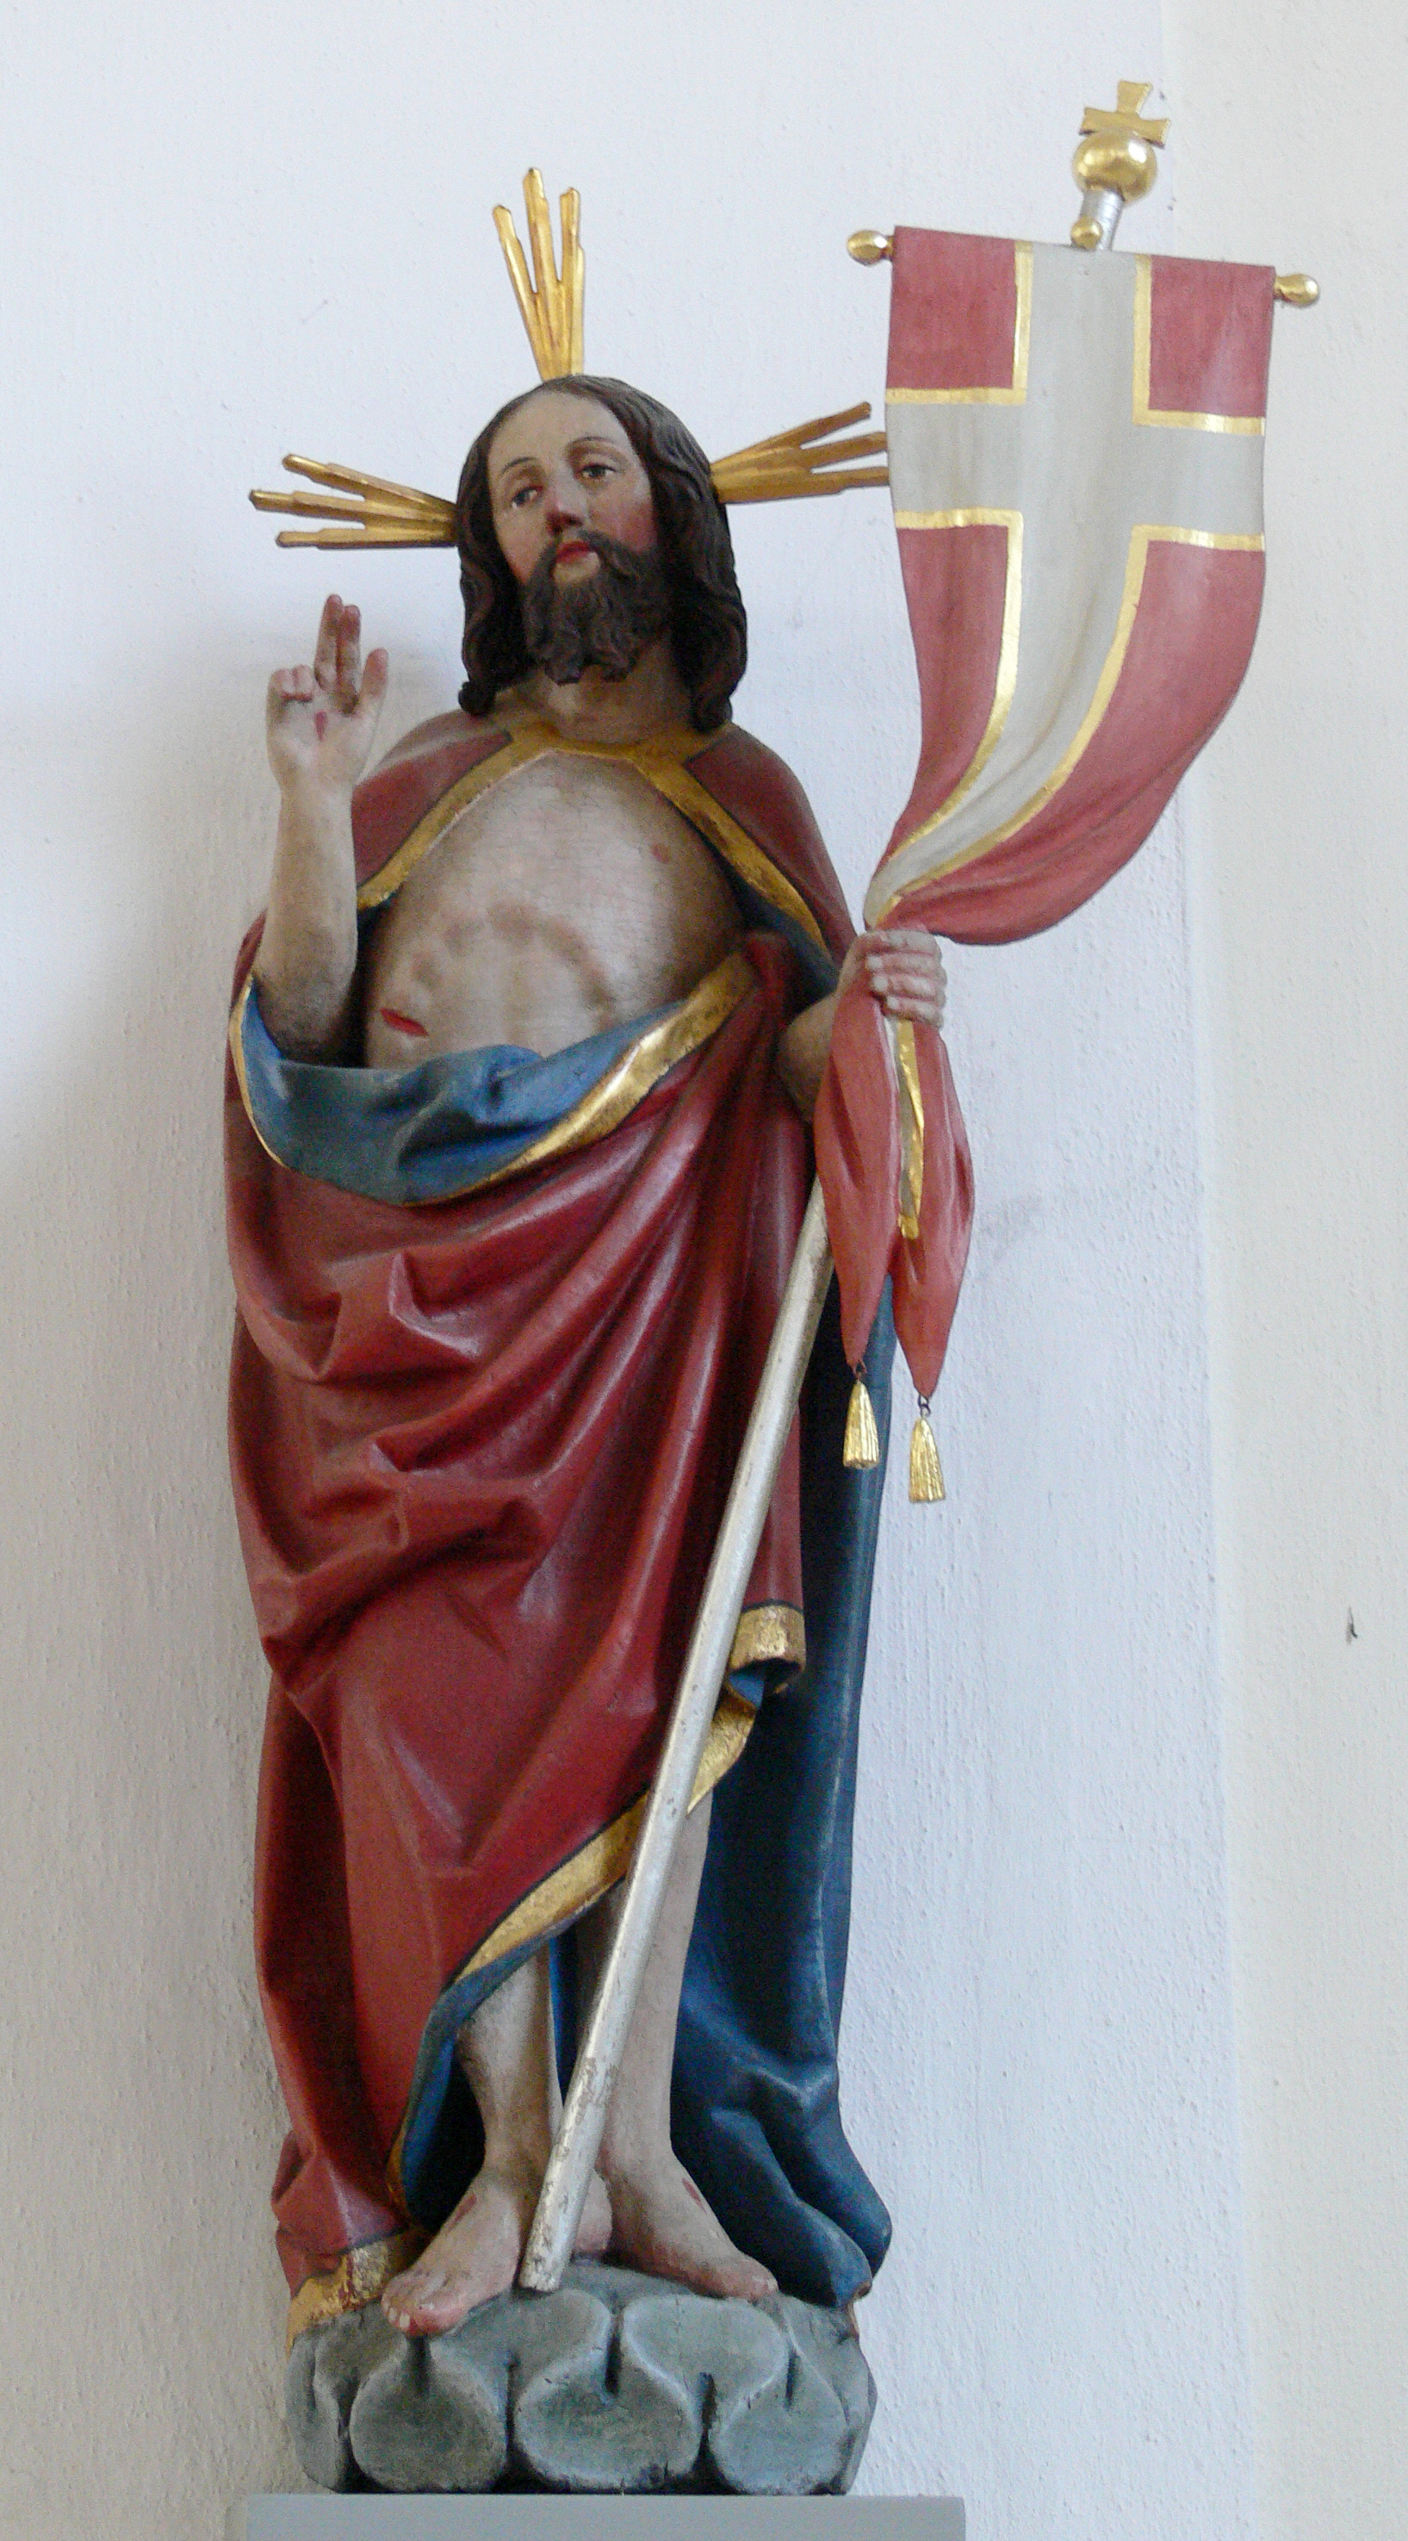

Slide 18
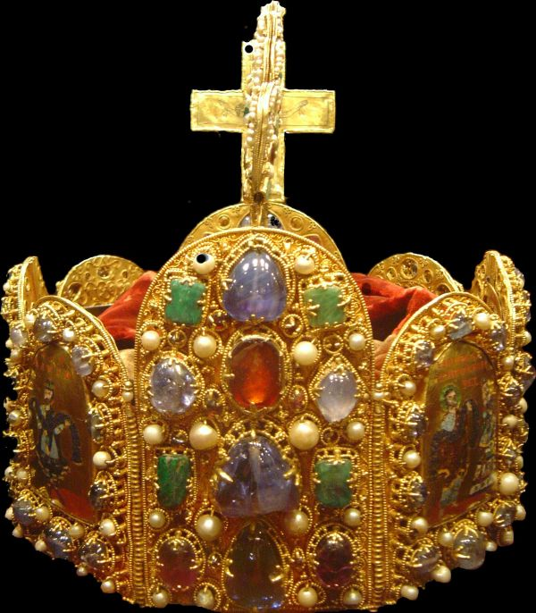
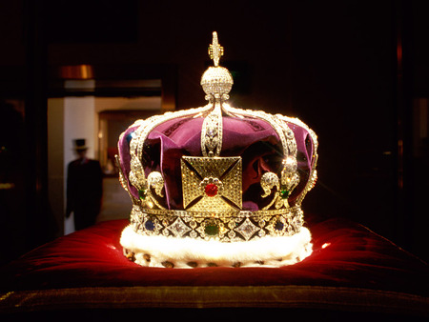

Slide 19
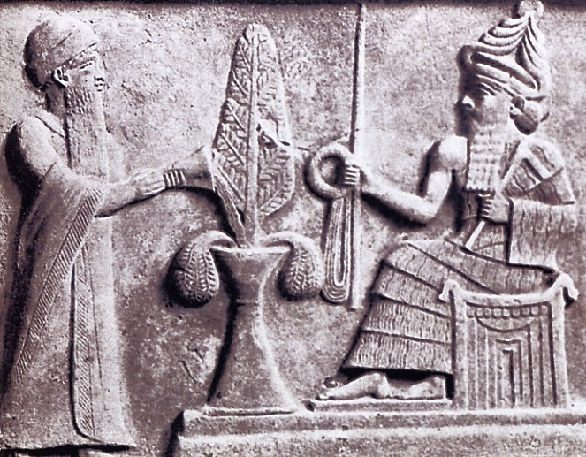
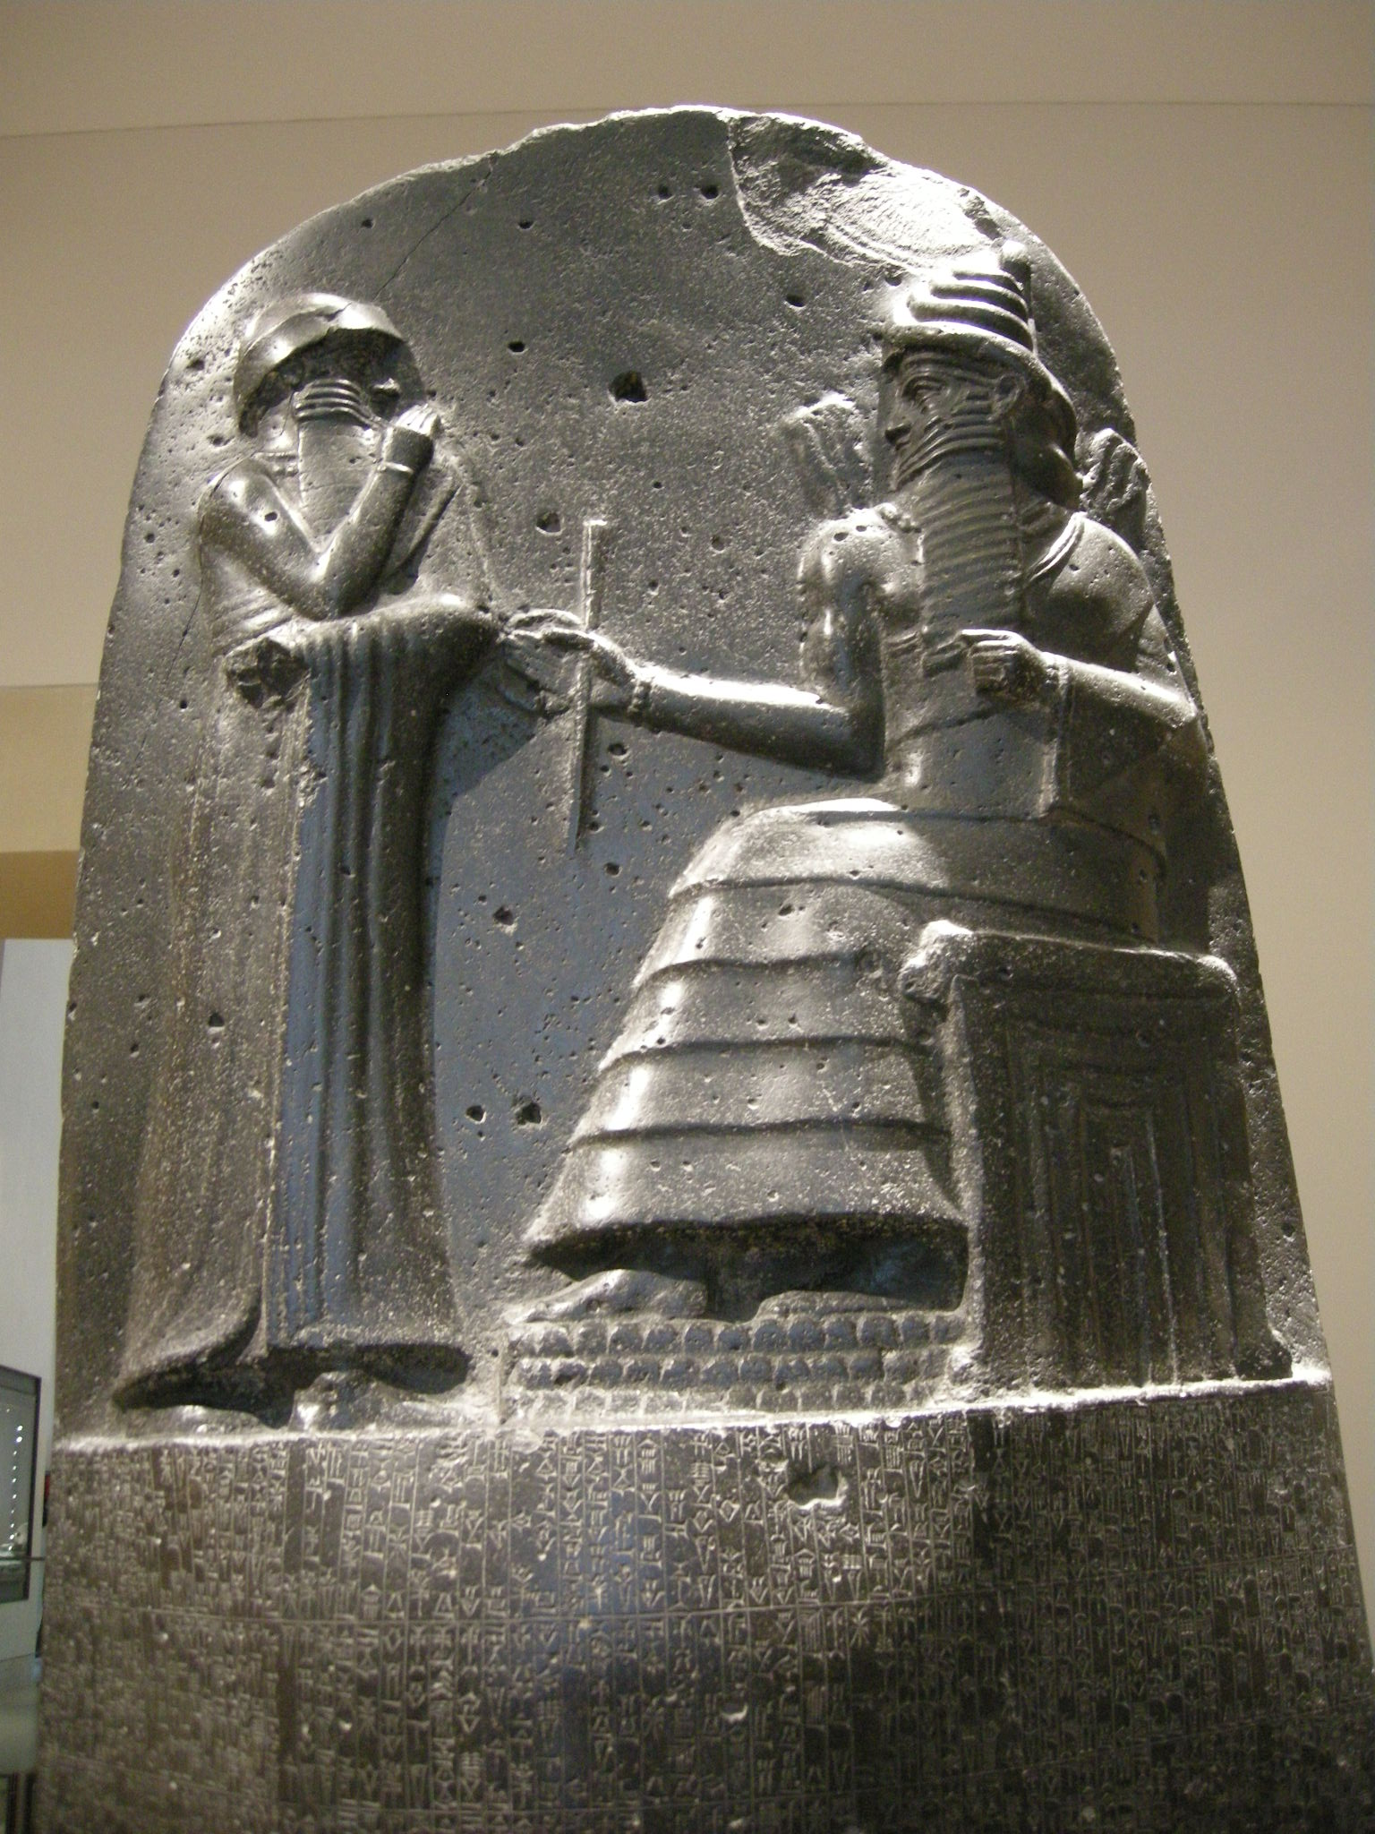
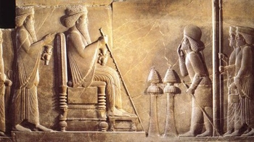

Slide 20
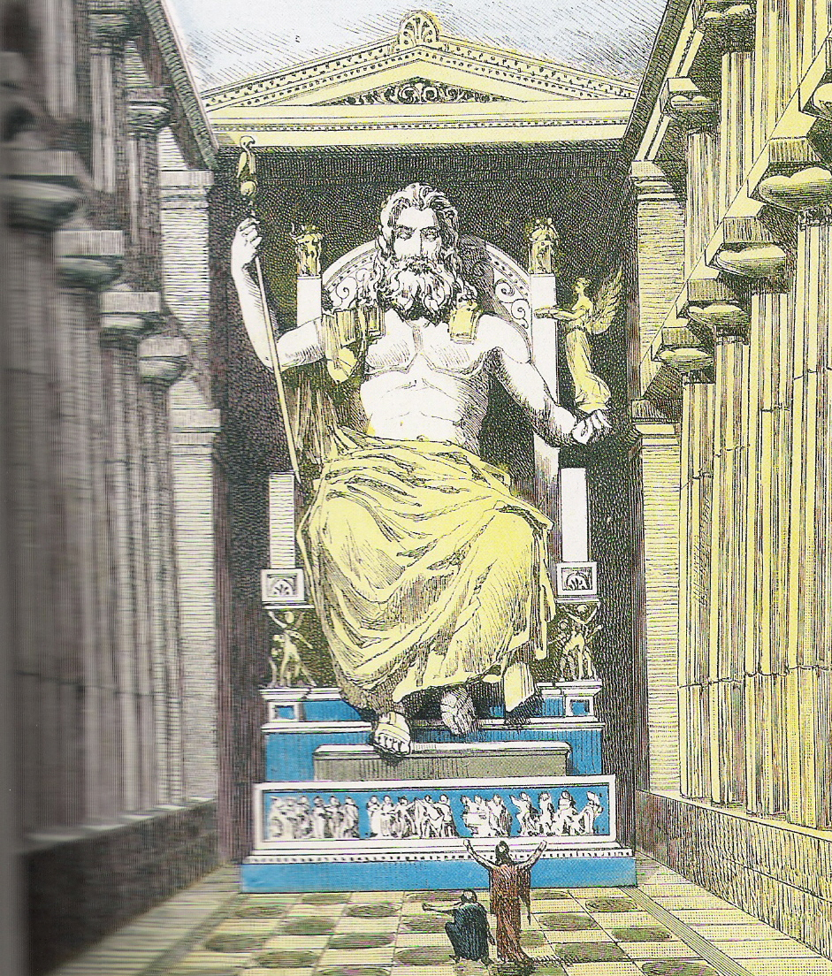

Slide 21
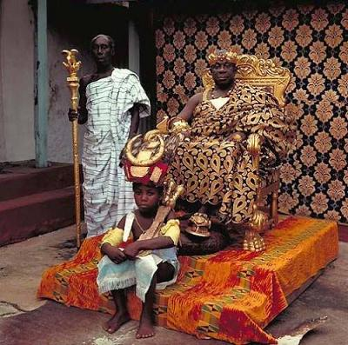
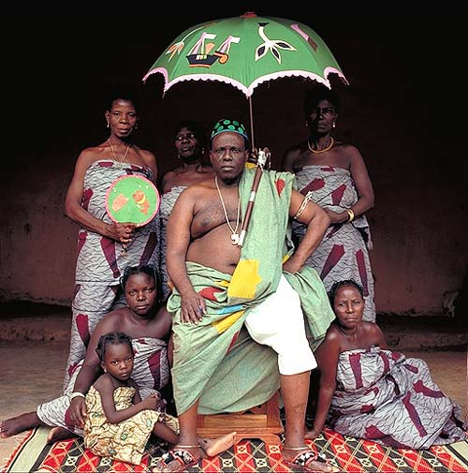

Slide 22
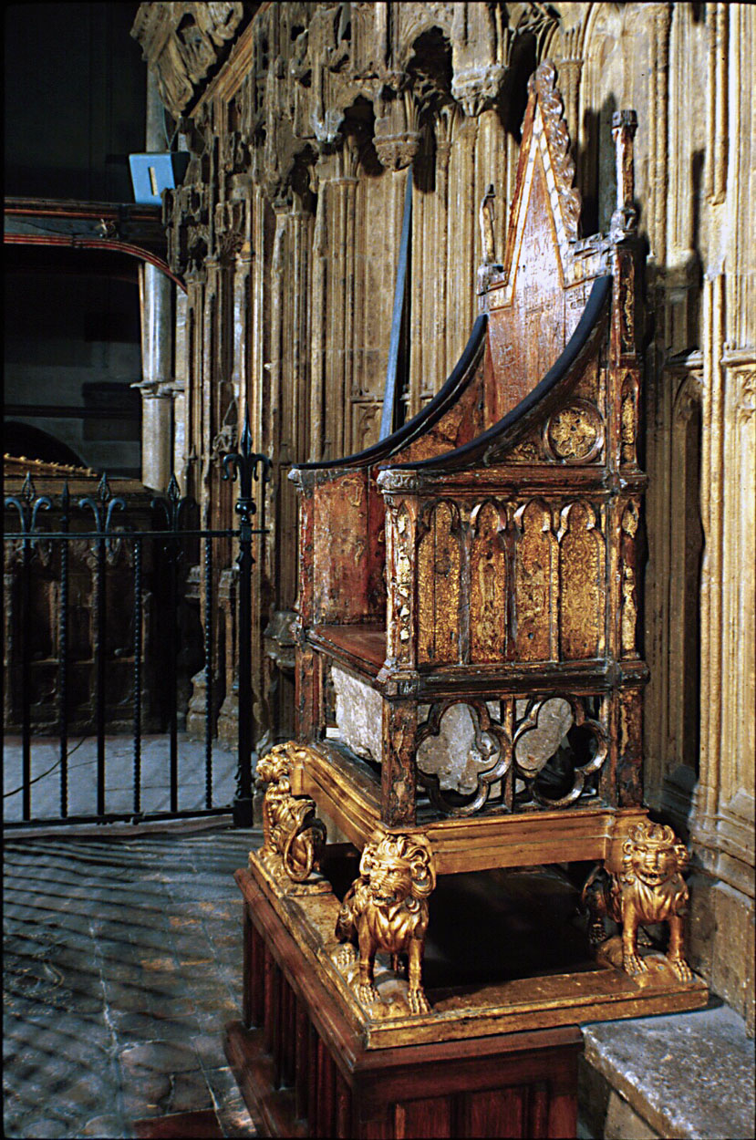
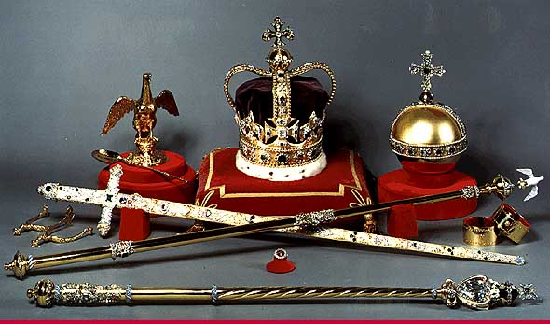
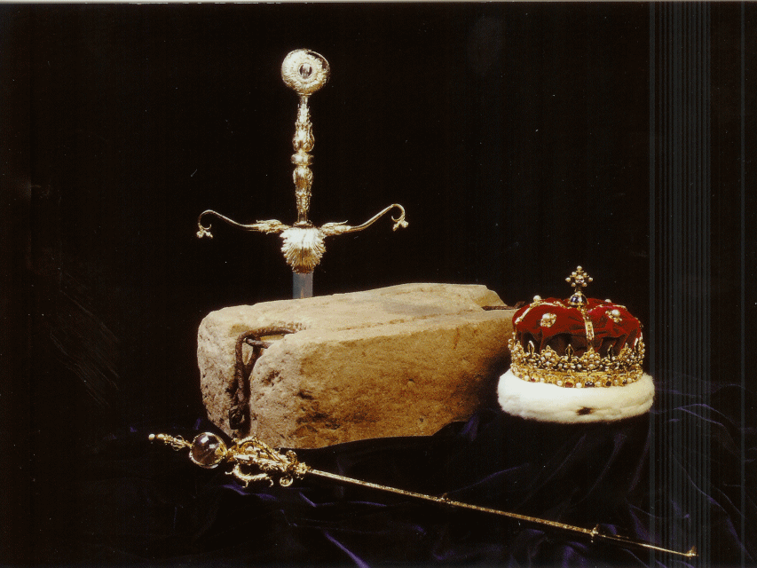

Slide 23
Scepter
New Testament
‘rhabdos’ - rod, staff, royal scepter
Old Testament
‘Matteh’ – a rod for chastening or discipline
Exodus 4 – Moses rod,
Exodus 7, 8 – Aarons rod

Slide 24
Scepter
‘Shebet’ - rod, staff (mark of discipline and law)
Psalm 89:32 - I will visit their transgression with the rod.
Proverbs 13:24 - He that spareth the rod hateth his son
Proverbs 22:15 - the rod of correction shall drive (foolishness) far from him
Proverbs 23:13 - the rod of correction
Proverbs 29:15 - the rod of reproof gives wisdom

Slide 25
‘shebet’ - scepter
Genesis 49:16, 28
Exodus 24:4, 28:21, 39:14
2 Kings 17:18 , 21:7
1 Chronicles 27:16, 27:22, 28:1 , 29:6
2 Chronicles 6:5, 11:16, 12:13, 33:7
Psalms 78:55, 67, 68, 122:4
Ezekiel 37:19, 45:8, 47:13, 47:21,22, 48:19,29,31
Hosea 5:9

Slide 26
‘shebet’
Isaiah 63:16-17
16 …You, O LORD, are our Father; Our Redeemer from Everlasting is Your name.
17 O LORD, why have You made us stray from Your ways, And hardened our heart from Your fear? Return for Your servants’ sake, The tribes of Your inheritance.
Psalm 74:1-2
1 O God, why have You cast us off forever?
Why does Your anger smoke against the sheep of Your pasture?
2 Remember Your congregation, which You have purchased of old, The tribe of Your inheritance, which You have redeemed: This Mount Zion where You have dwelt.

Slide 27
‘shebet’
Isaiah 63:16-17
16 …You, O LORD, are our Father; Our Redeemer from Everlasting is Your name.
17 O LORD, why have You made us stray from Your ways, And hardened our heart from Your fear? Return for Your servants’ sake, The tribes of Your inheritance.
Psalm 74:1-2
1 O God, why have You cast us off forever?
Why does Your anger smoke against the sheep of Your pasture?
2 Remember Your congregation, which You have purchased of old, The tribe of Your inheritance, which You have redeemed: This Mount Zion where You have dwelt.

Slide 28
the scepter
Jeremiah 10:16 & Jeremiah 51:19
“…For He is the Maker of all things, And Israel is the tribe of His inheritance; The LORD of hosts is His name.”

Slide 29
The Scepter
King
Ruler
People

Slide 30
The Scepter
Tribes
King
Ruler
People

Slide 31
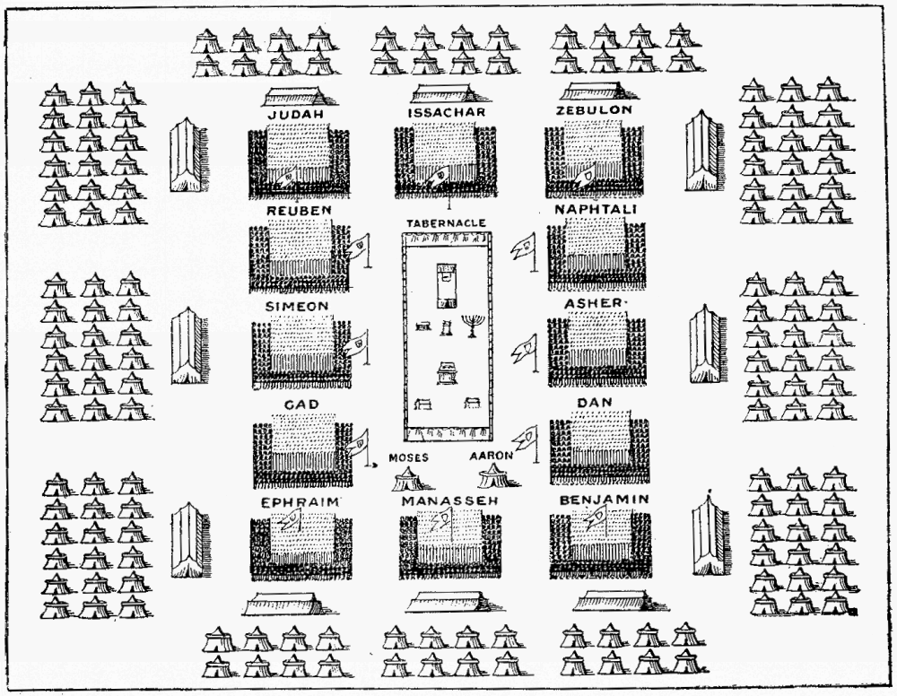

Slide 32
Deuteronomy 18

Slide 33
The Scepter
Levites
King
Ruler
People

Slide 34
Crown
New Testament
‘Diadema’ – ‘diadem’
‘Stefanos’ – wreath given to victors of public games
1 Corinthians 9:25
24 Do you not know that those who run in a race all run, but one receives the prize? Run in such a way that you may obtain it. 25 And everyone who competes for the prize is temperate in all things. Now they do it to obtain a perishable crown, but we for an imperishable crown.

Slide 35
Crown
New Testament
‘Diadema’ – ‘diadem’
‘Stefanos’ – wreath given to victors of public games
1 Corinthians 9:25
24 Do you not know that those who run in a race all run, but one receives the prize? Run in such a way that you may obtain it. 25 And everyone who competes for the prize is temperate in all things. Now they do it to obtain a perishable crown, but we for an imperishable crown.

Slide 36
A crown of victory
2 Timothy 4:8
…there is laid up for me a crown of righteousness
1 Peter 5:4
…and when the Chief Shepherd appears, you will receive the crown of glory that does not fade away.
James 1:12
Blessed is the man who endures temptation; for when he has been approved, he will receive the crown of life which the Lord has promised to those who love Him.
Revelation 2:10
Be faithful until death, and I will give you the crown of life.

Slide 37
Crown
Old Testament - focus on the head:
‘Qodqod’ – lit. the crown/top of the head, scalp or pate
‘Nezer’ - the crown of the head / CONSECRATION
Lexicon - something by which you are separated from other people.
Leviticus 21:10-12
10 ‘He who is the high priest among his brethren, on whose head the anointing oil was poured and who is consecrated to wear the garments, shall not uncover his head nor tear his clothes; 11 nor shall he go near any dead body, nor defile himself for his father or his mother; 12 nor shall he go out of the sanctuary, nor profane the sanctuary of his God; for the consecration of the anointing oil of his God is upon him: I am the LORD.

Slide 38
Crown
Old Testament - focus on the head:
‘Qodqod’ – lit. the crown/top of the head, scalp or pate
‘Nezer’ - the crown of the head / CONSECRATION
Lexicon - something by which you are separated from other people.
Leviticus 21:10-12
10 ‘He who is the high priest among his brethren, on whose head the anointing oil was poured and who is consecrated to wear the garments, shall not uncover his head nor tear his clothes; 11 nor shall he go near any dead body, nor defile himself for his father or his mother; 12 nor shall he go out of the sanctuary, nor profane the sanctuary of his God; for the consecration of the anointing oil of his God is upon him: I am the LORD.

Slide 39
Psalm 103
1 Bless the Lord, O my soul; And all that is within me, bless His holy name!
2 Bless the Lord, O my soul, And forget not all His benefits:
3 Who forgives all your iniquities, Who heals all your diseases,
4 Who redeems your life from destruction, Who crowns you with loving kindness and tender mercies,
5 Who satisfies your mouth with good things, So that your youth is renewed like the eagle’s.

Slide 40
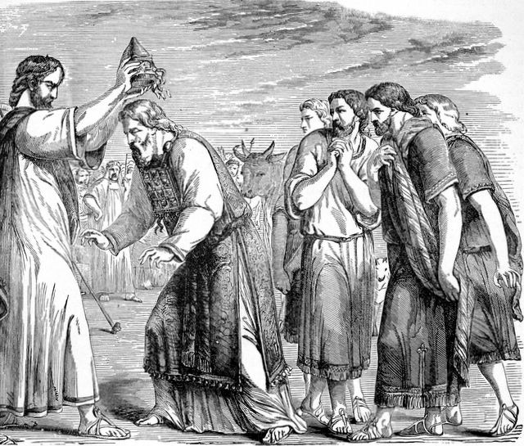

Slide 41
Throne
New Testament
‘thronos’ – throne
‘bema’ - a judgment seat
‘kathedra’ - “a seat that is canopied”
Mark 12:38-39
38 And he said unto them in his doctrine, Beware of the scribes, which love to go in long clothing, and love salutations in the marketplaces,
39 And the chief seats in the synagogues, and the uppermost rooms at feasts:

Slide 42
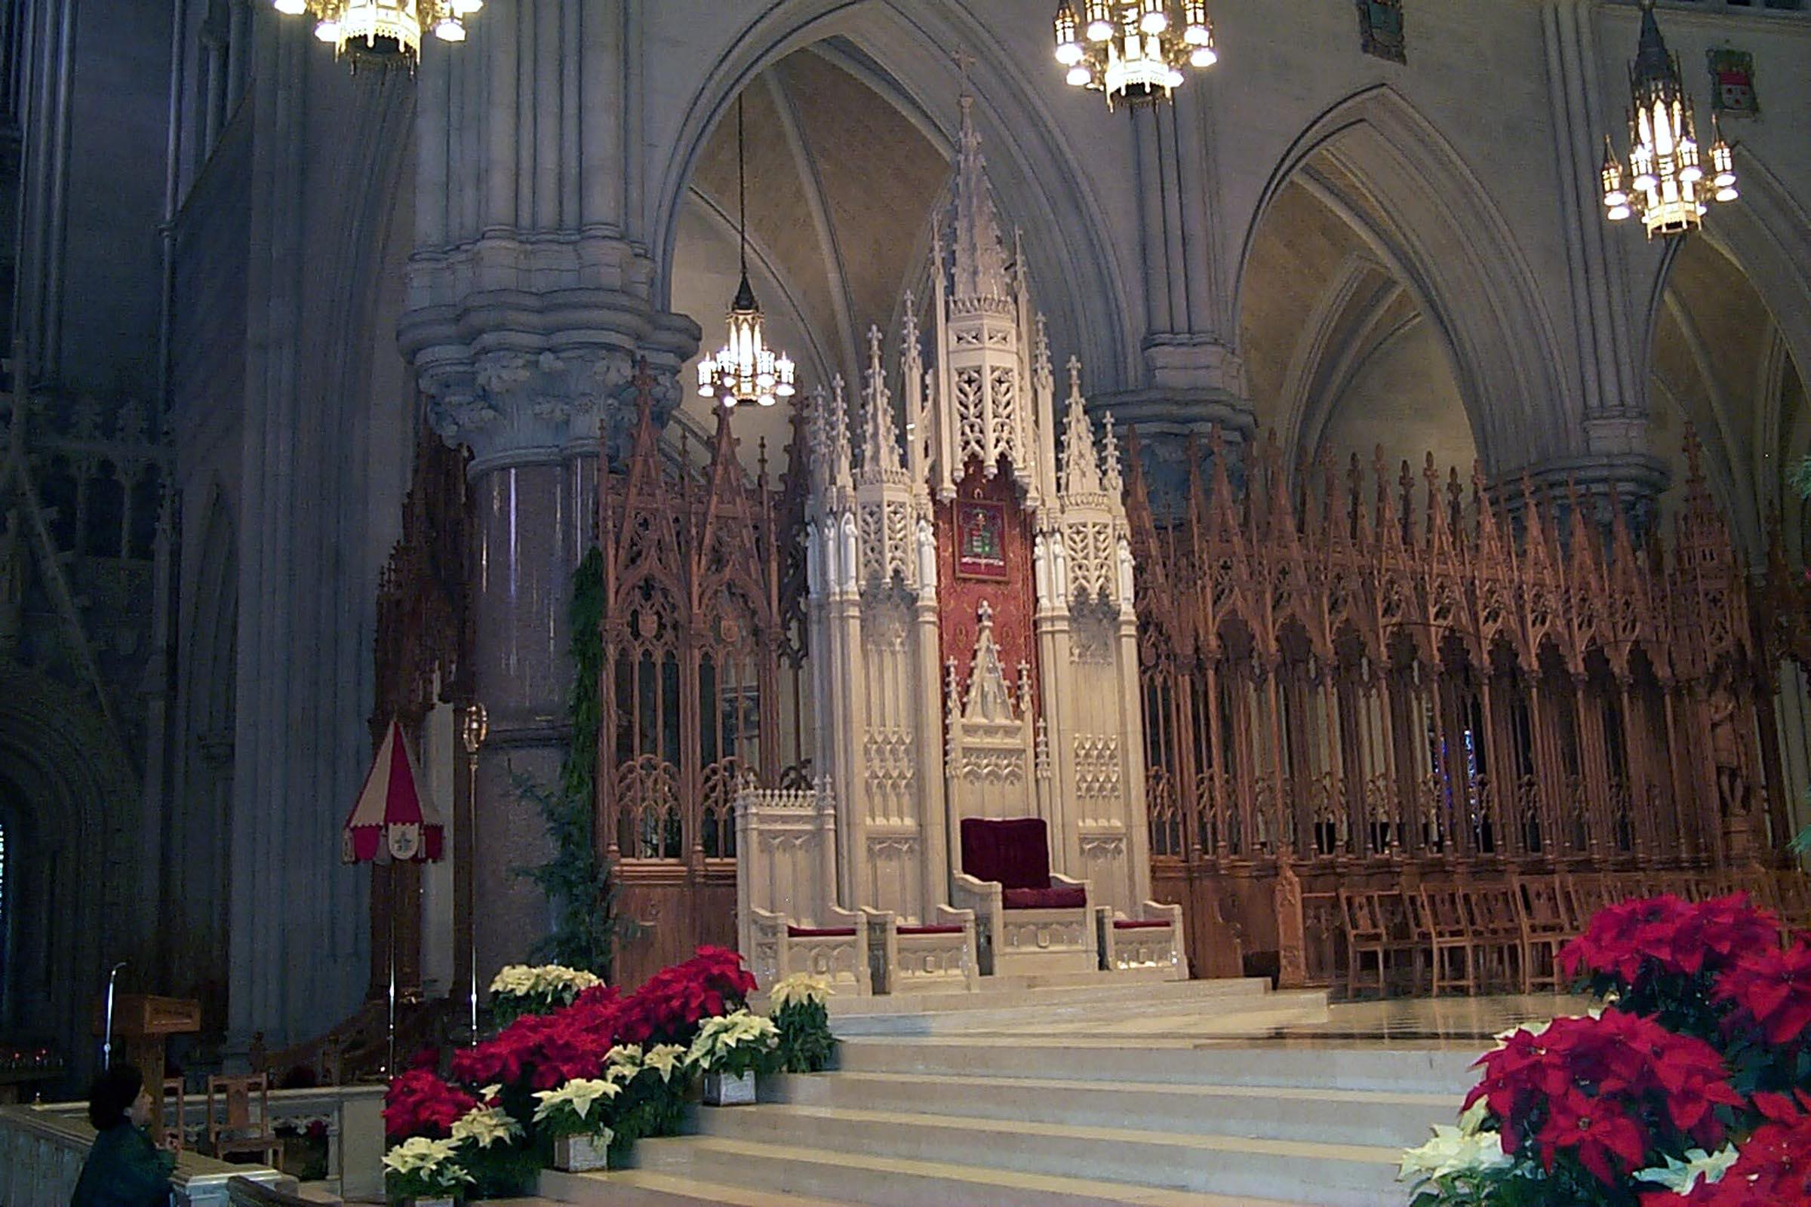
kathedra

Slide 43
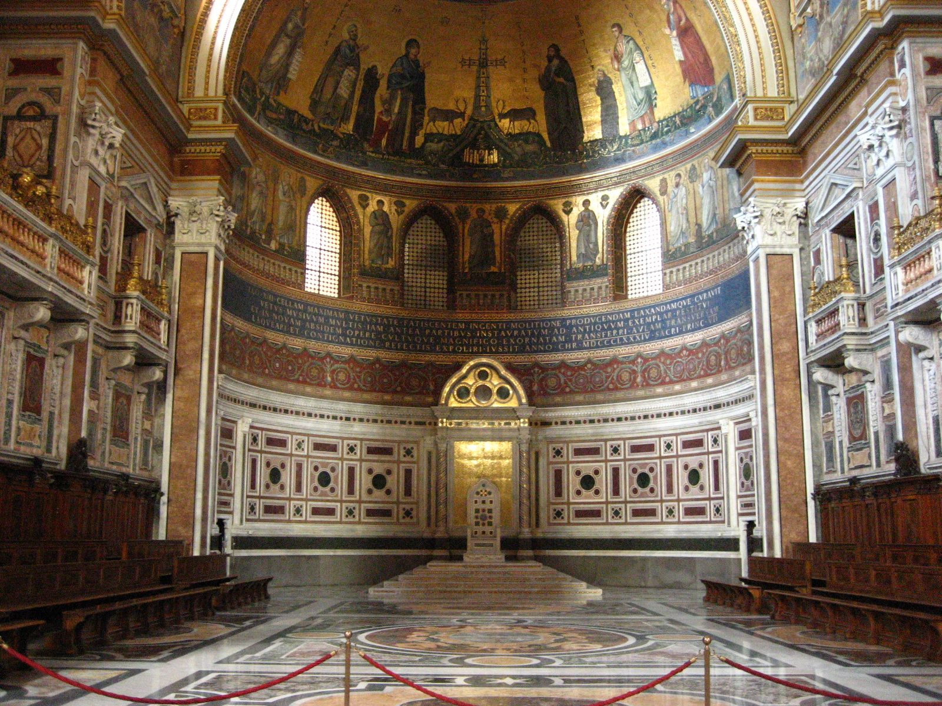
kathedra

Slide 44
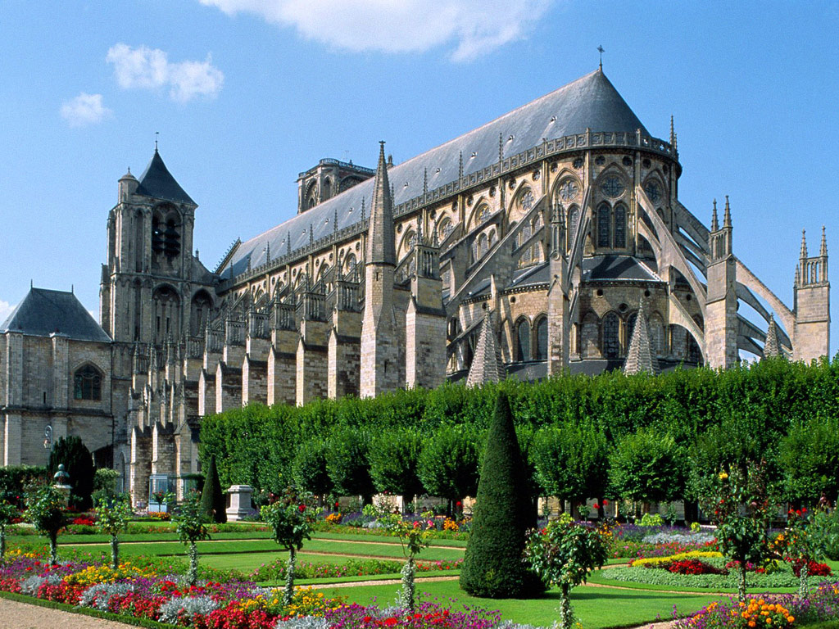
cathedral

Slide 45
A throne of JUDGMENT?
Proverbs 20
8 A king that sitteth in the throne of judgment scattereth away all evil with his eyes.
Proverbs 20:28
28 Mercy and truth preserve the king: and his throne is upholden by mercy.

Slide 46
A throne of JUDGMENT?
Proverbs 20
8 A king that sitteth in the throne of judgment scattereth away all evil with his eyes.
28 Mercy and truth preserve the king: and his throne is upholden by mercy.

Slide 47
NO! – A throne of MERCY!
Proverbs 20
8 A king that sitteth in the throne of judgment scattereth away all evil with his eyes.
28 Mercy and truth preserve the king: and his throne is upholden by mercy.

Slide 48
Numbers 24:17
15… “The utterance of Balaam the son of Beor, And the utterance of the man whose eyes are opened; 16 …the one who hears the words of God, And has the knowledge of the Most High, Who sees the vision of the Almighty, Who falls down, with eyes wide open…
17 “I see Him, but not now, I behold Him, but not near; A Star shall come out of Jacob; A Scepter shall rise out of Israel, And batter the brow of Moab, And destroy all the sons of tumult.

Slide 49
Numbers 24:17
15… “The utterance of Balaam the son of Beor, And the utterance of the man whose eyes are opened; 16 …the one who hears the words of God, And has the knowledge of the Most High, Who sees the vision of the Almighty, Who falls down, with eyes wide open…
17 “I see Him, but not now, I behold Him, but not near; A Star shall come out of Jacob; A Scepter shall rise out of Israel, And batter the brow of Moab, And destroy all the sons of tumult.

Slide 50
The crown of our King

Slide 51
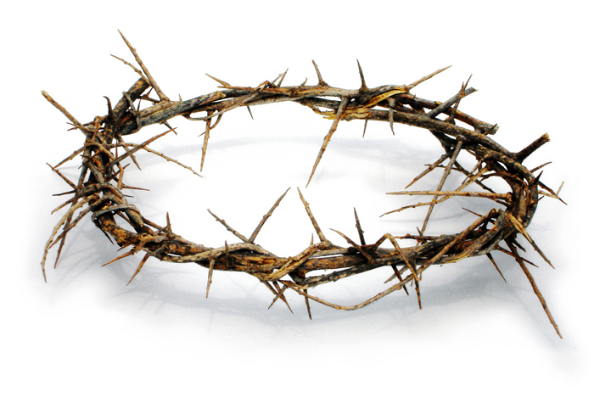
The crown of our King
Mark 15:17
Matthew 27:29
John 19:2,5
17 And they clothed Him with purple; and they twisted a crown of thorns, put it on His head,
18 and began to salute Him, “Hail, King of the Jews!”

Slide 52
A crown of VICTORY!

Slide 53
Philippians 4

Slide 54
Crown
Hebrew - ‘Atarah’ - ‘an ornament’ to one’s head
Proverbs 12:4 - A virtuous woman is a crown to her husband
Proverbs 17:6 - grandchildren are the crown of old men.

Slide 55
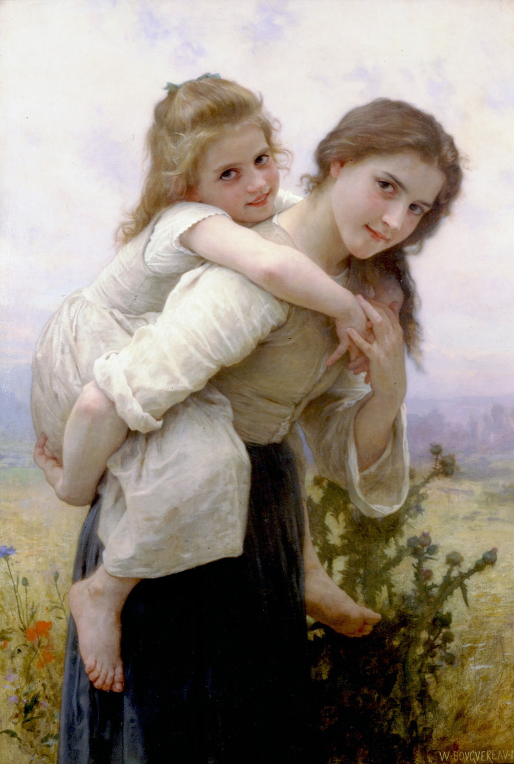
Crown
Hebrew - ‘Atarah’ - ‘an ornament’ to one’s head
Proverbs 12:4 - A virtuous woman is a crown to her husband
Proverbs 17:6 - grandchildren are the crown of old men.

Slide 56
Zechariah 9

Slide 57
Isaiah 62

Slide 58
Psalm 89
3 I have made a covenant with my chosen, I have sworn unto David my servant, 4 Thy seed will I establish for ever, and build up thy throne to all generations.
13 Thou hast a mighty arm: strong is thy hand, and high is thy right hand. 14 Justice and judgment are the habitation of thy throne: mercy and truth shall go before thy face.
26 He shall cry unto me, Thou art my father, my God, and the rock of my salvation. 27 Also I will make him my firstborn, higher than the kings of the earth.

Slide 59
Psalm 89
3 I have made a covenant with my chosen, I have sworn unto David my servant, 4 Thy seed will I establish for ever, and build up thy throne to all generations.
13 Thou hast a mighty arm: strong is thy hand, and high is thy right hand. 14 Justice and judgment are the habitation of thy throne: mercy and truth shall go before thy face.
26 He shall cry unto me, Thou art my father, my God, and the rock of my salvation. 27 Also I will make him my firstborn, higher than the kings of the earth.

Slide 60
Psalm 89
3 I have made a covenant with my chosen, I have sworn unto David my servant, 4 Thy seed will I establish for ever, and build up thy throne to all generations.
13 Thou hast a mighty arm: strong is thy hand, and high is thy right hand. 14 Justice and judgment are the habitation of thy throne: mercy and truth shall go before thy face.
26 He shall cry unto me, Thou art my father, my God, and the rock of my salvation. 27 Also I will make him my firstborn, higher than the kings of the earth.

Slide 61
