Slide 1
The Kingmaker “Long Live The King!”

Slide 2
Kings and Priests
King
Priest
Be Consecrated
Have Faith
Personal Sacrifice and Offering
Instruction, Fellowship, Fruit of the Spirit

Slide 3
Kings and Priests
THE KING
Consecrated
Instructed in the Word
Lead by Faith & Trust
Life of Service & Sacrifice
THE PRIEST
Consecrated
Instructed in the Word
Lead by Faith & Trust
Life of Service & Sacrifice

Slide 4
Saul’s error
1 Samuel 15:26-30
26 But Samuel said to Saul, “I will not return with you, for you have rejected the word of the Lord, and the Lord has rejected you from being king over Israel.”
27 And as Samuel turned around to go away, Saul seized the edge of his robe, and it tore. 28 So Samuel said to him, “The Lord has torn the kingdom of Israel from you today, and has given it to a neighbor of yours, who is better than you. 29 And also the Strength of Israel will not lie nor relent. For He is not a man, that He should relent.” 30 Then he said, “I have sinned; yet honor me now, please, before the elders of my people and before Israel, and return with me, that I may worship the Lord your God.” 31 So Samuel turned back after Saul, and Saul worshiped the Lord.

Slide 5
Saul’s error
1 Samuel 15:26-30
26 But Samuel said to Saul, “I will not return with you, for you have rejected the word of the Lord, and the Lord has rejected you from being king over Israel.”
27 And as Samuel turned around to go away, Saul seized the edge of his robe, and it tore. 28 So Samuel said to him, “The Lord has torn the kingdom of Israel from you today, and has given it to a neighbor of yours, who is better than you. 29 And also the Strength of Israel will not lie nor relent. For He is not a man, that He should relent.” 30 Then he said, “I have sinned; yet honor me now, please, before the elders of my people and before Israel, and return with me, that I may worship the Lord your God.” 31 So Samuel turned back after Saul, and Saul worshiped the Lord.

Slide 6
Saul’s error
1 Samuel 15:26-30
26 But Samuel said to Saul, “I will not return with you, for you have rejected the word of the Lord, and the Lord has rejected you from being king over Israel.”
27 And as Samuel turned around to go away, Saul seized the edge of his robe, and it tore. 28 So Samuel said to him, “The Lord has torn the kingdom of Israel from you today, and has given it to a neighbor of yours, who is better than you. 29 And also the Strength of Israel will not lie nor relent. For He is not a man, that He should relent.” 30 Then he said, “I have sinned; yet honor me now, please, before the elders of my people and before Israel, and return with me, that I may worship the Lord your God.” 31 So Samuel turned back after Saul, and Saul worshiped the Lord.

Slide 7
Kingly behaviour
Hebrew - ‘Nagid’
‘ruler, official, administrator’
Root ‘to preceed’, ‘go infront’, ‘go first’, ‘to lead’
2 Samuel 6:20-21
20 Then David returned to bless his household. And Michal the daughter of Saul came out to meet David, and said, “How glorious was the king of Israel today, uncovering himself today in the eyes of the maids of his servants, as one of the base fellows shamelessly uncovers himself!”
21 So David said to Michal, “It was before the LORD, who chose me instead of your father and all his house, to appoint me ruler over the people of the LORD, over Israel. Therefore I will play music before the LORD.

Slide 8
Kingly behaviour
People
King

Slide 9
Kingly behaviour
2 Samuel 6:20-21
20 Then David returned to bless his household. And Michal the daughter of Saul came out to meet David, and said, “How glorious was the king of Israel today, uncovering himself today in the eyes of the maids of his servants, as one of the base fellows shamelessly uncovers himself!”
21 So David said to Michal, “It was before the LORD, who chose me instead of your father and all his house, to appoint me ruler over the people of the LORD, over Israel. Therefore I will play music before the LORD.

Slide 10
Kingly behaviour
2 Samuel 6:20-21
20 Then David returned to bless his household. And Michal the daughter of Saul came out to meet David, and said, “How glorious was the king of Israel today, uncovering himself today in the eyes of the maids of his servants, as one of the base fellows shamelessly uncovers himself!”
21 So David said to Michal, “It was before the LORD, who chose me instead of your father and all his house, to appoint me ruler over the people of the LORD, over Israel. Therefore I will play music before the LORD.
‘nagid’ – “to be the one who goes before…”

Slide 11
Kingly behaviour
People
King

Slide 12
“the one who goes before…”
2 Samuel 7:8-16
8 Now therefore, thus shall you say to My servant David, ‘Thus says the LORD of hosts: “I took you from the sheepfold, from following the sheep, to be ruler over My people, over Israel.
9 And I have been with you wherever you have gone, and have cut off all your enemies from before you, and have made you a great name, like the name of the great men who are on the earth.

Slide 13
“the one who goes before…”
2 Samuel 7:8-16
8 Now therefore, thus shall you say to My servant David, ‘Thus says the LORD of hosts: “I took you from the sheepfold, from following the sheep, to be ruler over My people, over Israel.
9 And I have been with you wherever you have gone, and have cut off all your enemies from before you, and have made you a great name, like the name of the great men who are on the earth.
‘nagid’ – “to be the one who goes before…”

Slide 14
“the one who goes before…”
2 Samuel 7:8-16
8 Now therefore, thus shall you say to My servant David, ‘Thus says the LORD of hosts: “I took you from the sheepfold, from following the sheep, to be ruler over My people, over Israel.
9 And I have been with you wherever you have gone, and have cut off all your enemies from before you, and have made you a great name, like the name of the great men who are on the earth.

Slide 15
“the one who goes before…”
10 Moreover I will appoint a place for My people Israel, and will plant them, that they may dwell in a place of their own and move no more…
12 “When your days are fulfilled and you rest with your fathers, I will set up your seed after you…. and I will establish his kingdom.
13 He shall build a house for My name, and I will establish the throne of his kingdom forever...
14 I will be his Father, and he shall be My son.

Slide 16
Kingly behaviour
People
King

Slide 17
“the one who goes before…”
People
King
God

Slide 18
Psalm 72

Slide 19
The role of the King
A righteous and understanding judge
A pioneer who goes out in front
A deliverer of the poor and the needy
A deliverer from oppression
A helper of the helpless
A saviour
TO BE A PRIEST FIRST AND A KING SECOND !

Slide 20
1 Kings 3

Slide 21
“the one who goes before…”
People
King
God

Slide 22
Our King
Acts 5:29-31
29 But Peter and the other apostles answered and said: “We ought to obey God rather than men.
30 The God of our fathers raised up Jesus whom you murdered by hanging on a tree.
31 Him God has exalted to His right hand to be Prince and Savior, to give repentance to Israel and forgiveness of sins.

Slide 23
Our King
Acts 5:29-31
29 But Peter and the other apostles answered and said: “We ought to obey God rather than men.
30 The God of our fathers raised up Jesus whom you murdered by hanging on a tree.
31 Him God has exalted to His right hand to be Prince and Savior, to give repentance to Israel and forgiveness of sins.

Slide 24
Our King
Acts 5:29-31
29 But Peter and the other apostles answered and said: “We ought to obey God rather than men.
30 The God of our fathers raised up Jesus whom you murdered by hanging on a tree.
31 Him God has exalted to His right hand to be Prince and Savior, to give repentance to Israel and forgiveness of sins.
c
‘Archagos’ = ‘Captain’, ‘Author’

Slide 25
Hebrews - The Priest King
Hebrews 2:9-11
9 But we see Jesus, who was made a little lower than the angels, for the suffering of death crowned with glory and honor, that He, by the grace of God, might taste death for everyone. 10 For it was fitting for Him, for whom are all things and by whom are all things, in bringing many sons to glory, to make the captain of their salvation perfect through sufferings. 11 For both He who sanctifies and those who are being sanctified are all of one, for which reason He is not ashamed to call them brethren
Hebrews 12:1-2
1 Therefore we also, since we are surrounded by so great a cloud of witnesses, let us lay aside every weight, and the sin which so easily ensnares us, and let us run with endurance the race that is set before us, 2 looking unto Jesus, the author and finisher of our faith, who for the joy that was set before Him endured the cross, despising the shame, and has sat down at the right hand of the throne of God.

Slide 26
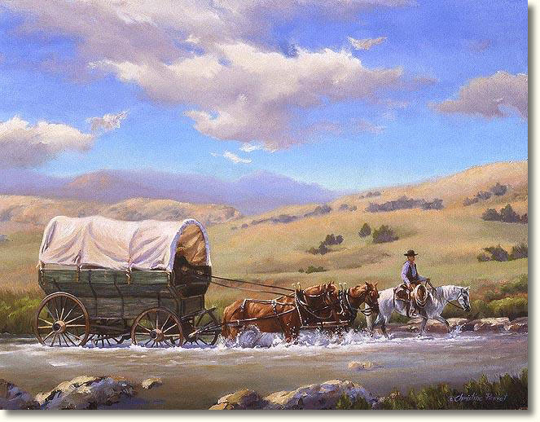
‘archagos’
‘captain’, ‘author’
‘to rule’, ‘to begin’, ‘to be the first’
“one who takes the lead”
“one who leads by example”
“A PIONEER”

Slide 27
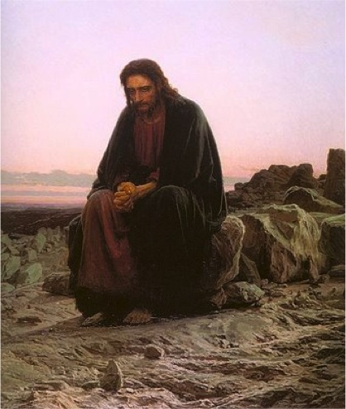
The ‘Pioneer’ of our salvation

Slide 28
Colossians 1

Slide 29
‘proteuo’
First
First in rank
First in influence

Slide 30
The preparation of the King
Anointed
Glad Tidings
Gifts and Offerings
Fellowship Instruction Spirit Gifts

Slide 31
Jesus’ preparation
My beloved Son in whom I am well pleased
Behold – The Lamb of God!
She has done a good deed to me
Fellowship Instruction

Slide 32
Jesus’ preparation
My beloved Son in whom I am well pleased
Behold – The Lamb of God!
She has done a good deed to me
Fellowship Instruction

Slide 33
Jesus’ preparation
My beloved Son in whom I am well pleased
Behold – The Lamb of God!
She has done a good deed to me
Fellowship Instruction

Slide 34
Jesus’ preparation
My beloved Son in whom I am well pleased
Behold – The Lamb of God!
She has done a good deed to me
Fellowship Instruction

Slide 35
The greater son of David
King
His was a COMPLETE consecration
His was a life of COMPLETE faith
His was a COMPLETE Sacrifice and Offering
His a call to COMPLETE fellowship and relationship

Slide 36
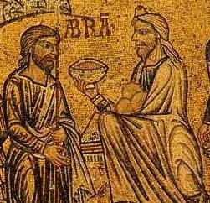
Genesis 14:18-20
18 Then Melchizedek king of Salem brought out bread and wine; he was the priest of God Most High.
19 And he blessed him and said: “Blessed be Abram of God Most High, Possessor of heaven and earth;
20 And blessed be God Most High, who has delivered your enemies into your hand”

Slide 37
Genesis 14:18-20
18 Then Melchizedek king of Salem brought out bread and wine; he was the priest of God Most High.
19 And he blessed him and said: “Blessed be Abram of God Most High, Possessor of heaven and earth;
20 And blessed be God Most High, who has delivered your enemies into your hand”

Slide 38
“God Most High”
Numbers 24 – A Deliverer will come:
16 The utterance of him who hears the words of God, and has the knowledge of the Most High, who sees the vision of the Almighty, who falls down, with eyes wide open:
17 “I see Him, but not now; I behold Him, but not near; A Star shall come out of Jacob; a Scepter shall rise out of Israel.
2 Samuel 22 – Praise for the Lord’s Deliverance:
14 “The Lord thundered from heaven, and the Most High uttered His voice.
15 He sent out arrows and scattered them; Lightning bolts, and He vanquished them.
16 Then the channels of the sea were seen, the foundations of the world were uncovered, at the rebuke of the Lord, at the blast of the breath of His nostrils.

Slide 39
“God Most High”
Numbers 24 – A Deliverer will come:
16 The utterance of him who hears the words of God, and has the knowledge of the Most High, who sees the vision of the Almighty, who falls down, with eyes wide open:
17 “I see Him, but not now; I behold Him, but not near; A Star shall come out of Jacob; a Scepter shall rise out of Israel.
2 Samuel 22 – Praise for the Lord’s Deliverance:
14 “The Lord thundered from heaven, and the Most High uttered His voice.
15 He sent out arrows and scattered them; Lightning bolts, and He vanquished them.
16 Then the channels of the sea were seen, the foundations of the world were uncovered, at the rebuke of the Lord, at the blast of the breath of His nostrils.

Slide 40
“God Most High”
Daniel 4
2 I thought it good to declare the signs and wonders that the Most High God has worked for me. 3 How great are His signs, and how mighty His wonders! His kingdom is an everlasting kingdom, and His dominion is from generation to generation.
34… and I blessed the Most High and praised and honored Him who lives forever: For His dominion is an everlasting dominion, And His kingdom is from generation to generation.

Slide 41
“God Most High”
Daniel 4
2 I thought it good to declare the signs and wonders that the Most High God has worked for me. 3 How great are His signs, and how mighty His wonders! His kingdom is an everlasting kingdom, and His dominion is from generation to generation.
34… and I blessed the Most High and praised and honored Him who lives forever: For His dominion is an everlasting dominion, And His kingdom is from generation to generation.
THE ABSOLUTE MAJESTY OF GOD!

Slide 42
“God Most High”
Psalms 7, 9, 18, 21, 46, 47, 50, 56, 57, 73, 78, 82, 83, 87, 91, 92, 97, 107
Psalm 9
1 I will praise You, O Lord, with my whole heart; I will tell of all Your marvelous works.
2 I will be glad and rejoice in You; I will sing praise to Your name, O Most High.
3 When my enemies turn back, They shall fall and perish at Your presence.
4 For You have maintained my right and my cause; You sat on the throne judging in righteousness.
5 You have rebuked the nations, You have destroyed the wicked…

Slide 43
Psalm 21 - A Psalm of the King
1 The king shall have joy in Your strength, O Lord; And in Your salvation how greatly shall he rejoice!
2 You have given him his heart’s desire, and have not withheld the request of his lips. 3 For You meet him with the blessings of goodness; You set a crown of pure gold upon his head.
4 He asked life from You, and You gave it to him— Length of days forever and ever. 5 His glory is great in Your salvation; Honor and majesty You have placed upon him.
6 For You have made him most blessed forever; You have made him exceedingly glad with Your presence.
7 For the king trusts in the Lord, and through the mercy of the Most High he shall not be moved.

Slide 44
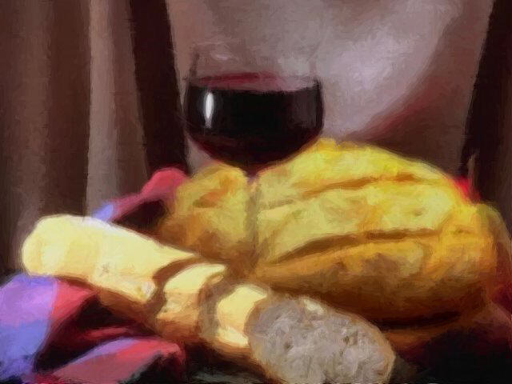

Slide 45
The King-maker
A righteous and understanding judge
A pioneer who goes out in front
A deliverer of the poor and the needy
A deliverer from oppression
A helper of the helpless
A saviour
TO BE A PRIEST FIRST AND A KING SECOND !

Slide 46
The King-maker
The choice:
the ‘god-king’ - OR - God’s King
man’s way - OR - God’s way
Man’s way to make a king is through STRENGTH
God’s way to make a king is through WEAKNESS
Man’s way to make a king is to TAKE control
God’s way to make a king is to RELINQUISH control
Man’s way to make a king is to demand SERVITUDE
God’s way to make a king is to live a life of SERVICE

Slide 47
The King-maker
The choice:
the ‘god-king’ - OR - God’s King
man’s way - OR - God’s way
Man’s way to make a king is through STRENGTH
God’s way to make a king is through WEAKNESS
Man’s way to make a king is to TAKE control
God’s way to make a king is to RELINQUISH control
Man’s way to make a king is to demand SERVITUDE
God’s way to make a king is to live a life of SERVICE

Slide 48
The King-maker
The choice:
the ‘god-king’ - OR - God’s King
man’s way - OR - God’s way
Man’s way to make a king is through STRENGTH
God’s way to make a king is through WEAKNESS
Man’s way to make a king is to TAKE control
God’s way to make a king is to RELINQUISH control
Man’s way to make a king is to demand SERVITUDE
God’s way to make a king is to live a life of SERVICE

Slide 49
The King-maker
The choice:
the ‘god-king’ - OR - God’s King
man’s way - OR - God’s way
Man’s way to make a king is through STRENGTH
God’s way to make a king is through WEAKNESS
Man’s way to make a king is to TAKE control
God’s way to make a king is to RELINQUISH control
Man’s way to make a king is to demand SERVITUDE
God’s way to make a king is to live a life of SERVICE

Slide 50
2 Chronicles 23

Slide 51
Our King is coming!

Slide 52
Our King is coming!
“LONG LIVE THE KING!”

