Slide 2
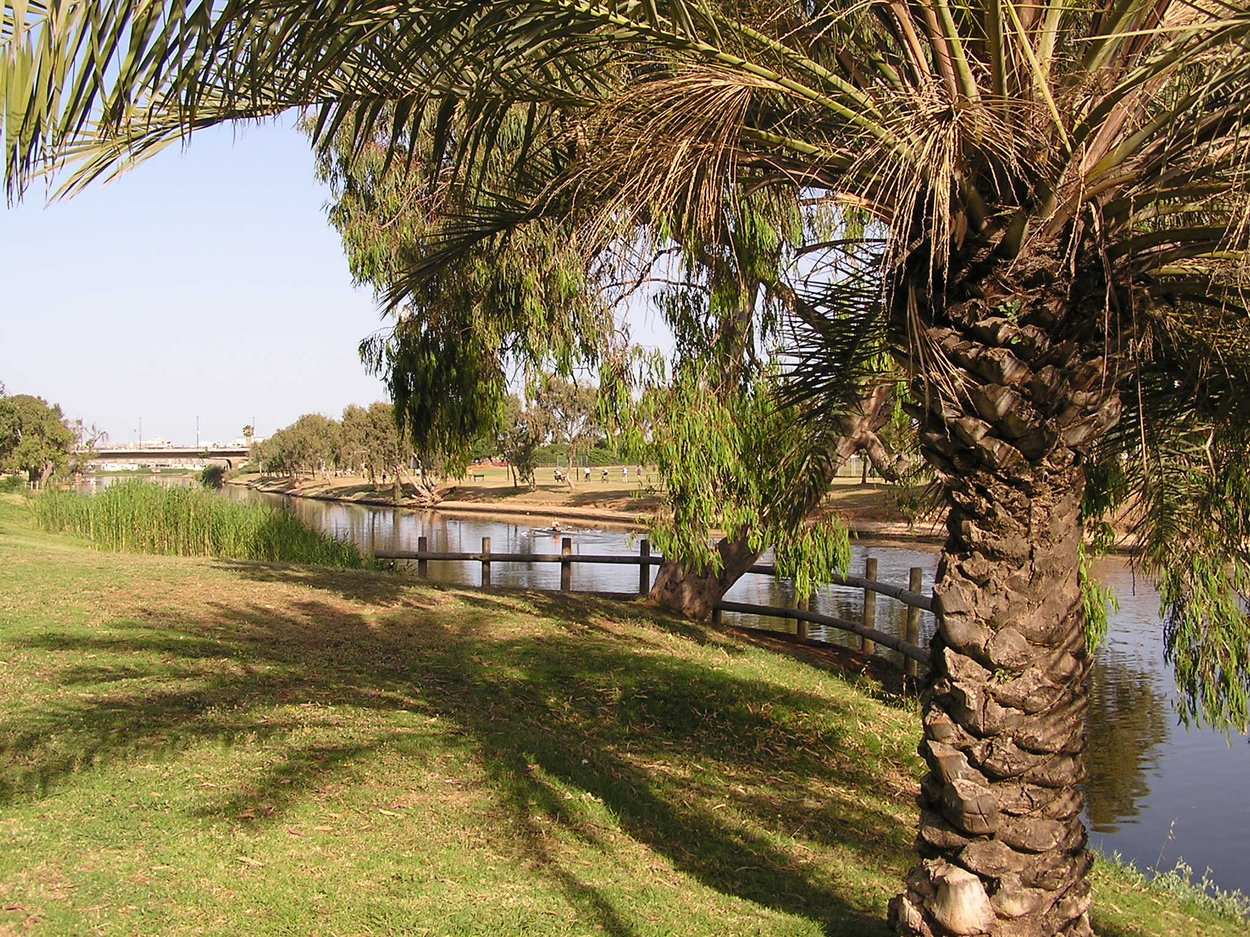
A LAND FLOWING
WITH MILK AND HONEY
FARMING IN ISRAEL IN BIBLE TIMES
Hymn no : 85
Reading : Deuteronomy 11: 8 - 21

Slide 3
“THE LAND OF PROMISE”
“FLOWING WITH MILK AND HONEY”
PART ONE

Slide 4
TWO HUNDRED YEARS
The Israelites had been in Egypt over 200 years
  i.e. 430 years from Abraham’s covenant to the Exodus (Galatians 3:17),
  less 25 years from Abraham’s promise until Isaac, Isaac was 60 when Jacob was born, Jacob was 130 when he went into Egypt
  430-(25+60+130)=210
So, over 200 years in Egypt

Slide 5
TWO HUNDRED YEARS
This means the Israelites had no memories of Canaan

Slide 6
A NATION OF SLAVES
The Israelites in Egypt were seriously oppressed
So the Egyptians made the Israelites their slaves. They made their lives bitter, forcing them to mix mortar and make bricks and do all the work in the fields. They were ruthless in all their demands’ (Exodus 1:11 – 14 ESV)

Slide 7
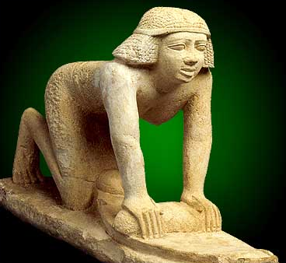
Slavery

Slide 8
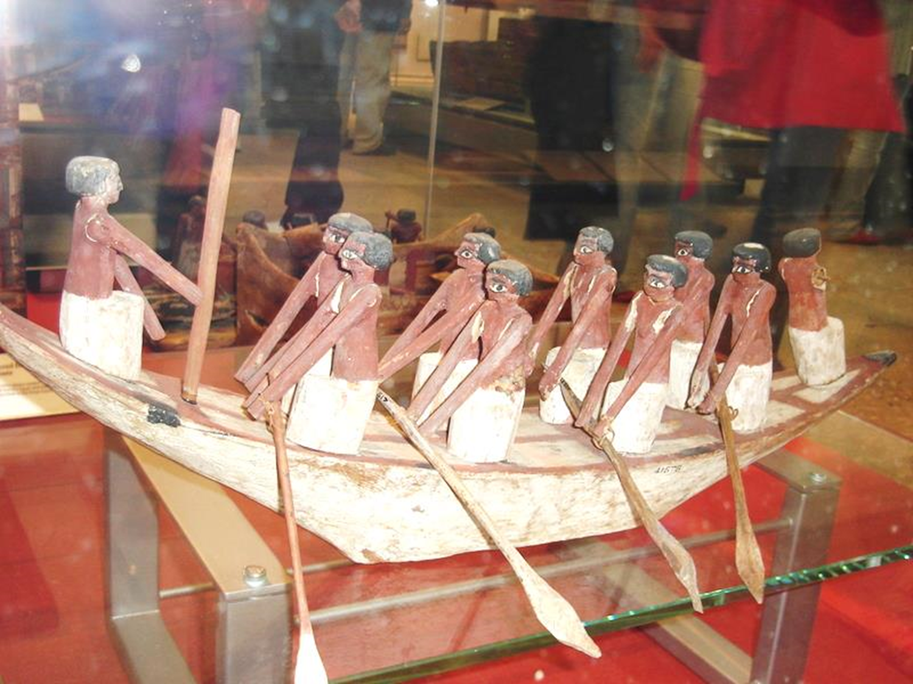
Slavery

Slide 9
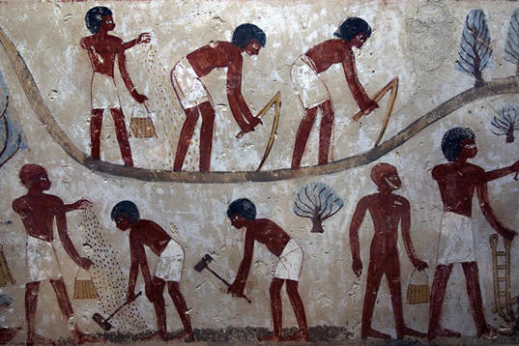
Slavery

Slide 10
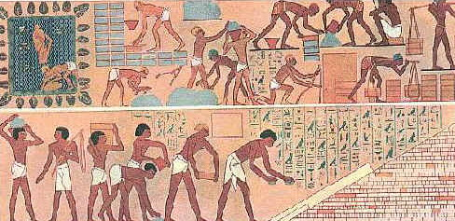
taskmaster

Slide 11
MOSES’ MESSAGE
“I have certainly seen the oppression of my people in Egypt. I have heard their cries of distress because of their harsh slave drivers. …. So I have come down to rescue them from the power of the Egyptians and lead them out of Egypt into their own fertile and spacious land. It is a land flowing with milk and honey …’” (Exodus 3:7,8)

Slide 12
MILK AND HONEY
Milk – means cows, sheep and goats - green pastures
Honey – means flowers and trees
See Deuteronomy 8:7 - 9

Slide 13
SO DIFFERENT!
See Deuteronomy 11:10 - 12
Egypt has no rain
It has no forests
Nothing grows without water from the Nile
Egyptian farming is labour-intensive

Slide 14
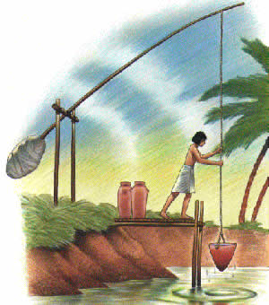
Raising water from the Nile

Slide 15
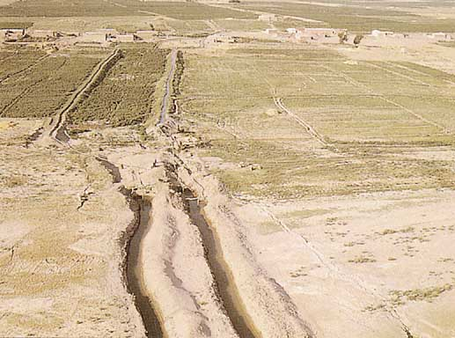
Furrow irrigation

Slide 16
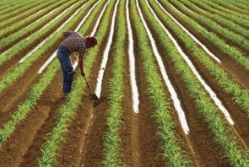
Watering with the foot

Slide 17
A SLAVE’S DREAM
In Egypt the people had no freedom and no property
The promise of having their own farms was like a dream

Slide 18
THE LAND BASIS OF THE LAW
The Law at Sinai ruled that each family would have a small-holding
The boundaries would be marked
The plot of land would stay in the family in perpetuity
It would give them the means to produce food, drink and clothing

Slide 19
THE SPIES’ REPORT
“We entered the land you sent us to explore, and it is indeed a bountiful country—a land flowing with milk and honey. Here is the kind of fruit it produces” (Numbers 13:27)

Slide 20
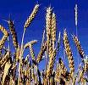
GOD KEPT HIS WORD
‘He brought us to this place and gave us this land flowing with milk and honey! And now, O LORD, I have brought you the first portion of the harvest you have given me from the ground’ (Deuteronomy 26: 9,10)

Slide 21
A LAND OF CONTRASTS
Israel had a great variety of landscapes
  The coastal plain was fertile and good for wheat
  The Shephelah foothills were ideal for grazing
  The central mountains were forested
  The Jordan valley was tropical

Slide 22
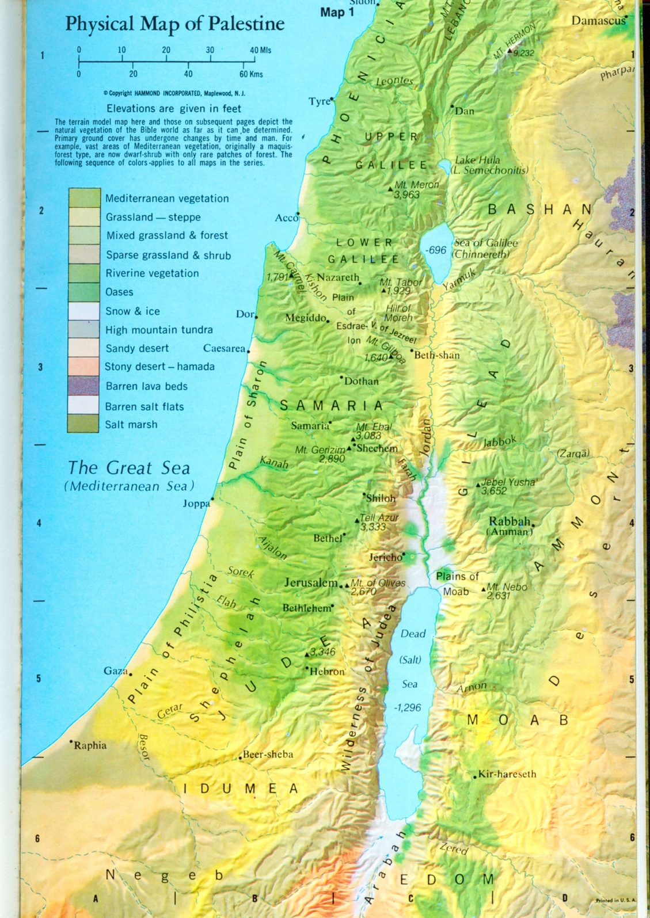
A SMALL COUNTRY
70 km
250 km

Slide 23
A RANGE OF HEIGHTS
+800m
-365m

Slide 24
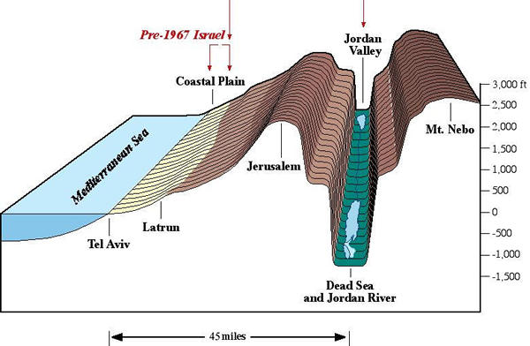
CROSS SECTION
THROUGH ISRAEL

Slide 25
Coastal plain
wheat

Slide 26
Shephelah
cattle and sheep

Slide 27
Mountains
timber, sheep and goats

Slide 28
Arabah
palms, vegetables

Slide 29
Gilead
cattle

Slide 30
THE WET SEASON
The ‘Early rains’ in October allow seed sowing (Joel 2:23)
‘Winter rain’ falls from December to February (Ezra 10:9)
It may snow in January/February on the hills
The “Latter rains” in March bulk out the crops (Hosea 6:3)

Slide 31
THE DRY SEASON
  From May to October it is completely dry
  But the nights are cold, and dew is important (Hosea 6:4)

Slide 33

END OF PART ONE

Slide 34
A LAND FLOWING
WITH MILK AND HONEY
FARMING IN ISRAEL IN BIBLE TIMES
Hymn no : 426
Reading : Deuteronomy 8:1-18

Slide 35

“THE BREAD OF LIFE”
“FLOWING WITH MILK AND HONEY”
PART TWO

Slide 36
THE STAFF OF LIFE
Bread is first mentioned in Genesis 3:18 (grain) and 3:19 (bread)
This implies Adam cultivated cereals, made flour and baked bread
Lot baked unleavened bread (Genesis 19:3)
Both wheat and barley were grown in the Land of Promise (Deuteronomy 8:8)
Barley ripens first (Exodus 9:31,32)

Slide 37
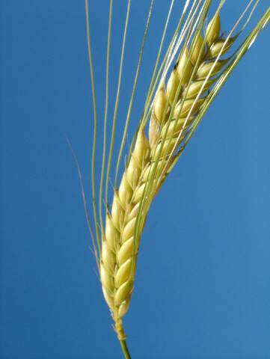
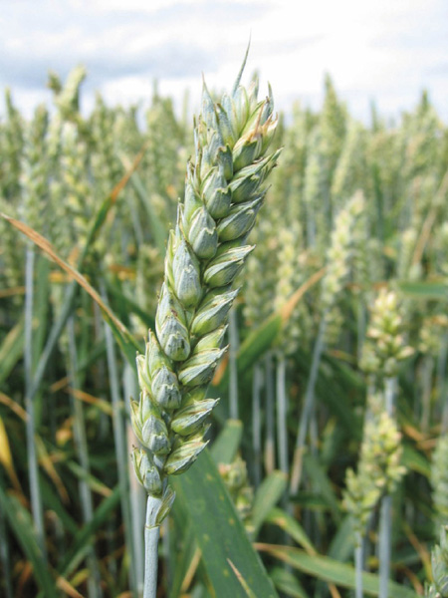
barley
wheat

Slide 38
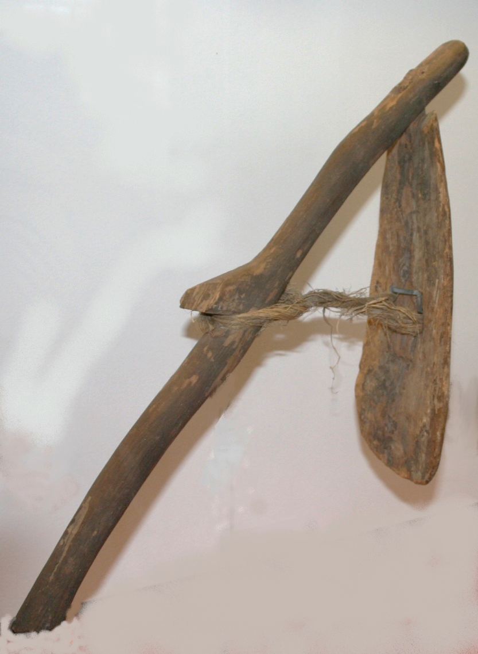
CULTIVATING THE SOIL
The soil must be broken up before sowing
this is only possible after the Early Rains
it could be done by hand with a mattock
See Isaiah 7:25

Slide 39
Slavery

Slide 40
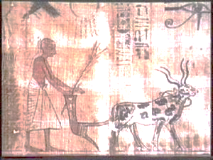
PLOUGHING
Ancient ploughs simply split open the soil
ard

Slide 41
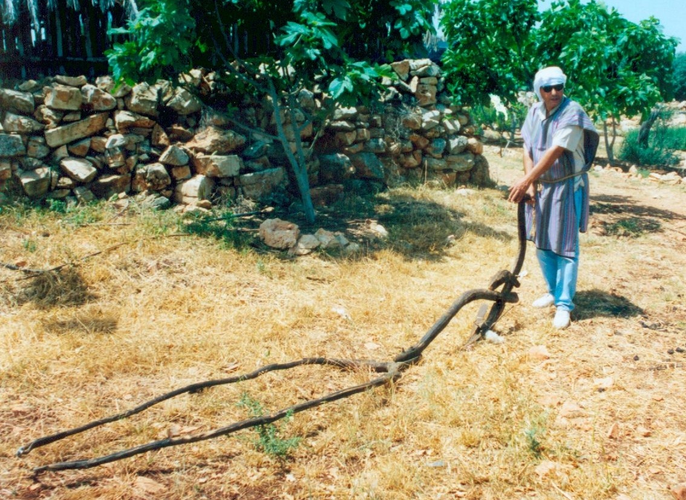
PLOUGHING

Slide 42
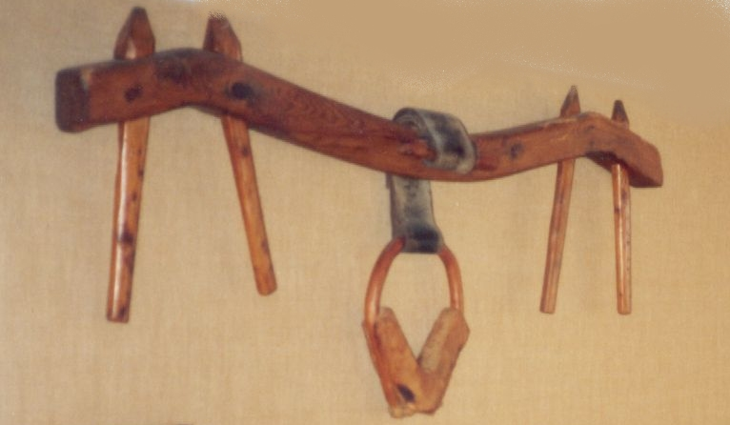
YOKES
For extra power animals were yoked in pairs

Slide 43
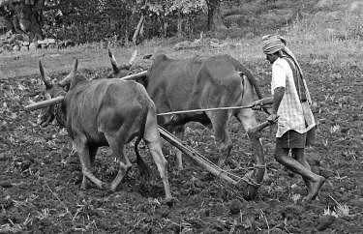
PLOUGHING

Slide 44
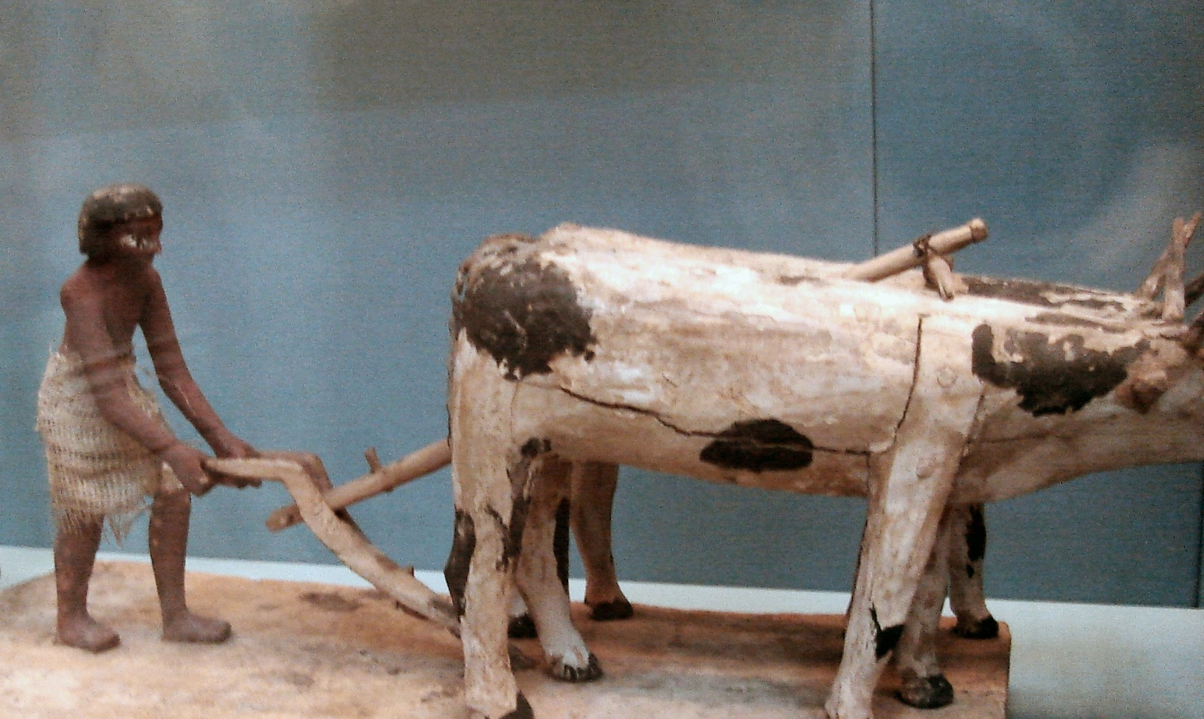
PLOUGHING IN EGYPT

Slide 45
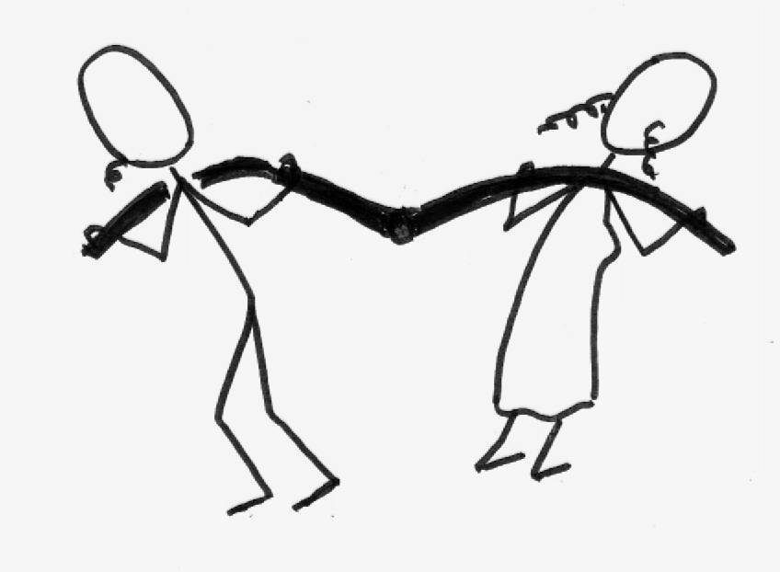
YOKES
The Law forbade yoking different species
Paul says we should not be yoked with unbelievers (2 Corinthians 6:14)

Slide 46
YOKES
Jesus offers to be yoked with us (Matthew 11:29)

Slide 47
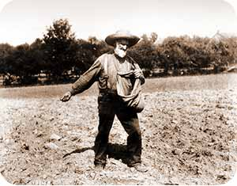
SOWING
Seed for sowing was precious (Psalm 126:6)
It was scattered by hand from a bag
It fell randomly on the ground (as in the Parable of the Sower)

Slide 48
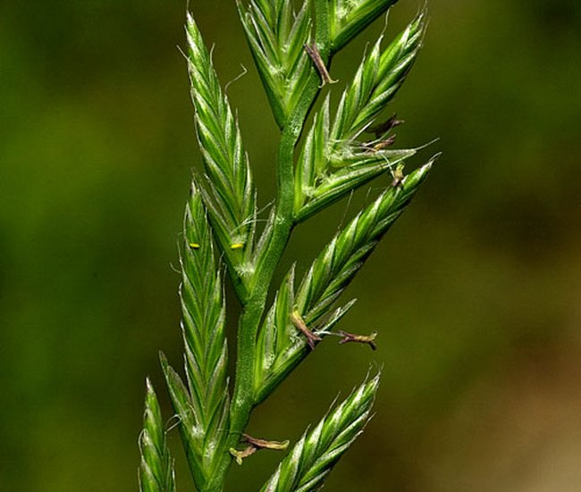
WEEDS
Jesus mentions weeds that grew in the crop
  thorns and thistles in ‘The Sower’
  tares in ‘The Wheat and Tares’ (rye grass looks like wheat but gives no crop, needs pulling out)

Slide 49
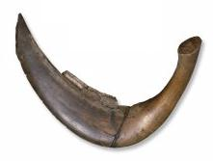
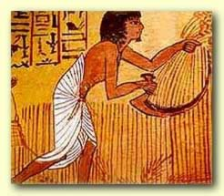
HARVEST
The ripe wheat stalk was severed with a sickle
flints

Slide 50
HARVEST
The cut heads were gathered and bound with straw ‘ropes’
The bundles were taken to the threshing floor
This was in a windy place (e.g. the Temple Mount)

Slide 51
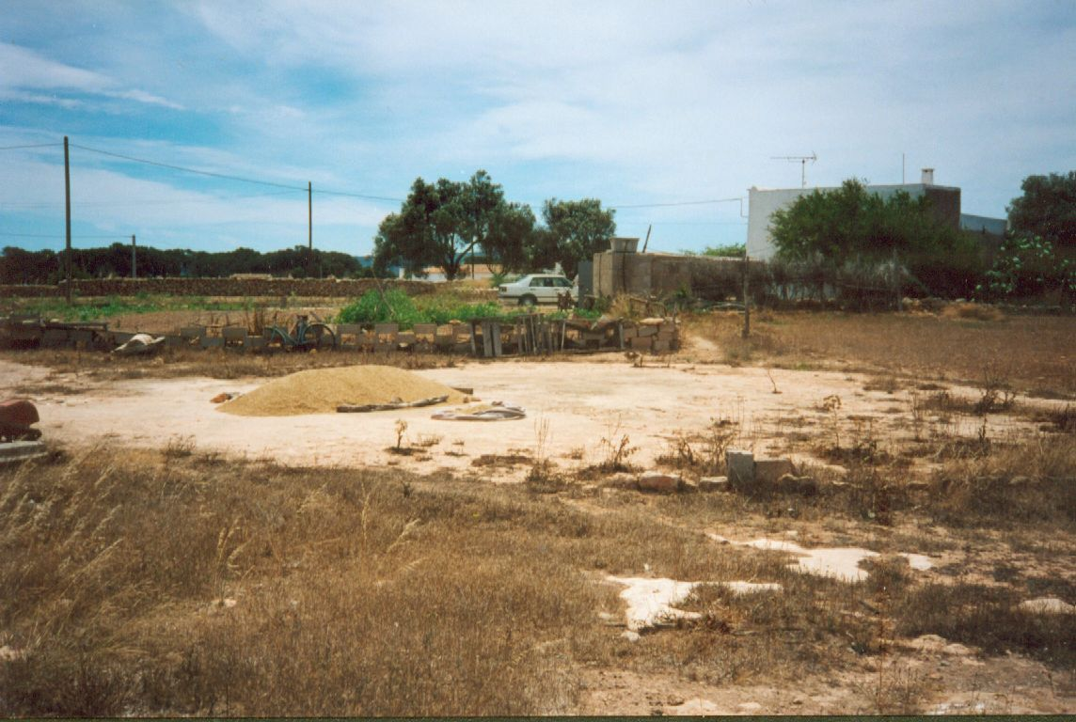
Village threshing floor

Slide 52
THRESHING
Threshing releases the grain from its inedible sheath
It could be threshed by trampling with animals
(‘thou shalt not muzzle the ox that treadeth out the corn’)
or towing a threshing sledge (see Isaiah 41:15)

Slide 53
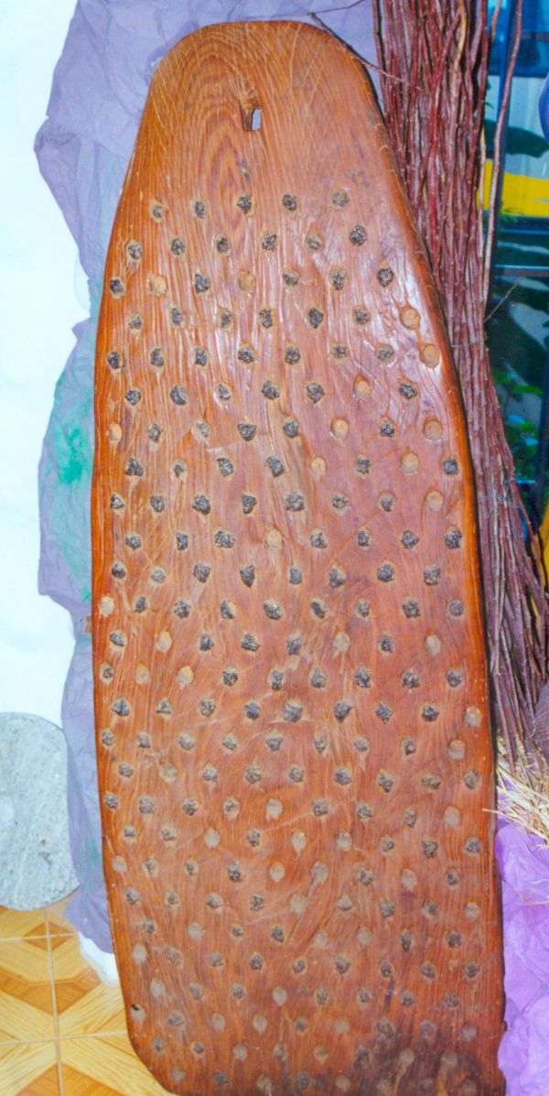
Mediterranean threshing sledge

Slide 54
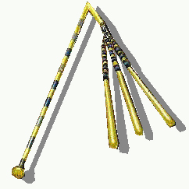
THRESHING
On a small scale, and for smaller seeds, a flail was used.
See Isaiah 28:26 - 28

Slide 55
WINNOWING
The mixed grain and chaff is thrown into the air with a hand-held fan for the wind to separate it
Gideon tried to conceal his dust cloud!

Slide 56
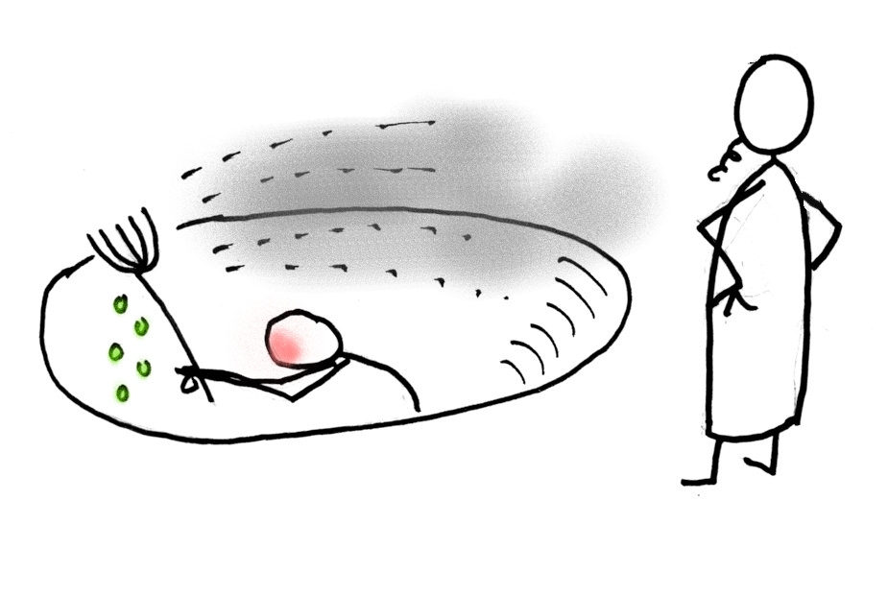

Slide 57
SIEVING
If the grain had stones or husks mixed with it, it was sieved
Sieving also removes weed seeds which could contaminate seed corn
(see Amos 9:9)

Slide 58
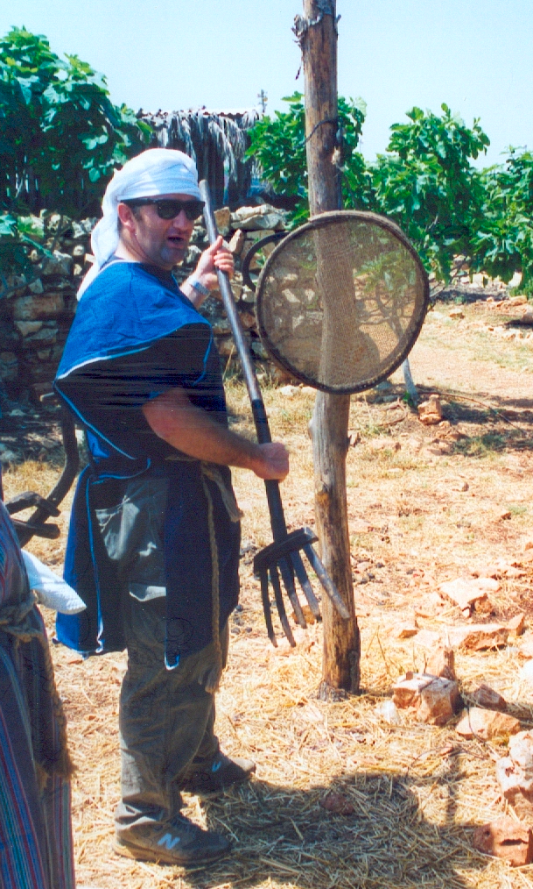
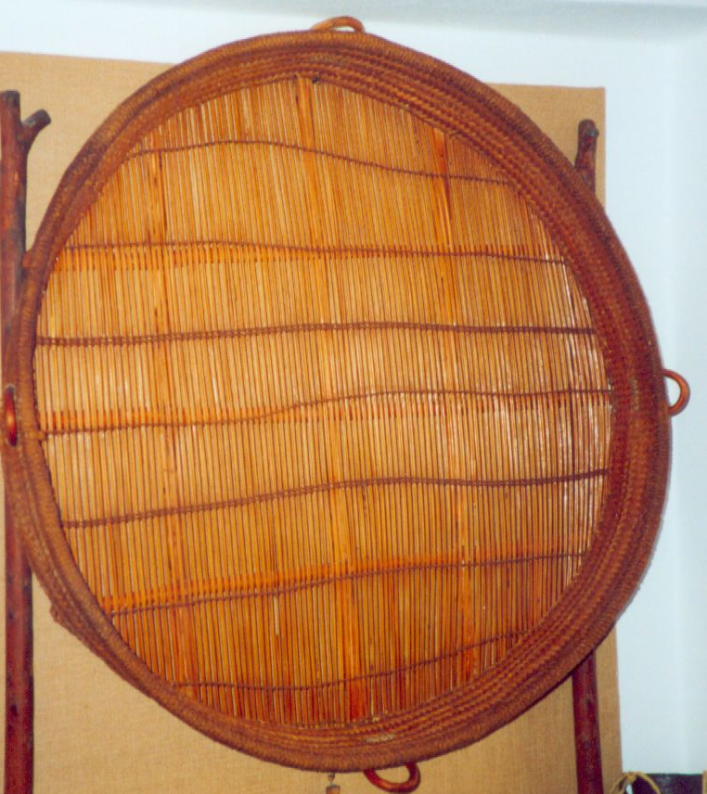
Corn sieves

Slide 59
STORAGE
The grain was stored in a dry pit or in pottery urns
After the harvest, the chaff was burnt
(see Matthew 3:12)

Slide 60
MAKING BREAD
The grain for bread was ground daily by women
The quern is the oldest device

Slide 61
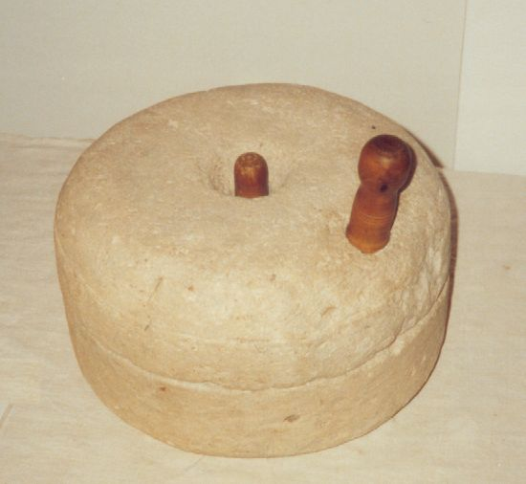
MAKING BREAD
Millstones were more efficient

Slide 62
MAKING BREAD
Two women were needed to turn the top stone
‘… two women will be grinding flour at the mill; one will be taken, the other left’ (Matthew 24:41)

Slide 63
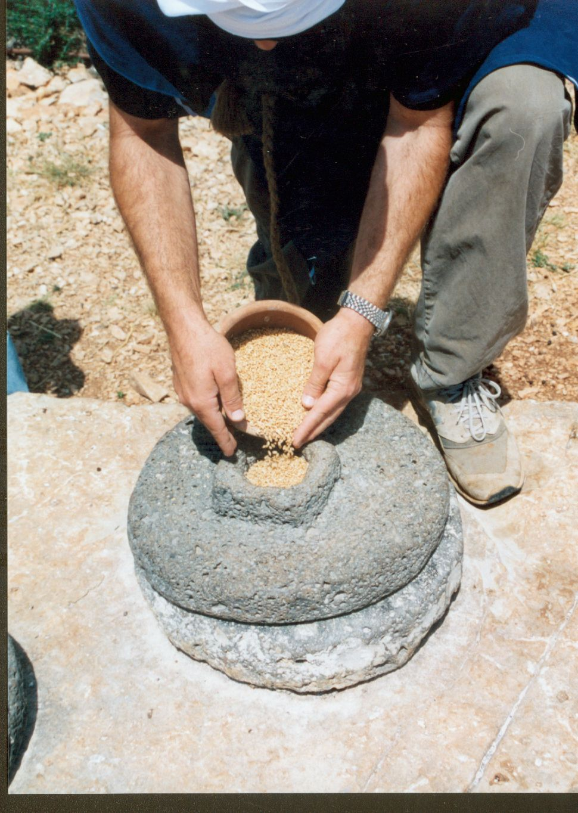
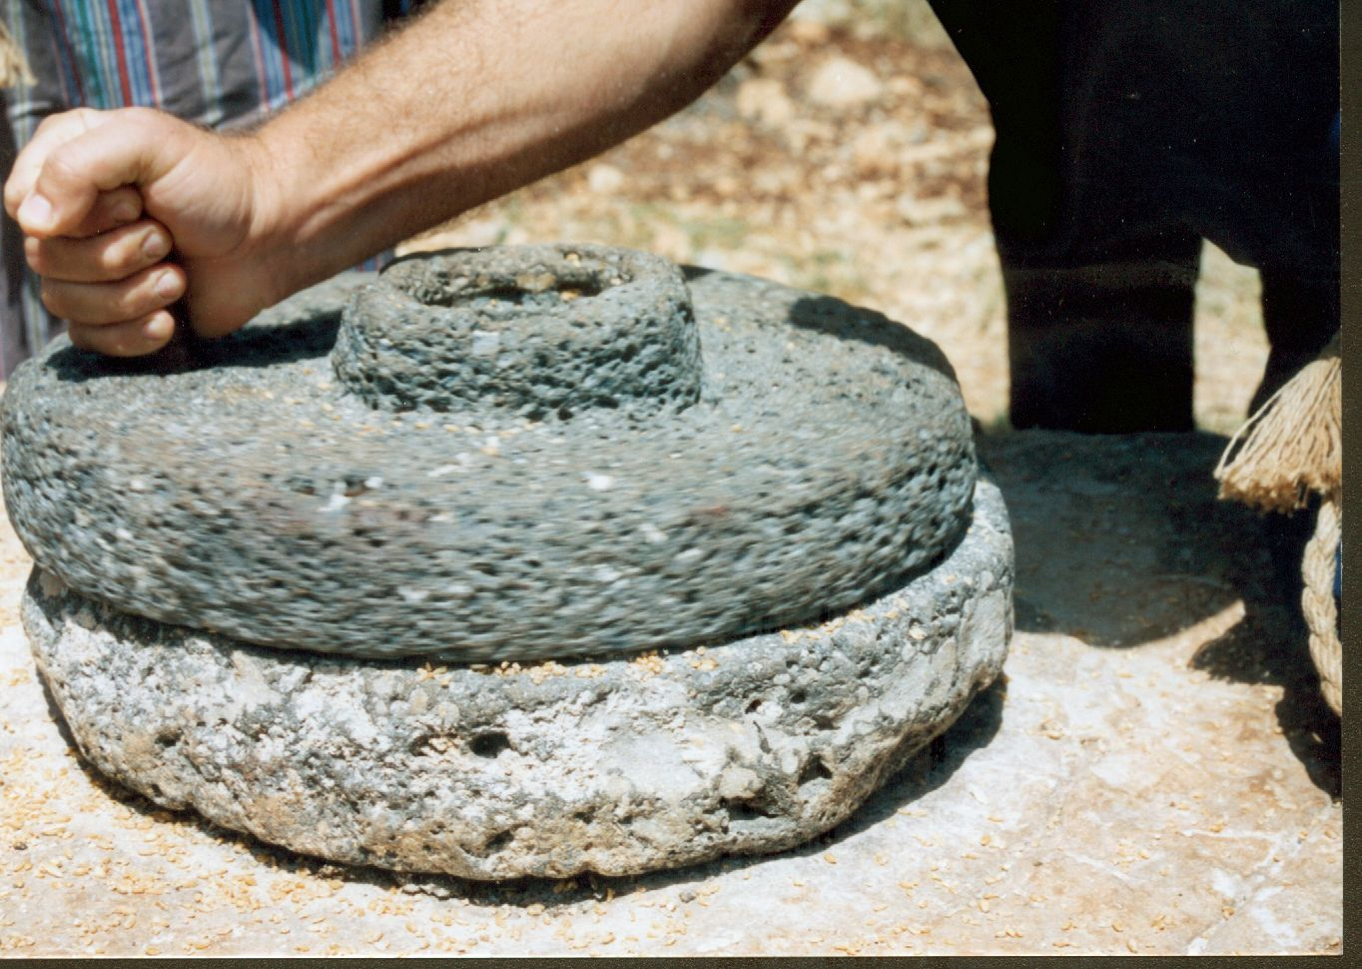

Slide 64
BAKING BREAD
The ground flour was mixed with water, salt and leaven
Leaven is a mixture of yeast and lacto-bacillus bacteria
It creates gas bubbles, which lift the dough
e.g. the Parable of the leaven

Slide 65
THE PARABLE OF THE LEAVEN
  ‘It is like leaven, which a woman took and hid in three measures of meal, till the whole was leavened’ (Luke 13:21)
Three measures is 21kgs of flour – bread for 100 people!

Slide 66
BAKING BREAD
The dough was left to ‘prove’ (rise) in a warm oven
The oven was made of stone or pottery
After proving, the oven was heated up with brushwood or grass
‘if God cares so wonderfully for flowers that are here today and thrown into the fire tomorrow …’ (Luke 12:28)
The dough was then left to cook
See Hosea 7:4,6

Slide 67
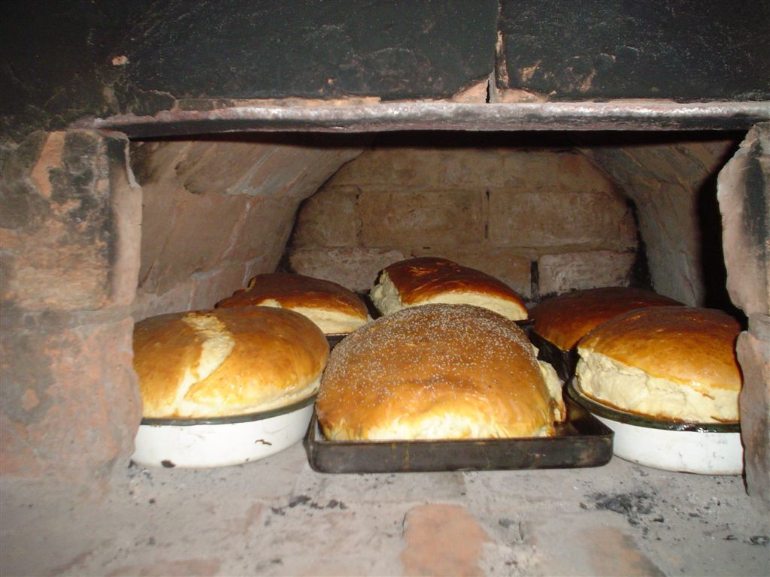
Traditional brick oven

Slide 68
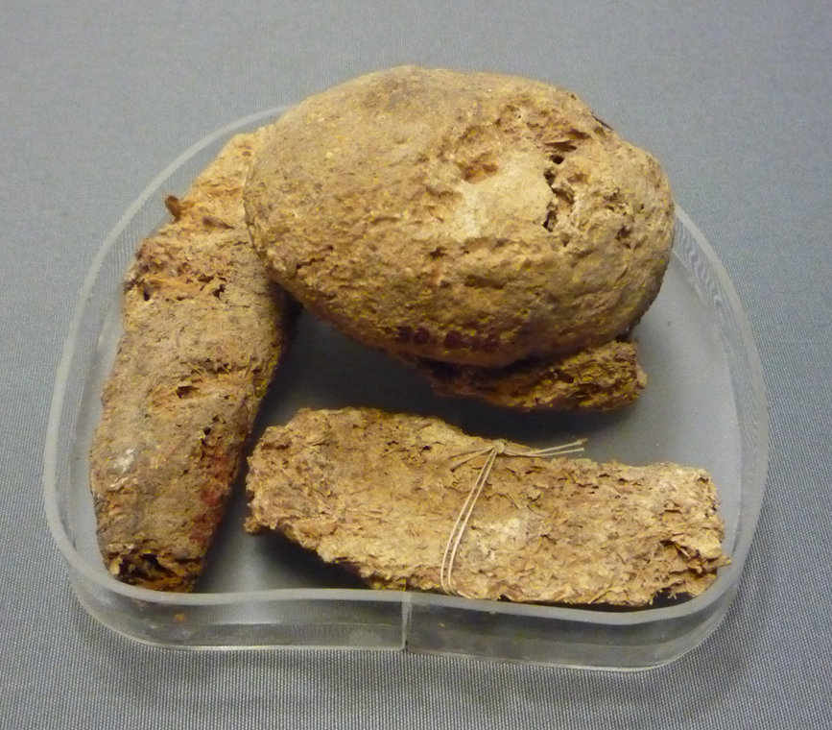
Bread from an Egyptian tomb

Slide 69
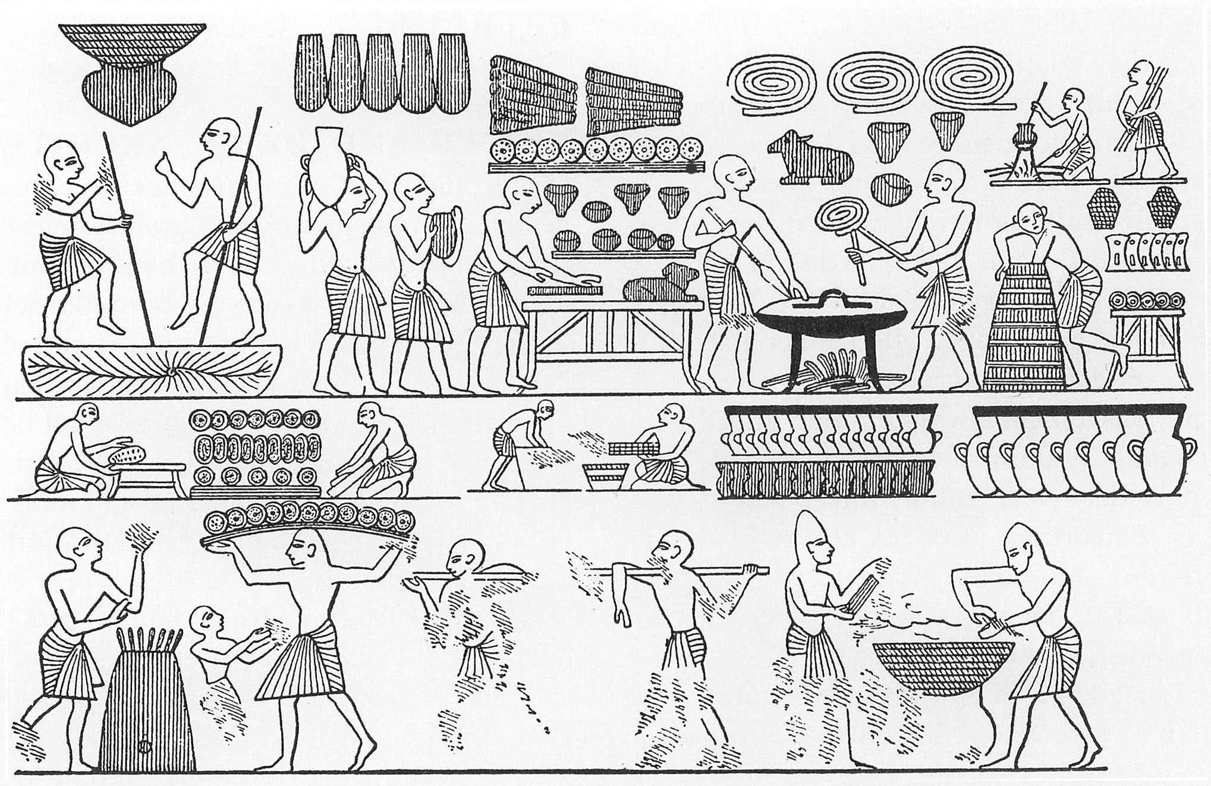

Slide 70
SYMBOLISM OF BREAD

Slide 71
THE BREAD OF LIFE
Bread and wine were the staple diet
Jesus represents the bread from heaven that gives eternal life

Slide 72
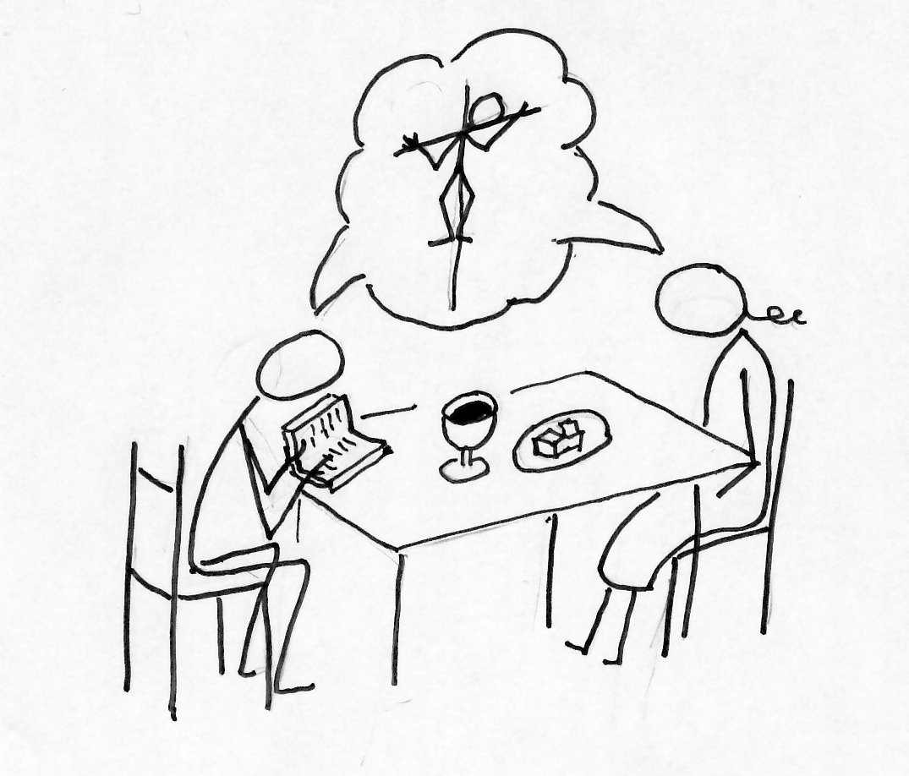

Slide 73
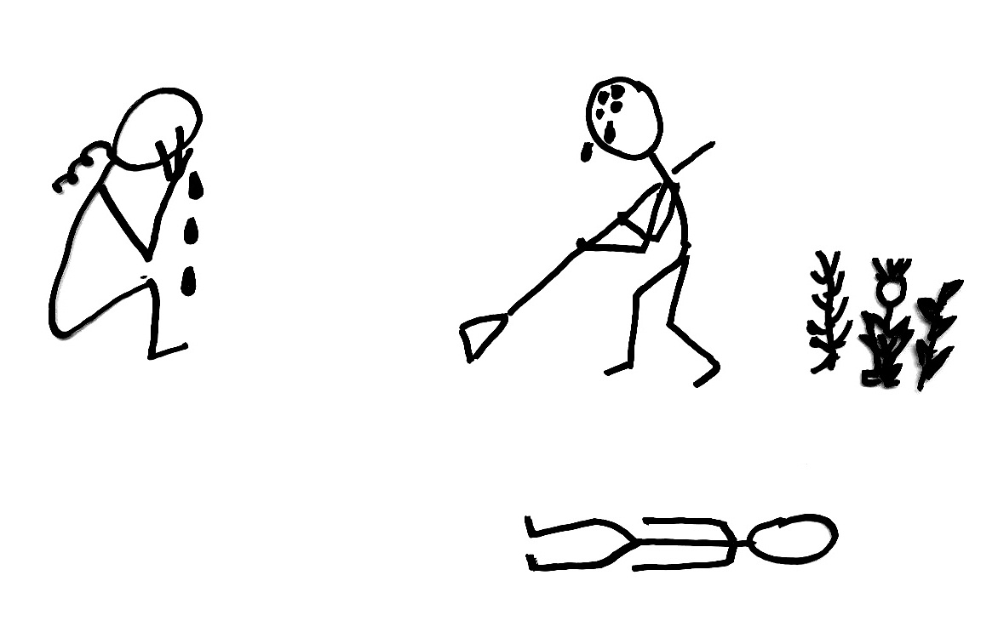
THE BREAD OF LIFE
Today we live by toil
‘In the sweat of thy face shalt thou eat bread ..’
In reality, we live by God’s word
‘..man doth not live by bread only, but by every word that proceedeth out of the mouth of the LORD’

Slide 74
THE BREAD OF LIFE
Jesus takes away the Curse
He can give us the right to eat of the Tree of Life

Slide 75
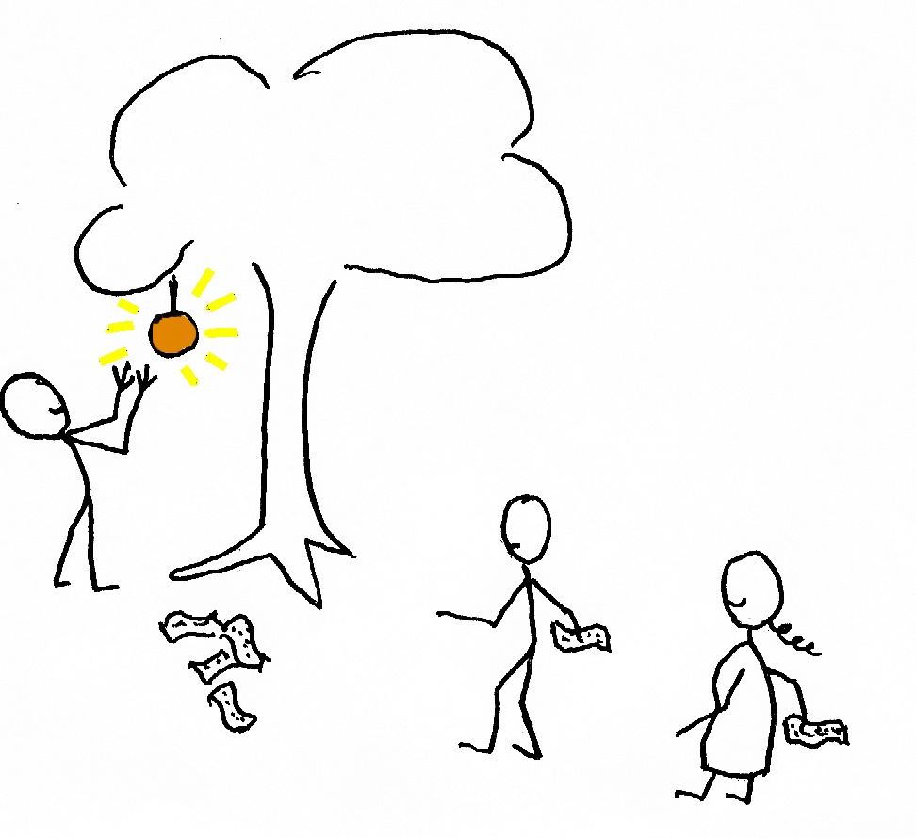

Slide 76
END OF PART TWO
Hymn no: 426

Slide 77
A LAND FLOWING
WITH MILK AND HONEY
FARMING IN ISRAEL IN BIBLE TIMES
Hymn no : 316
Reading : Psalm 104:1-24

Slide 78
“OIL TO MAKE HIS FACE TO SHINE”
“FLOWING WITH MILK AND HONEY”
PART THREE

Slide 79
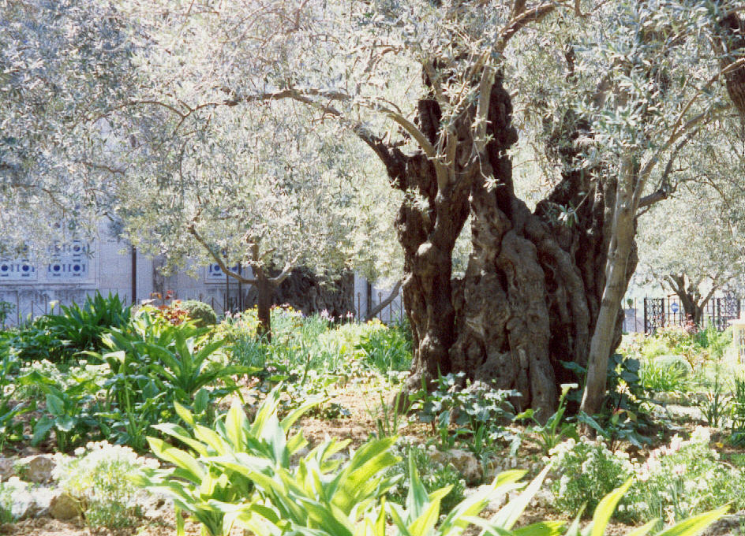
THE OLIVE TREE

Slide 80
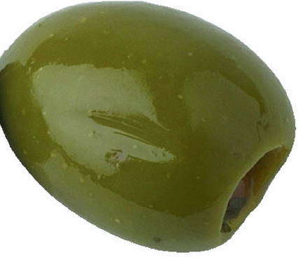
OLIVES
Olive trees are grown for their berries
These can be eaten whole
Or they can be pressed to extract the liquid oil

Slide 81
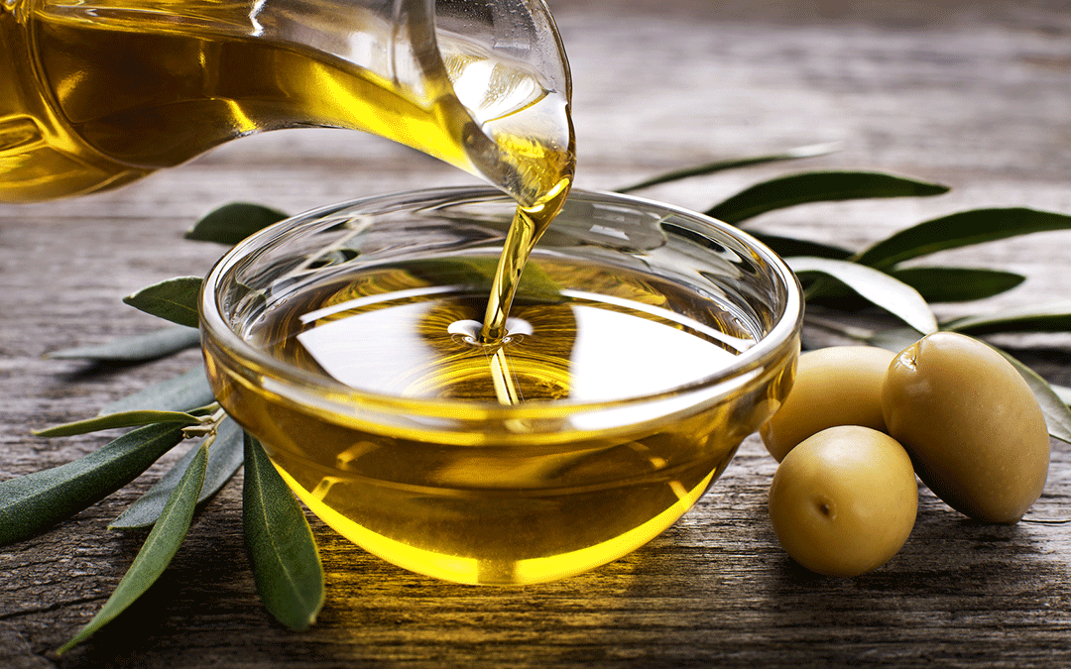

Slide 82
OLIVE OIL
The oil of the olive tree was essential to a comfortable life in the Land
It was used for
  light
  cooking
  medicine
  cosmetics
The olive tree also gives ornamental timber

Slide 83
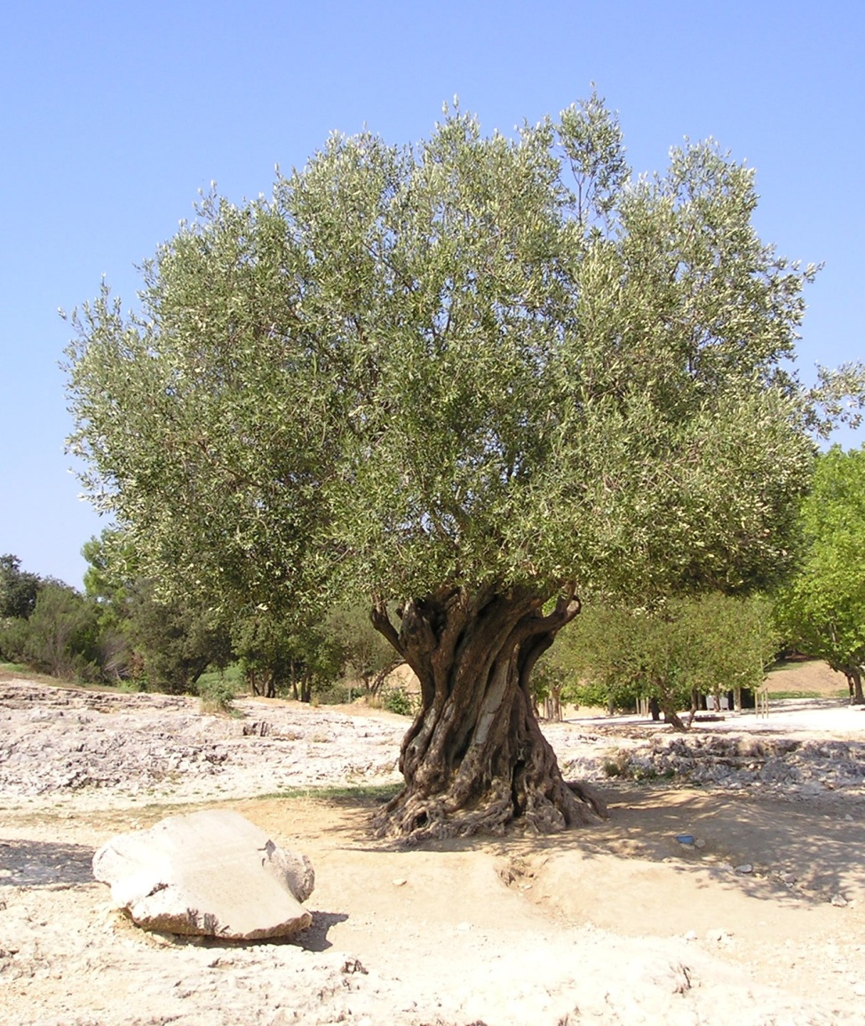
OLIVE TREES
Olive trees live up to 2000 years
they are evergreen
they thrive in dry, stony soils
see Deuteronomy 32:13

Slide 84
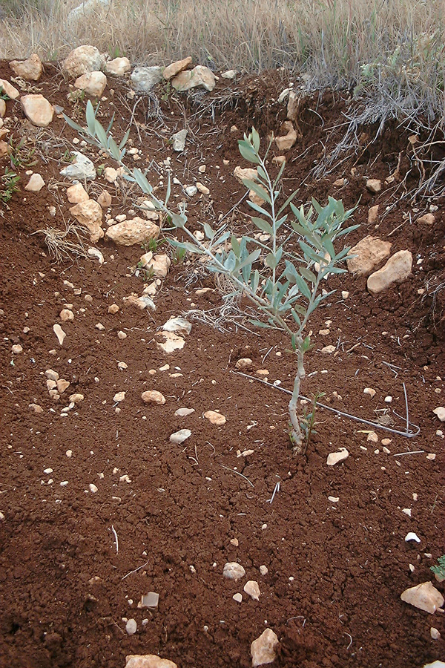
OLIVE TREES
Like apples and roses, cultivated olives are grafted, to control the characteristics

Slide 85
OLIVE TREES
Wild olives are bitter and inedible
Grafting or rooting cuttings is a form of cloning
It fixes height, yield and quality
There are 700 million olive trees around the Mediterranean

Slide 86
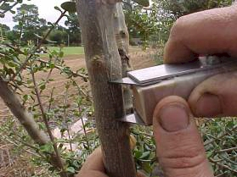
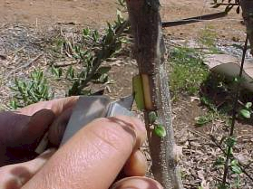
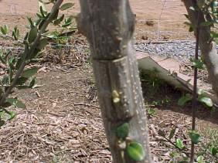
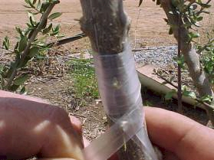
grafting olives

Slide 87
PAUL’S HORTICULTURE LESSON
Paul’s analogy in Romans 11:17 is a process ‘contrary to nature’ (verse 24)
Perhaps this illustrates God’s mercy – he is prepared to forego a higher yield, to save us

Slide 88
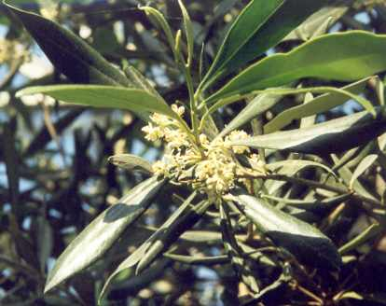
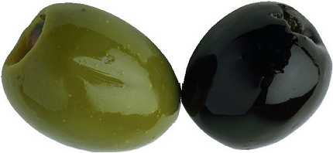
GROWTH AND MATURITY
It takes five or six years to first fruit
the flowers are yellow
the berries are first green, then ripen to black

Slide 89
HARVESTING
Harvesting is November to January
the tree is shaken or beaten (see Isaiah 24:13, Deuteronomy 24:20)
the berries are then picked up by hand

Slide 90

Greek urn with olive harvest

Slide 91


Slide 92
OLIVES
Fresh olives are bitter
They are fermented and stored in brine to make them good to eat

Slide 93
EXTRACTING THE OIL
To make olive oil, the berries and pits (stones) are crushed by a roller

Slide 94

Berry crusher

Slide 95
EXTRACTING THE OIL
The slimy pulp is packed into string bags

Slide 96

Pulp bag

Slide 97
EXTRACTING THE OIL
A stack of bags is fitted under the olive press
the weights squeeze out the oil and juices
Gethsemane means ‘olive press’

Slide 98

lever
weights
bags

Slide 99


Slide 100
HOW MUCH OIL?
The pure oil floats on the watery berry juices and is skimmed off
A typical tree yields 10 kg of fruit
10 kg yields1.5 to 2 litres of oil

Slide 101
HOW MUCH OIL?
See 2 Chronicles 2:10
1 bath = 22 litres
20,000 x 22 litres = 440,000 litres
This means 300,000 trees were devoted to oil rations for Hiram’s workers

Slide 102
OIL FOR LIGHT
Pottery lamps had a woven wick of flax
The oil burns with a clear yellow light

Slide 103

ancient oil lamp

Slide 104

OIL FOR LIGHT
The flax needs trimming as it chars and curls, or it will smoke
see Exodus 37:23
see Isaiah 42:3
snuffer

Slide 105
OIL FOR HEALTH
See Psalm 23:5
See Daniel 10:3
See Mark 6:13

Slide 106
OIL FOR COOKING
See Exodus 29:2

Slide 107


OLIVE WOOD FOR TIMBER
See 1 Kings 6:23, 31

Slide 108
SYMBOLISM OF THE OLIVE

Slide 109

THE OLIVE BRANCH
The olive branch has come to symbolise peace
(Genesis 8 v 11)

Slide 110
LIGHT IN DARKNESS
The Tabernacle was dark
The Lampstand provided light
See Exodus 25 v 31 – 33, v 37
It was a golden almond tree

Slide 111

THE MENORAH

Slide 112
LIGHT IN DARKNESS
The olive oil burning represents the Word of God
It guides our way
We are called to shine in a dark world
The Holy Spirit given to the apostles was like oil which anointed their heads
See 1 John 2:20

Slide 113
LIGHT IN DARKNESS
We take in the oil from Scripture, then give it out
See Zechariah 4:1-3 and 12-14

Slide 114


Slide 115
THE GARDEN OF GETHSEMANE
The Mount of Olives is still covered with olive groves

Slide 116
THE BATTLE
Here the greatest battle in human history was fought – and won – surrounded by olives

Slide 117

THE MOUNT OF OLIVES

Slide 118
THE RETURN
To this place the Lord will return in glory

Slide 119


Slide 120
THE RETURN OF THE LORD
‘Then the LORD will go out to fight against those nations, as he has fought in times past. On that day his feet will stand on the Mount of Olives, east of Jerusalem. And the Mount of Olives will split apart . . . Then the LORD my God will come, and all his holy ones with him. And the LORD will be king over all the earth. On that day there will be one LORD—his name alone will be worshipped’ (Zechariah 14:3,4,9)

Slide 121
END OF PART THREE

Slide 122
Emma Barker
David Pearce
1861
1946
2019
158 years

Slide 123
SOME AMAZING ARITHMETIC
I spoke to Granny Barker, who was born in 1861
That is a span of 158 years
Repeat that 26 times
Call those twenty six people into this room
One of them would be Japhet, who was born before the Flood
Two more, and one of them could be Eve
Notes:
Three and a half months to Australia

Slide 124
END OF PART THREE
Hymn no: 140

Slide 125
A LAND FLOWING
WITH MILK AND HONEY
FARMING IN ISRAEL IN BIBLE TIMES
Hymn no : 225
Reading : Isaiah 5:1-7

Slide 126
“WINE THAT MAKES GLAD THE HEART”
“FLOWING WITH MILK AND HONEY”
PART FOUR

Slide 127


Slide 128
THE FRUIT OF THE VINE
Vines were grown for grapes to make wine
Wine is a ‘safe’ drink where water is often contaminated
The alcohol acts as an antiseptic

Slide 129
EARLY REFERENCES
The Law referred to vineyards (see Leviticus 19:10)
The Canaanites had productive vines (see Numbers 13:23, 24)

Slide 130


Slide 131
VITICULTURE
Grapes are found in the wild

Slide 132

Wild grapes

Slide 133
GRAPE PRODUCTION
Cultivated grapes are grafted to preserve characteristics and combat disease
Vines thrive on sunshine and good drainage
Vines die in frost
Israel is covered with ancient terraces used for vines and olives
Terraces reduce the impact of erosion during storms and allow rain to soak in

Slide 134

Ancient terraces

Slide 135
GRAPE PRODUCTION
A traditional vineyard had a wall or hedge, and a tower for observation
This was to prevent damage by wild animals (see Psalm 80:8, 12, 13)
It also had a vat for the juice
see Isaiah 5:1,2

Slide 136

Vineyard watch tower

Slide 137

ancient juice vat

Slide 138
TRAINING
The young vines were planted in rows
They could be trained onto frames or walls
It takes three years to produce grapes

Slide 139

A modern vineyard

Slide 140
THE VINEYARD YEAR
As the vines branches shoot from the twisted stem they are pruned heavily to admit light and air
For eating grapes, the bunches are thinned out drastically to give bigger berries
see John 15:1,2

Slide 141

Vine bud

Slide 142

Vine flower

Slide 143

Pruning

Slide 144

Effects of pruning

Slide 145
THE VINE YEAR
Harvest comes in September when there is a ‘bloom’ on the fruits
The grape bunches were cut off with a sickle
See Revelation 14:18 - 20

Slide 146

The vintage

Slide 147
THE VINE YEAR
The wine vat was filled with grapes
Men trampled the berries to release the juices
Loud shouts kept the trampling coordinated
(see Jeremiah 25:30 and 48:32, 33)

Slide 148
WINE PRODUCTION
The juice was run off into a separate vat to settle
It was transferred to jars to ferment quickly
Once fermentation ceased the jars were sealed
Goatskins or sheepskins were an alternative container (see Matthew 9:17)

Slide 149
END OF THE YEAR
In the winter months the vines were pruned back to the stems
Briars and brambles were removed
Diseased branches were cut off
The clippings were burnt
see Isaiah 27:2, 4,11

Slide 150

Winter pruning

Slide 151

Burning the clippings

Slide 152
VINE TIMBER
The sole purpose of vines is to produce fruit
Vines are not ornamental
Vine wood is no good for timber
see Ezekiel 15:2 - 4

Slide 153

Vine wood

Slide 154

Vines are grown only for fruit

Slide 155
STRONG DRINK

Slide 156
BARLEY FOR BEER
Barley can be used for bread making
But its main use is for beer
In KJV, ‘strong drink’!
Distillation to enhance alcohol content was unknown in Bible times
The Philistines drank beer

Slide 157
BREWING BEER
Stage 1: Barley grains are spread out and wetted
After sprouting, the ‘malt’ is roasted and ground
Malt and water are mixed and warmed
Enzymes turn starch into sugars
Stage 2: The brew is then fermented with yeast
Modern beer is flavoured with hops

Slide 158

Beer recipe
Notes:
2050 BC in Ur

Slide 159

malted barley

Slide 160

Beer jars

Slide 161
WINE – GOOD AND BAD

Slide 162
GOOD
Wine contains alcohol. The yeasts die when the content reaches 10 to 13%
Beer has around 5% alcohol
Alcohol kills germs (as before an injection!)
Where water can be contaminated, the alcohol makes it safer. Wine was mixed with water for drink on a hot day
Paul advised Timothy to change from water (1 Timothy 5:23)

Slide 163
GOOD
Communion wine is fortified by adding more alcohol from distillation, and transfer of disease is therefore unlikely
The soldiers at the crucifixion had sour wine (John 19:29)
Scientists say if you drink a moderate amount of wine (125 ml) per day you will live longer than a teetotaller

Slide 164
BAD
Alcohol slows reaction time (e.g. when driving, walking or speaking)
It switches off inhibitions (cf. ‘Dutch courage’, crimes, immoral behaviour and domestic violence)
It knocks out our temperature control system (see Genesis 9:20, 21)

Slide 165
BAD
Alcohol is toxic, so the stomach rejects it (see Isaiah 28:7,8)
The liver deactivates alcohol in the blood stream, but this takes time
Alcohol is addictive, (see Proverbs 23:30-34)
The high calorie content diminishes appetite, so inbalancing the diet
Alcoholism eventually leads to cirrhosis of the liver and death

Slide 166

SYMBOLISM OF THE GRAPE

Slide 167
SYMBOLISM OF THE GRAPE
The sole purpose of the vine was to produce fruit – in symbol, the fruit of the Spirit
See Isaiah 5:7
Jesus says God ‘prunes’ us to increase our yield
See John 15:2
God’s word is the pruning knife
We must be united and linked back to Jesus (verse 5)

Slide 168
SYMBOLISM OF THE GRAPE
The alcohol in wine (and strong drink) dulls the conscience and removes reasoning (as Noah discovered)
The Woman in Revelation 17 fools the nations with her false teaching:
    ‘Babylon was a golden cup in the LORD's hand, making all the earth drunken; the nations drank of her wine; therefore the nations went mad’
    (Jeremiah 51:7).

Slide 169
SYMBOLISM OF THE GRAPE
Genesis 49:10–12 is a remarkable prophecy of Jesus’ death
‘The sceptre shall not depart from Judah, nor the ruler's staff from between his feet, until tribute comes to him; and to him shall be the obedience of the peoples. Binding his foal to the vine and his donkey's colt to the choice vine, he has washed his garments in wine and his vesture in the blood of grapes’ (Genesis 49:12)

Slide 170
SYMBOLISM OF THE GRAPE
Grape juice and wine resemble the life-giving blood of Jesus
‘Jesus said to them, "Truly, truly, I say to you, unless you eat the flesh of the Son of Man and drink his blood, you have no life in you. Whoever feeds on my flesh and drinks my blood has eternal life, and I will raise him up on the last day’ (John 6:53, 54)

Slide 171


Slide 172
END OF PART FOUR
Hymn no: 226

Slide 173
“SHEEP AND OXEN AND FAT CATTLE”
“FLOWING WITH MILK AND HONEY”
PART FIVE

Slide 174

CATTLE

Slide 175
CATTLE
The agricultural economy included cattle
Cows yield milk, butter, cheese, leather and meat
Oxen provide motive power

Slide 176
CATTLE
As ruminants, cattle need a lot of grass
Less sure-footed than sheep, they thrive on level ground
Hence the choice of the plateau east of Jordan by the two and a half tribes
See Numbers 32:1,2

Slide 177
OXEN
The ox has great pulling power
A yoke is needed to transfer the energy without chafing
It can be clipped to the horns
Or around the shoulders

Slide 178

Oxen yoked by the horns

Slide 179

Shoulder yokes

Slide 180
OXEN
Oxen transform the amount of work that can be done
See Proverbs 14:4
Elisha’s family had 12 ox teams (see 1 Kings 19:19)
An ox could incite envy (see Deuteronomy 5:21)
The ox was to share in the crop (see 1 Corinthians 9:9)

Slide 181
COW FACTS
Cows bear calves after 9 months
The calf is separated from the mother so that the milk can be kept for humans (see 1 Samuel 6:7, 12)
Lactation lasts a two or three years
After a few months the cow is normally mated to produce another calf

Slide 182

MILK
Milk soon sours without refrigeration
Bacteria produce acids which curdle the milk
The curds can be eaten fresh or dried
See Judges 5:25

Slide 183

CHEESE
If rennet (enzyme from a calf’s stomach) is added to milk it produces a strong curd
This can be strained off and moulded into cheese
See Job 10:10,11

Slide 184

BUTTER
Butter is produced by shaking cream for a long time (churning)
See Proverbs 30:33
This breaks up the fat globules until they coalesce
The liquid (buttermilk) is drained off
Salt is added

Slide 185

Churning butter

Slide 186
CURDS AND HONEY
See Isaiah 7:22-25
‘Curds (‘Butter’ KJV) and honey’ are the diet of a nomadic herder
In this prophecy, formal agriculture would break down with the invasion of the land

Slide 187

SYMBOLISM OF CATTLE

Slide 188
SYMBOLISM OF CATTLE
These animals are called ‘clean’ in the time of Noah
They are herbivores (they do not kill)
They ruminate
They serve man
Thus they can symbolise Jesus, the Servant of the Lord

Slide 189

SHEEP

Slide 190
SHEPHERDING
Sheep provided milk, meat and wool
Goats yielded milk and hair
Sheep and goats were often run together
They are not easy to distinguish
See Matthew 25:31- 33

Slide 191

A sheep
and a goat

Slide 192
DIFFERENCES
Israelite sheep would have spots and streaks
they had horns
they kept their tails (a fat store)

Slide 193

Traditional sheep

Slide 194
SHEPHERDING
Sheep in Israel thrive on mountains
They feed on grass and scrub
They eat on the hoof
The shepherd leads them to the pastures

Slide 195
THE SONG OF DAVID THE LAMB

Slide 196
    ‘The LORD is my shepherd; I shall not want. He makes me lie down in green pastures. He leads me beside still waters. He restores my soul. He leads me in paths of righteousness for his name's sake. Even though I walk through the valley of the shadow of death, I will fear no evil, for you are with me; your rod and your staff, they comfort me….’ (Psalm 23:1-4).

Slide 197
THE SONG OF THE LAMB
(Psalm 23)
A Psalm of David.
“The LORD is my shepherd; I shall not want. He makes me lie down in green pastures”.
Sheep only lie down when they are well fed

Slide 198

GREEN PASTURES
Photos taken in 1898

Slide 199
THE SONG OF THE LAMB
“He leads me beside still waters!
Sheep in Mediterranean countries must have water every day
See Genesis 29:7-10

Slide 200

STILL WATERS

Slide 201
THE SONG OF THE LAMB
“He restores my soul”.

Slide 202
THE SONG OF THE LAMB
“He restores my soul”.
The shepherd brings back the erring sheep

Slide 203

The shepherd brings back a wandering sheep

Slide 204
THE SONG OF THE LAMB
“He leads me in paths of righteousness for his name’s sake”.
The shepherd must have a mental map of pastures and water points for days ahead. It is a point of honour that he can do this.

Slide 205
The shepherd knows the pastures off by heart

Slide 206
THE SONG OF THE LAMB
“Even though I walk through the valley of the shadow of death, I will fear no evil, for you are with me; your rod and your staff, they comfort me”.
Sometimes the next pasture is on the other side of the mountain
Lions could be hiding behind the rocks in the dark valley
But the lamb has confidence in his shepherd

Slide 207

Enemies of sheep
  bears
  lions
  wolves
the sling was used as a long distance weapon
It threw a stone at 160 km/h
see Judges 20:16

Slide 208


Slide 209
The rod was a club
It was used for close combat

Slide 210
THE SONG OF THE LAMB
The shepherd also had a long staff with a hooked end

Slide 211

The staff was to guide and to count the sheep
see Leviticus 27:32
The hooked end is used to rescue a sheep that is caught in briars

Slide 212
THE SONG OF THE LAMB
“You prepare a table before me in the presence of my enemies”
The shepherd clears snakes and poisonous weeds from the grass

Slide 213
THE SONG OF THE LAMB
“You anoint my head with oil; my cup overflows”
The shepherd treats cuts and wounds with oil
He brings water in a cup to a weary sheep

Slide 214
THE SONG OF THE LAMB
“Surely goodness and mercy shall follow me all the days of my life”.
Perhaps goodness and mercy were the two sheep dogs

Slide 215
THE SONG OF THE LAMB
“and I shall dwell in the house of the LORD forever”.
The house of the Lord is the sheep fold of the Kingdom

Slide 216
JESUS, THE GOOD SHEPHERD

Slide 217
THE SONG OF THE SHEPHERD
(John 10)
“He who enters by the door is the shepherd of the sheep.
To him the gatekeeper opens. The sheep hear his voice, and he calls his own sheep by name and leads them out.
When he has brought out all his own, he goes before them, and the sheep follow him, for they know his voice” (John 10:2-5)

Slide 218
A SHEEP FOLD

Slide 219

The fold holds the sheep at night
at dawn, each shepherd In turn calls out his own sheep by name
they know his voice

Slide 220
THE GOOD SHEPHERD
“I am the good shepherd. The good shepherd lays down his life for the sheep.
He who is a hired hand and not a shepherd, who does not own the sheep, sees the wolf coming and leaves the sheep and flees” (John 10:11,12)
To Jesus, his sheep are individuals he loves and knows by name

Slide 221
THE GOOD SHEPHERD
“So he told them this parable:
"What man of you, having a hundred sheep, if he has lost one of them, does not leave the ninety-nine in the open country, and go after the one that is lost, until he finds it? And when he has found it, he lays it on his shoulders, rejoicing” (Luke 15:4,5)
To Jesus, his sheep are not units of profit, but precious individuals

Slide 222

Shepherds live with the sheep ‘24/7’
They have to be teacher, midwife, doctor and armed guard

Slide 223
JESUS IS OUR SHEPHERD
Jesus is our shepherd
He maps out our life
He feeds us
He rescues us
He brings us to God’s fold
He will find us a place in God’s house

Slide 224
    ‘ For the Lamb in the midst of the throne will be their shepherd, and he will guide them to springs of living water, and God will wipe away every tear from their eyes’ (Revelation 7:17).

Slide 225


Slide 226
END OF PART FIVE
Hymn no 288

Slide 227
A LAND FLOWING
WITH MILK AND HONEY
FARMING IN THE KINGDOM
Hymn no : 12
Reading : Psalm 72

Slide 228
“FARMING IN THE KINGDOM”
“FLOWING WITH MILK AND HONEY”
PART SIX

Slide 229
THE FIRST CITIES
We all have to eat
In Bible times, there was enough wild life for people to live by hunting and gathering
Esau was a hunter
Others lived by farming (growing crops and /or tending livestock)
Jacob was a farmer

Slide 230
URBANISATION
As the world population grew, people built cities for protection
The first cities were in Mesopotamia
See Genesis 10:8-12
55% of people today live in cities
They have to have food brought to them
Their waste has to be broken down in sewage plants and is lost to the land

Slide 231
URBANISATION
To feed people in cities, factory farms are needed to produce food crops

Slide 232


Slide 233
URBANISATION IS INEFFICIENT
But vast fields of the same crop attract pests and diseases
This then requires powerful insecticides and fungicides and GM plants
Nutrients have to be supplied with artificial fertilisers
The soil degrades and loses fertility

Slide 234
URBANISATION
Meat is raised by intensive indoor animal housing

Slide 235


Slide 236


Slide 237
URBANISATION IS INEFFICIENT
But intensive housing of cows, pigs and poultry encourages disease and cannibalism
Dung and manure is a nuisance, polluting land and waterways

Slide 238

STALIN’S COLLECTIVISATION
In Russia in the 1920s, Stalin built huge cities
Then he drove small farmers from their land and created vast, standardised state farms
Some farms had thousands of cattle
Others were surrounded by prairies of wheat

Slide 239

Notes:
From 1932 to 1933 10 million peasants died from famine

Slide 240

COLLECTIVISATION

Slide 241

COLLECTIVISATION

Slide 242
STALIN’S COLLECTIVE FARMS
Today those farms stand empty
The experiment failed

Slide 243


Slide 244
SPECIALISATION
We are used to huge specialist plants that make cloth, beer, computer chips, cars or cooking pans
They consume earth’s resources and pollute the air

Slide 245


Slide 246


Slide 247
SPECIALISATION
Modern employees avoid Adam’s curse (they do not have to work physically)
They sit or drive and commute
But they suffer from boredom and heart disease

Slide 248


Slide 249
HUGE PROBLEMS
Modern cities need vast amounts of energy
Planet reserves of coal, oil and gas are disappearing amid pollution, ‘carbon footprints’ and ‘global warming’

Slide 250
HUGE PROBLEMS
Food for cities has to be packaged, refrigerated and transported, and the packaging dumped
Forests are cleared to grow palm oil or make paper, ending biodiversity and creating floods
Life is speeded up, but people suffer from depression, exhaustion and infertility

Slide 251
GOD’S IDEAL PATTERN
God’s pattern for Israel was efficient and healthy
Every family had a plot of land which was theirs in perpetuity
See 1 Kings 21:2,3

Slide 252
GOD’S IDEAL PATTERN
The boundaries were defined by marker stones
These must not be moved (see Deuteronomy 19:14)

Slide 253
GOD’S IDEAL PATTERN
In the Jubilee year all inheritances were restored
See Leviticus 25:23-28

Slide 254
GOD’S IDEAL PATTERN
On these family farms the Israelites grew a range of crops, on too small a scale to attract pests and diseases

Slide 255
GOD’S IDEAL PATTERN
Cows and goats provided meat, leather, milk, butter, cheese, wool and motive power
Manure from the livestock and the people was returned to the land to feed the crops
No nutrients were lost, and the soil stayed fertile

Slide 256








ISRAELITE FAMILY FARM

Slide 257
GOD’S IDEAL PATTERN
Human health was maximised from a home-grown, organic diet
Physical labour kept heart and muscles healthy

Slide 258
GOD’S IDEAL PATTERN
Village life allowed sharing and support e.g. at wheat and grape harvest
Transport relied on wind and animal power
God sent rain and sun to bless his faithful people and kept enemies away

Slide 259
SMALL IS BEAUTIFUL
In Bible times, there were village specialists – the carpenter, the baker, the butcher, the candle maker.
These people were a respected part of the community

Slide 260
FARMING IN THE KINGDOM
Maybe Kingdom life will return to the simplicity of Israel’s past?
See Micah 4:3,4
See Amos 9:13–15
See Psalm 72:16

Slide 261
FARMING IN THE KINGDOM
Growing conditions will be better
God controls the climate
Years ago the Sahara desert grew wheat for Rome!
See Acts 27:6 and 38

Slide 262

(grain ship)

Slide 263

Alexandrian coin of Claudius (41-52 AD)

Slide 264

FARMING IN THE KINGDOM
New water will enable food to grow in today’s deserts
See Isaiah 35:1-7, 41:19, 43:19,20, 51:3

Slide 265
A HAPPY WORLD
So much misery today comes from corruption, war and disease
In the Kingdom people will learn righteousness
We are the ones who will teach them God’s rules
We will be kings and priests
See Revelation 20:6

Slide 266
A HAPPY WORLD
Kings rule
The apostles are to rule the 12 tribes of Israel
Some saints will be set over ten cities, others over five
Kings lead by example
They organise and make rules and guide
See Isaiah 30:21
Kings are shepherds (e.g. the Mace)

Slide 267
A HAPPY WORLD
We will be priests
Priests teach and judge
See Malachi 2:5-7
They explain what to do when someone has sinned
They lead people to God
Maybe we will lead the singing too!
See Revelation 5:9-13

Slide 268
A HAPPY WORLD
It will be a slow and gradual process to bring the nations to a point where the earth is full of righteousness
See Isaiah 32:1, 16,17
we ourselves will be free from pain and suffering, but we will use the experiences of our mortality to encourage the mortals we work with
See Hebrews 2:18 and 4:15,16

Slide 269
A HAPPY WORLD
Peace and prosperity come with righteousness
God will be praised and thanked
After 1000 years, the earth will be full of his glory

Slide 270

THE KINGDOM OF GOD
THE LAW TAUGHT FROM JERUSALEM
PROSPEROUS AGRICULTURE
NATIONS AT PEACE
HEALING
FREEDOM FROM FEAR
THE END OF WAR
FOOD FOR ALL

Slide 271
‘You crown the year with your bounty; your wagon tracks overflow with abundance. The pastures of the wilderness overflow, the hills gird themselves with joy, the meadows clothe themselves with flocks, the valleys deck themselves with grain, they shout and sing together for joy’ (Psalm 65:9-13)

Slide 272

THE END
Hymn no : 125
Hymn no: 289

